Slide 1
Noise Suppression in the Nerve

Slide 2
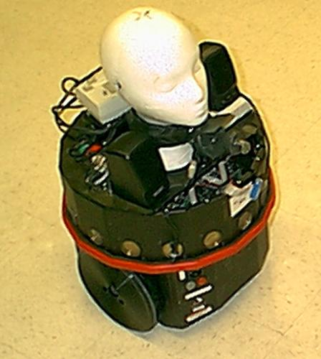

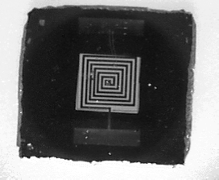
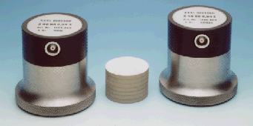
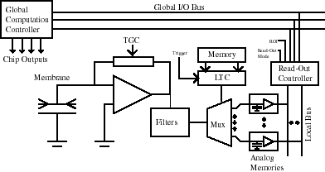

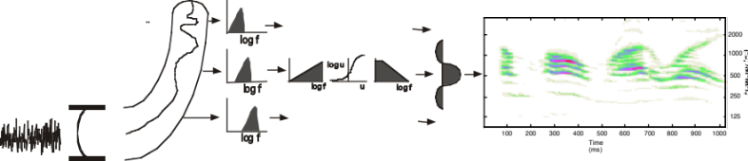
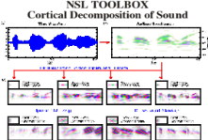
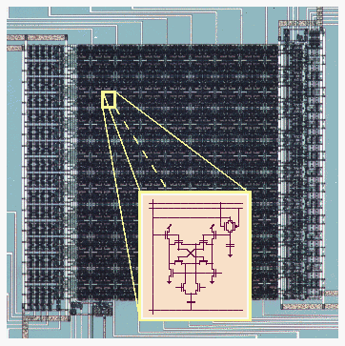
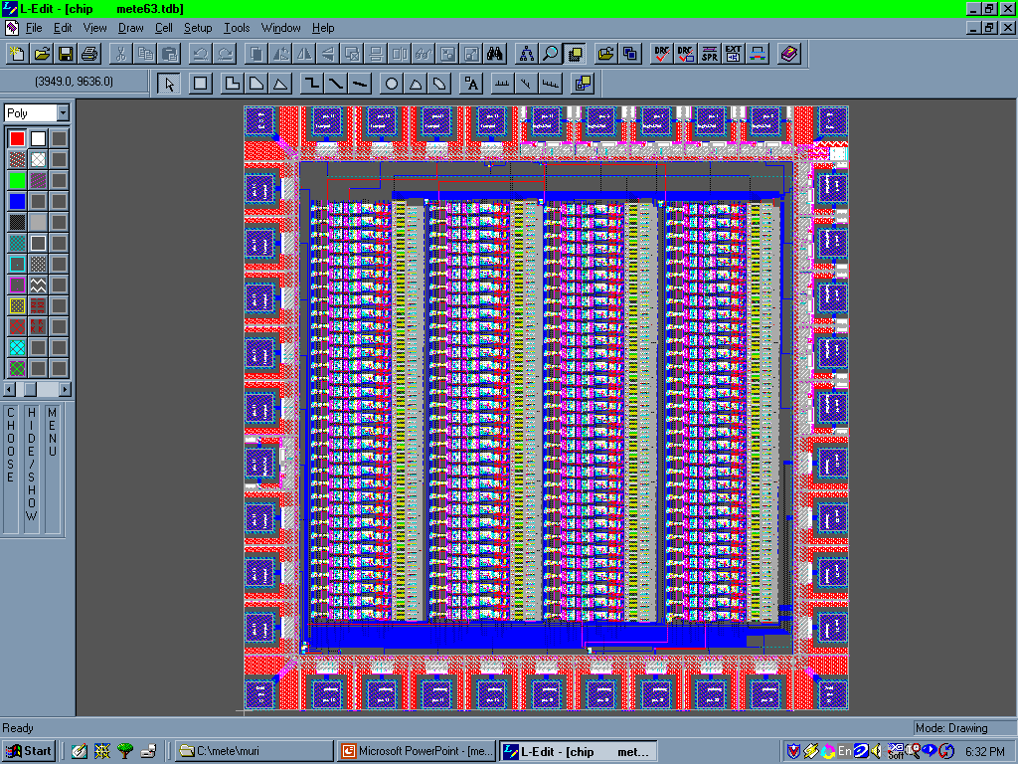
Integrating Sensors and Signal Processing
Active Audition
Auditory scene analysis
Multi-modal integration, especially of audio-visual cues
Auditory-motor interactions
Integrated MEMS Sensors and Systems
Reliable intelligent MEMS sensors
Integrated conditioning and processing circuitry
platform-noise reduction algorithms
VLSI Implementations
Formulations of neuromorphic algorithms
Hybrid digital and analog implementations
Development of design and testing platforms

Slide 3
Auditory Processing
Analyzing sounds in complex reverberant environments requires :
Extracting the spectrum of incoming sounds
Estimating the pitch of concurrent sources
Localizing and tracking them accurately
Perceiving and recognizing their timbre

Slide 4
A
t
t
r
i
b
u
t
e
s
o
f
C
o
m
p
l
e
x
S
o
u
n
d
s
A
n
a
t
o
m
y
o
f
t
h
e
A
u
d
i
t
o
r
y
Location
Timbre
Pitch
S
y
s
t
e
m
C
e
n
t
r
a
l
A
u
d
i
t
o
r
y
S
t
a
g
e
s
Spatial
maps
Computing
pitch
MGB
C
o
l
l
i
c
u
l
a
r
IC
S
t
a
g
e
s
N
L
L
Harmonic
templates
ILD, ITD
Spectral cues
L
L
M
i
d
b
r
a
i
n
N
u
c
l
e
i
T
B
The auditory spectrum
D
C
N
E
a
r
l
y
A
u
d
i
t
o
r
y
P
V
C
N
S
t
a
g
e
s
A
V
C
N
s
o
u
n
d

Slide 5
Schematic Neural Processing Module
Analog Conditioning
And Processing
New Feature
Map
Sound
Sensor
Spikes
Adaptive influences
Post-synaptic
cell
Analog Conditioning
And Processing
New Feature
Map
Spikes
Actions
Transduction
Reconstruction
Distributed information
(high redundancy)
Amplitude compression
(phase coding)
Adaptive mechanisms
(ongoing behavioral
context)
Reduction via Soft
categorization
(many-to-one map)
Place coding
More abstract
representations
Pulse-coded
links
Stochastic pulse
coding
Continuous time
Restoration and
transmission

Slide 6
Cochlear Analysis and Spike-Based
Encoding
Sound
Equivalent Transformation
Log u
cilia
l
Log f
Log f
l
o
g
U
l
o
g
Transduction
in Hair cell
Auditory-nerve fibers
Characteristic Frequency Axis (CF)
Basilar
membrane
vibrations
Transmitter release
Poisson point Process
Post-Synaptic Cell
Hair cells along
the tonotopic axis

Slide 7

Early Auditory Processing Stages
A
n
a
l
y
s
i
s
T
r
a
n
s
d
u
c
t
i
o
n
R
e
d
u
c
t
i
o
n
C
o
c
h
l
e
a
r
f
i
l
t
e
r
s
H
a
i
r
c
e
l
l
s
L
a
t
e
r
a
l
i
n
h
i
b
i
t
i
o
n
l
o
g
f
2
0
0
0
l
o
g
u
1
0
0
0
l
l
o
g
f
u
5
0
0
o
g
f
l
o
g
f
2
5
0
1
2
5
l
o
g
f
1
0
0
2
0
0
3
0
0
4
0
0
T
5
0
0
6
0
0
7
0
0
8
0
0
9
0
0
1
0
0
0
i
(
m
e
m
s
)
e
a
r
d
r
u
m
c
o
c
h
l
e
a
b
a
s
i
l
a
r
m
e
m
b
r
a
n
e
h
a
i
r
c
e
l
l
s
t
a
g
e
s
A
u
d
i
t
o
r
y
S
p
e
c
t
r
o
g
r
a
l
m
a
t
e
r
a
l
i
n
h
i
b
i
t
o
r
y
f
i
l
t
e
r
s
n
e
t
w
o
r
k

Slide 8
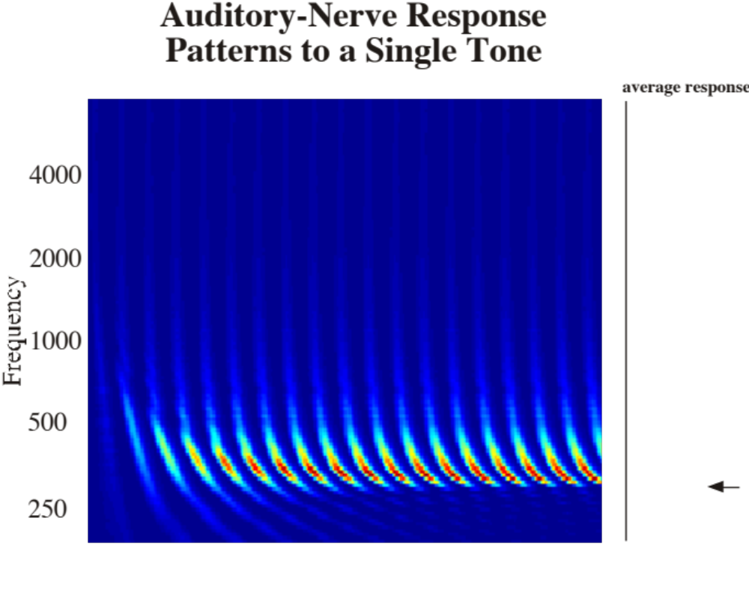

0
Time (ms)
60

Slide 9


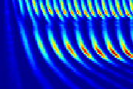
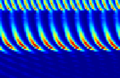
Auditory-Nerve Response
Patterns to Two-Tone Stimulus
average response
4000
2000
1000
500
250
0
Time (
ms
)
60

Slide 10
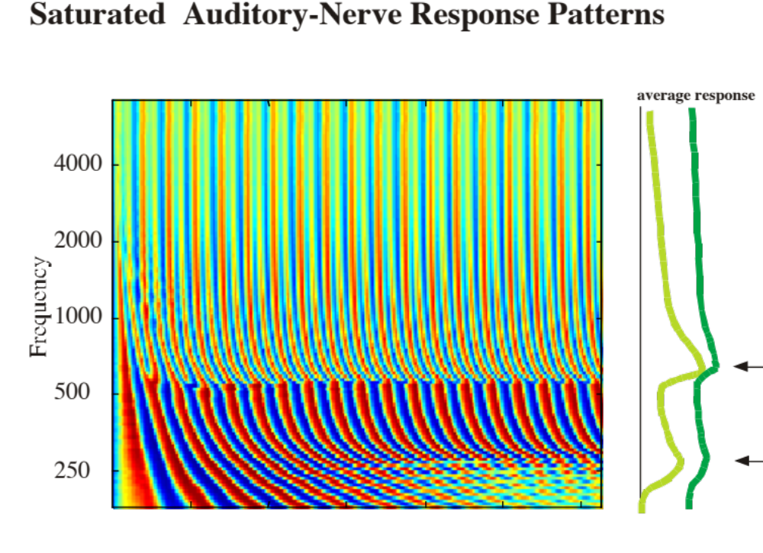

Slide 11
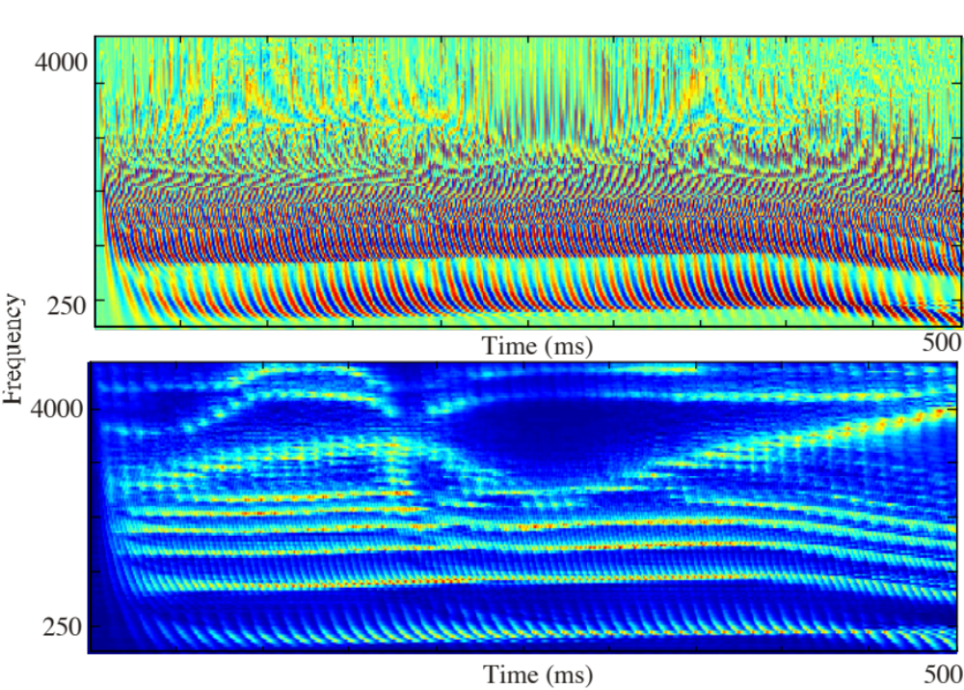

Slide 12



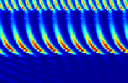
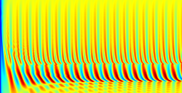






























Cochlear Analysis
Auditory-Nerve
Responses
Lateral Inhibitory
Network (LIN)
LIN Output: Estimated stimulus spectrum
4000
A
A’
Sound
CF (Hz)
250
4000
B
B’
CF (Hz)
Characteristic Frequency Axis (CF)
Auditory-nerve fibers
250
Time (msec)
60
Time (msec)
60
Basilar
membrane
vibrations
C
C’
4
C
CF (kHz)
Harmonic series
Hair cells along
the tonotopic axis
.25
Time (msec)
500
Time (msec)
500

Slide 13
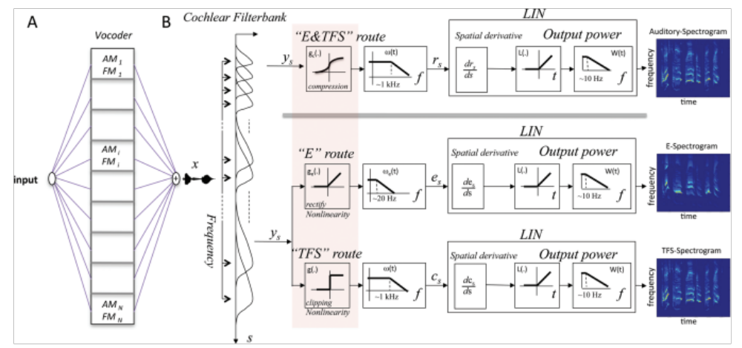
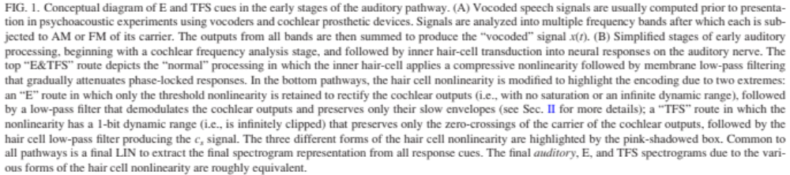

Slide 14
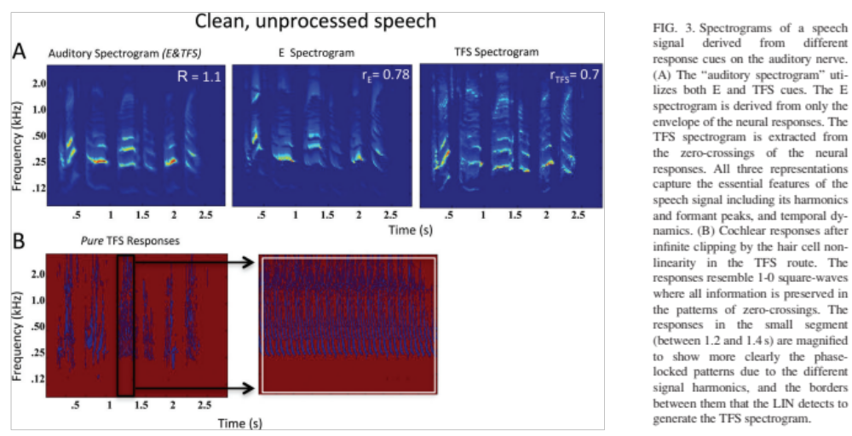

Slide 15
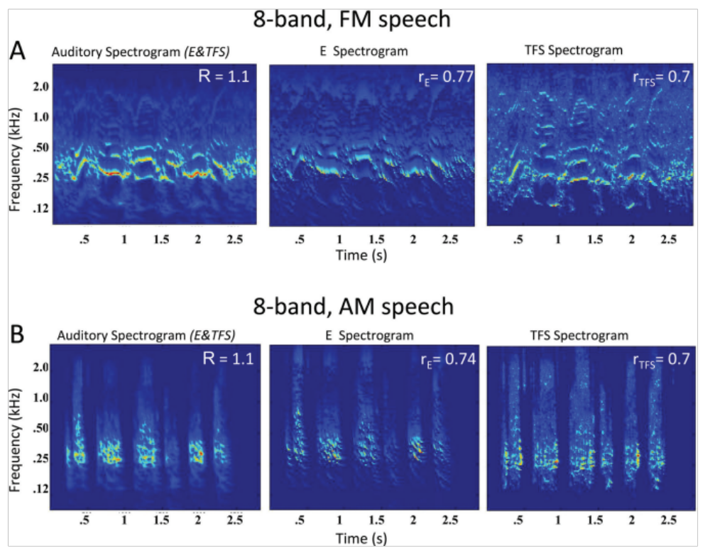

Slide 16
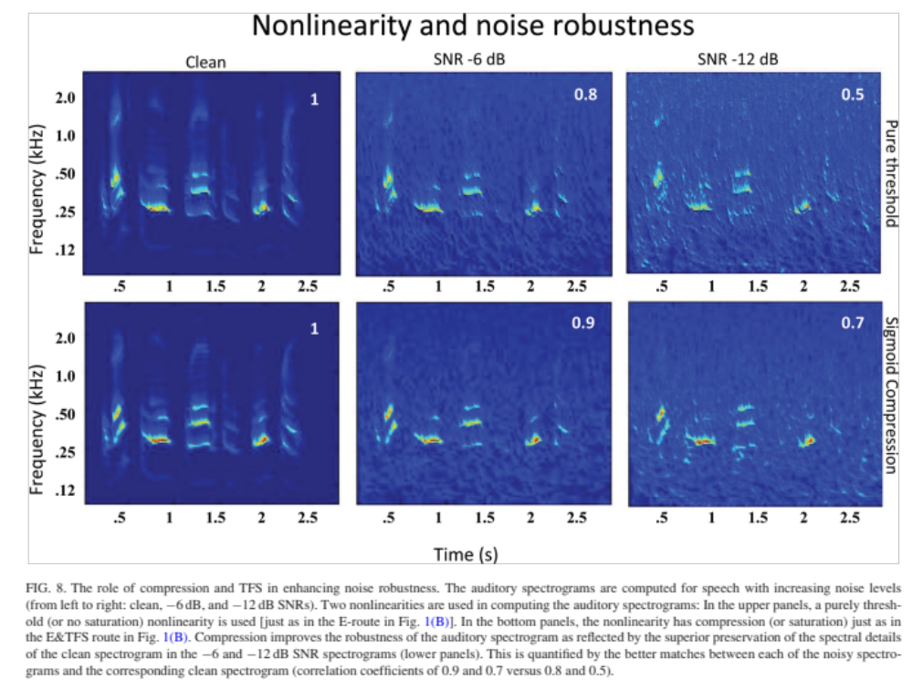

Slide 17
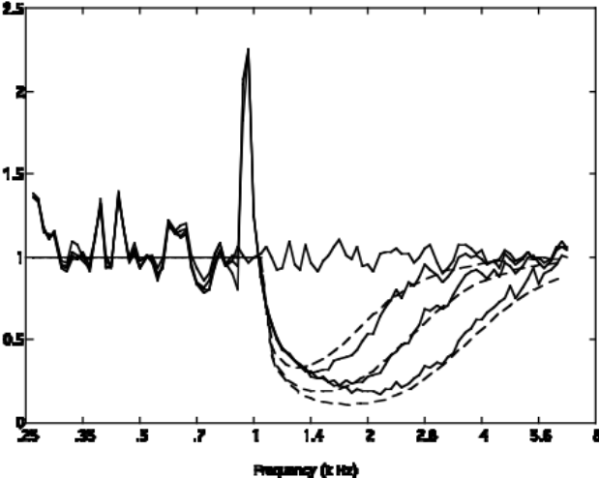
Spectral Enhancement
&
Masking
Efficient Spatial Localization
Direct Simulation
positive zero-crossings
XC
zero-crossing
pulses
ITD-histogram
Sound source
Sensor
positive zero-crossings
Combined cochlear Analysis and positive zero-crossings
Equivalent Simulation and Implementation
Sound source
Pulse-width
Encodes ITD
Sensor
Hard-limiter
adder
Hard-limiter
Cochlear Analysis

Slide 18
Summary and Conclusions
Sensory Neural Processing is effectively a
1. multi-stage hierarchical system of
2. integrated sensing and processing modules with
3. increasingly complex adaptive (behaviorally-influenced) pattern quantizations and
4. stochastic pulse-coded communication links.
Sensing ----- Analog Processing ----- Quantization ----- Encoding
Sound
Sensor
Analog Conditioning
And Processing
New Feature
Map
Spikes
Adaptive influences
Post-synaptic
cell
Spikes
Analog Conditioning
And Processing
New Feature
Map
Actions
Transduction
Reconstruction
Distributed information
(high redundancy)
Amplitude compression
(phase coding)
Adaptive mechanisms
(ongoing behavioral
context)
Reduction via Soft
categorization
(many-to-one map)
Place coding
More abstract
representations
Stochastic pulse
coding
Continuous time

Slide 19
Noise Suppression in the Cortex

Slide 20
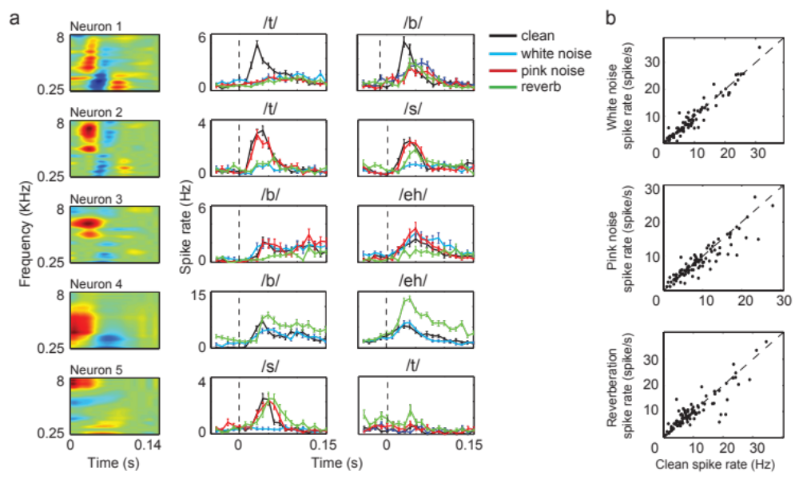
Spike Rates do not matter!

Slide 21
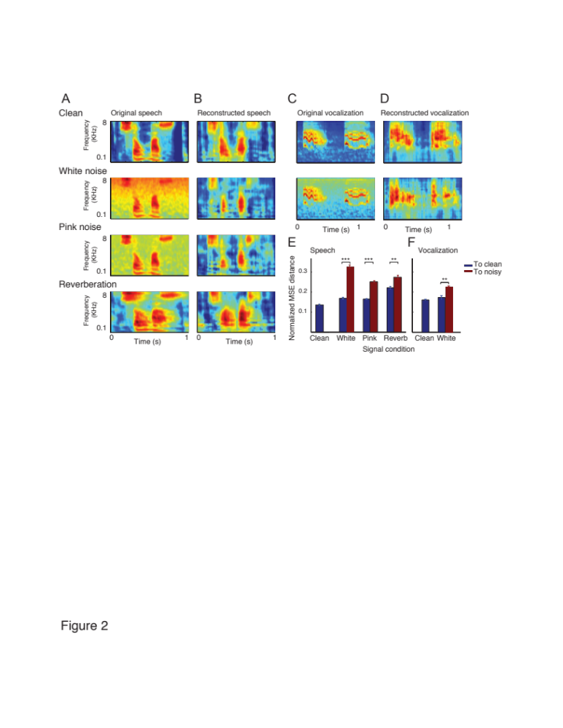

Slide 22
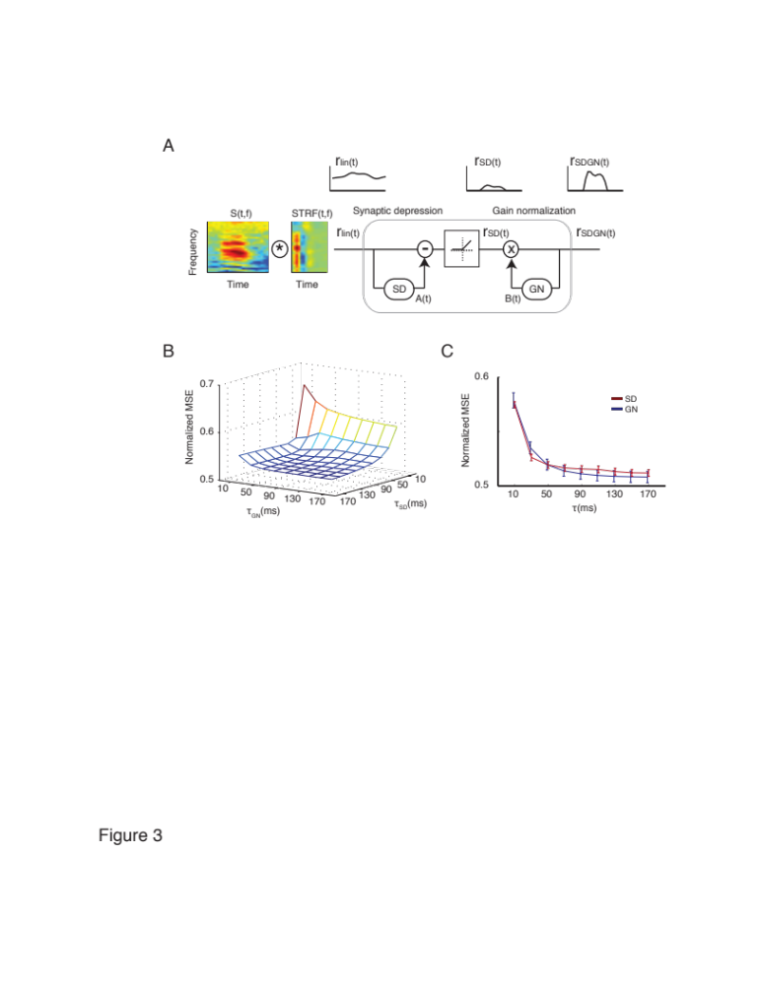

Slide 23
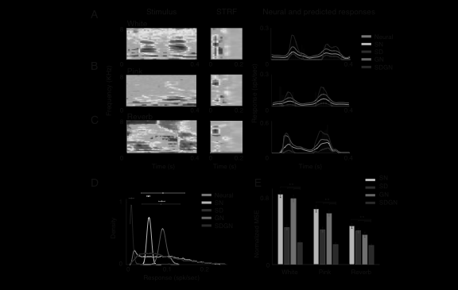

Slide 24
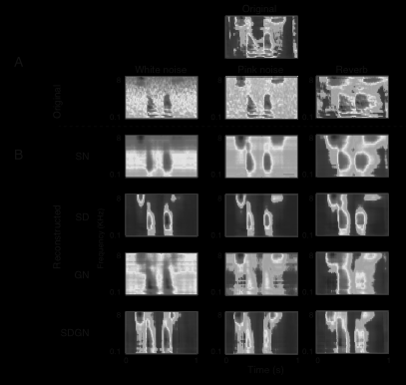

Slide 25
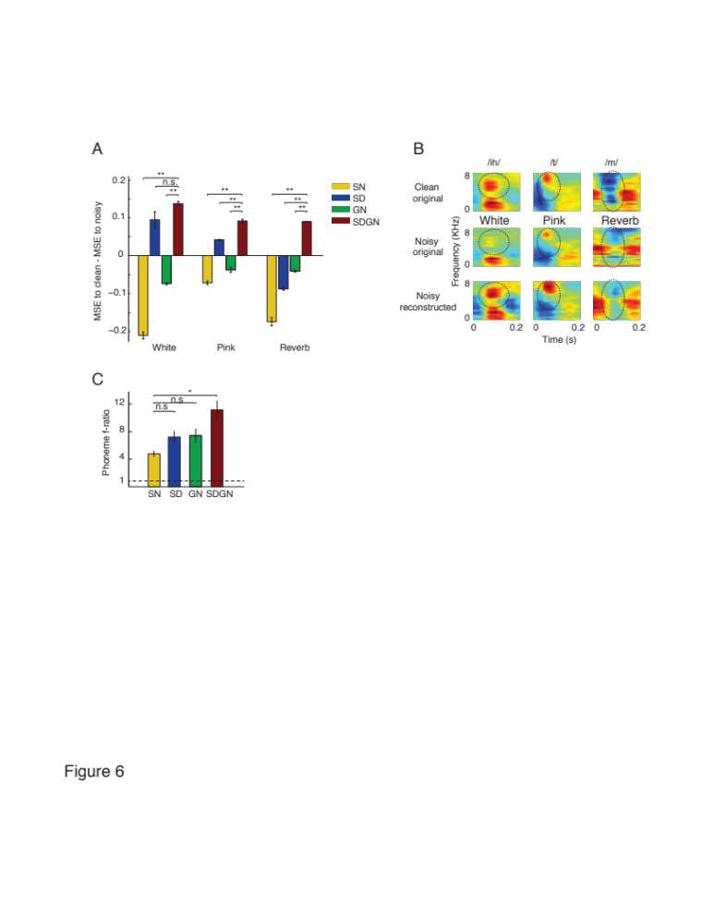

Slide 26
Building Noise Suppression
Algorithms

Slide 27
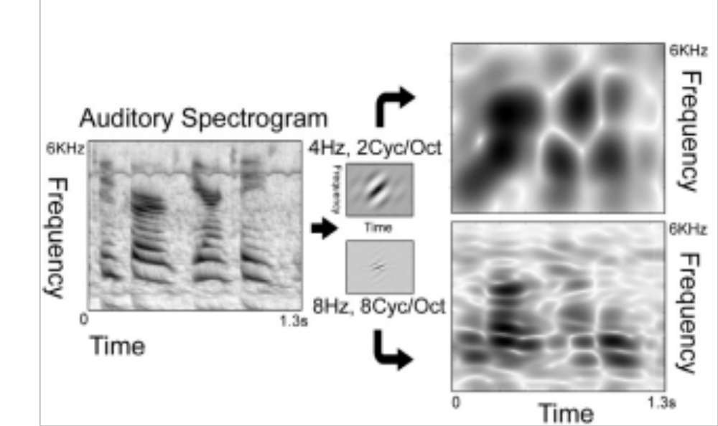

Slide 28
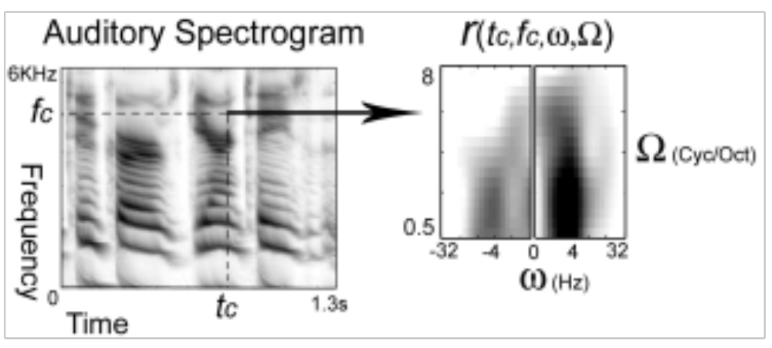

Slide 29
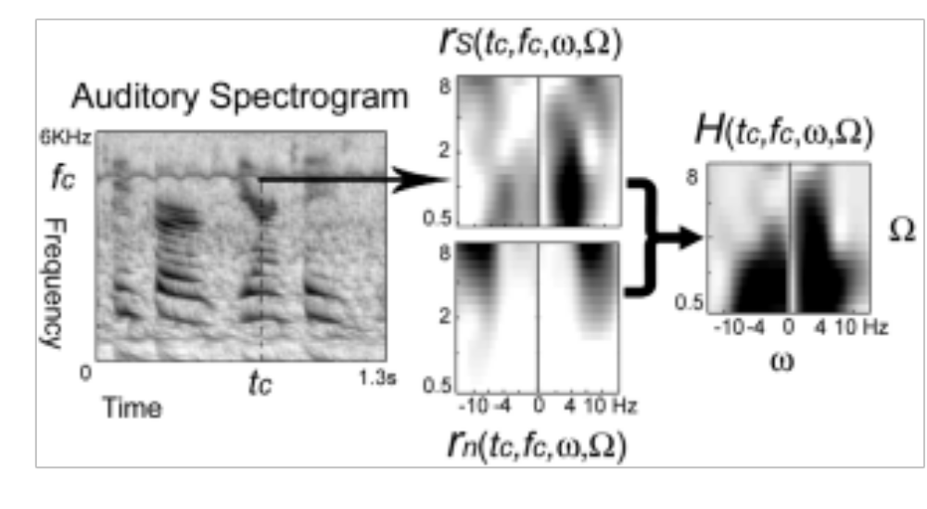
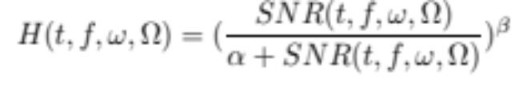

Slide 30
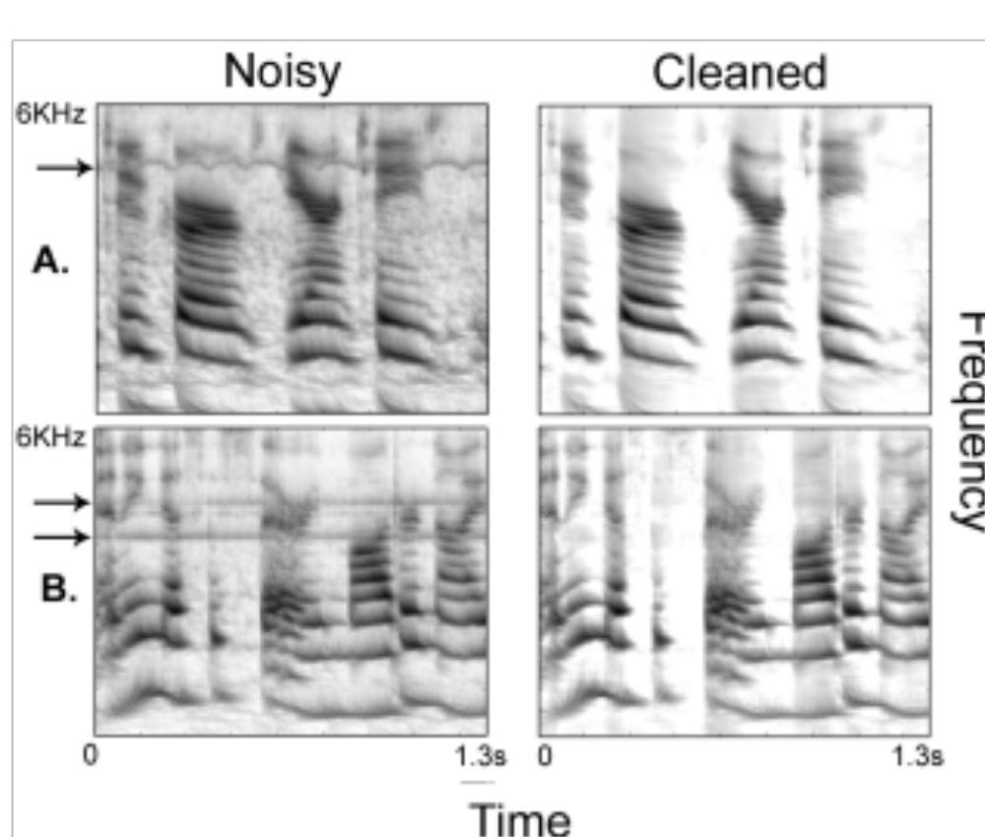

Slide 31
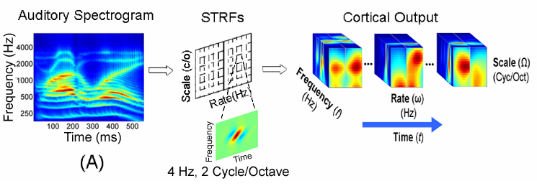
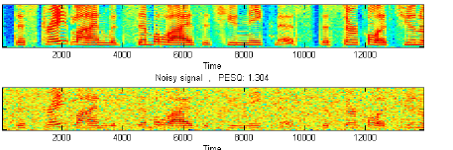

Attending to different regions of the cortical map
Scalar or tapped filter
Noisy Samples
rate
Clean Versions
forward
inverse
Auditory Spectrogram
Trained weights
scale
This mimics our ability to attend and adapt the STRFs in
different regions of the cortical map to achieve a goal
Nonlinear Noise

Slide 32

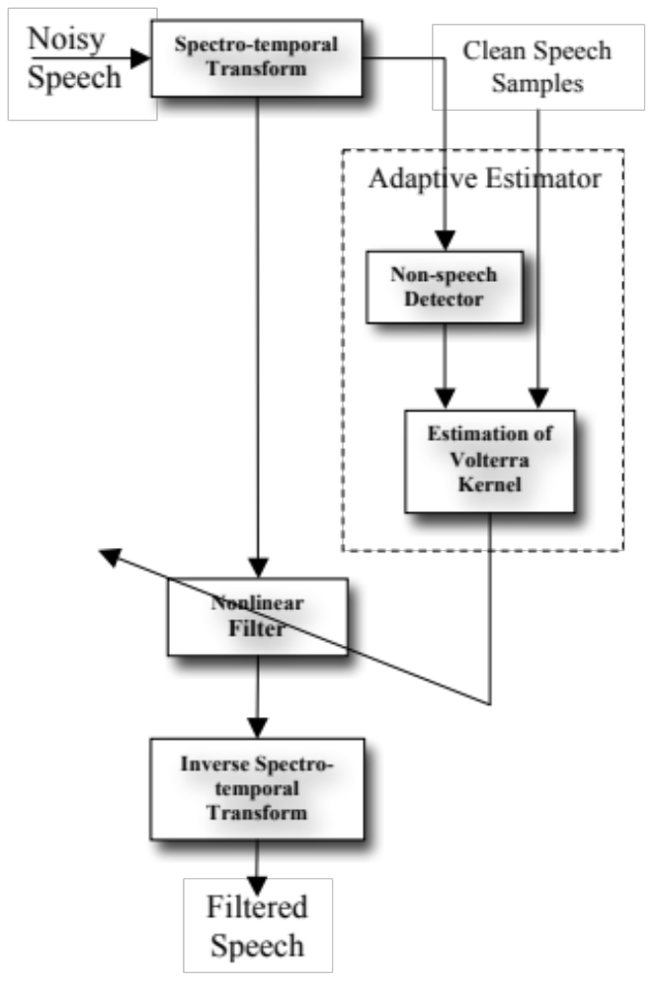
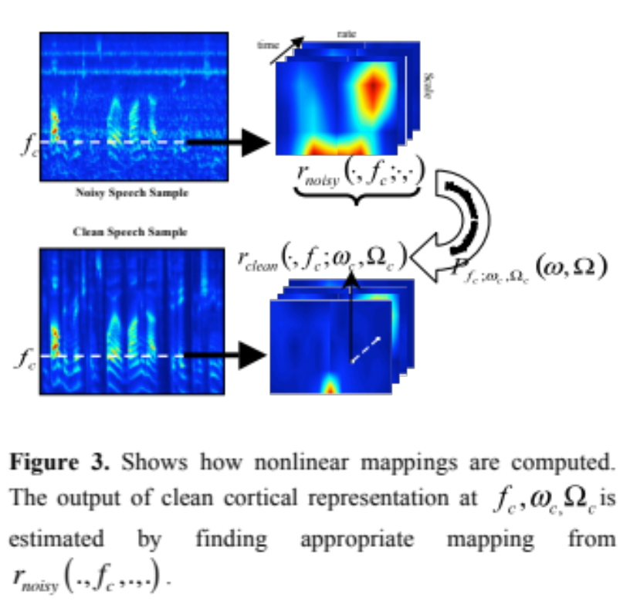
ICASSP 2010

Slide 33
Implications for Hearing impairments

Slide 34
Joshua G.W. Bernstein, Golbarg Mehraei, Shihab Shamma, Frederick J. Gallun, Sarah M. Theodoroff, Marjorie R. Leek, J Am Acad Audiol 24:293–306 (2013)
Spectrotemporal Modulation Sensitivity as a Predictor of Speech Intelligibility for Hearing-Impaired Listeners
A model that can accurately predict speech intelligibility for a given hearing-impaired (HI) listener
Elhilali, M., Chi, T., & Shamma, S. A. (2003). Speech communication, 41(2), 331-348.
A spectrotemporal modulation index (STMI) for assessment of speech intelligibility
A biologically motivated method for assessing the intelligibility of speech recorded or transmitted under various types of distortions.
----------------------------------------------------------------------------------------------------------------------------

Slide 35
Bharadwaj, H. M., Verhulst, S., Shaheen, L., Liberman, M. C., & Shinn-Cunningham, B. G. (2014). Frontiers in systems neuroscience, 8.
Cochlear neuropathy and the coding of supra-threshold sound
Measures of auditory subcortical steady-state responses (SSSRs) in humans and animals support the idea that the temporal precision of the early auditory representation can be poor even when hearing thresholds are normal.
Neuropathy is the hypothesis. Furthermore, recent studies suggest that noise-induced neuropathy may be selective for higher-threshold, lower-spontaneous-rate nerve fibers.

Slide 36
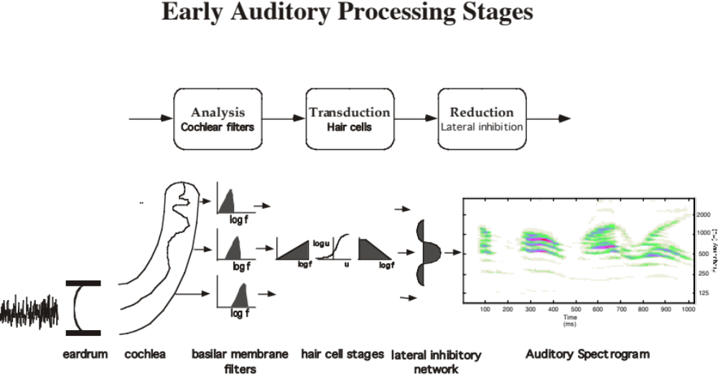
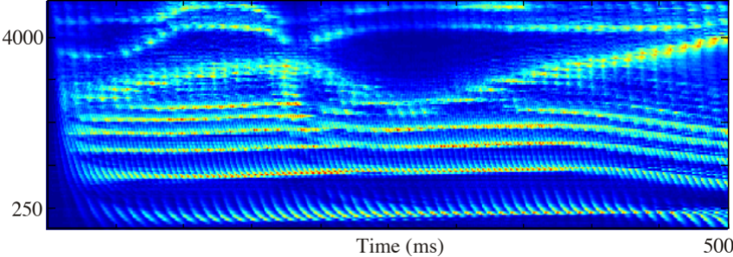

Slide 37
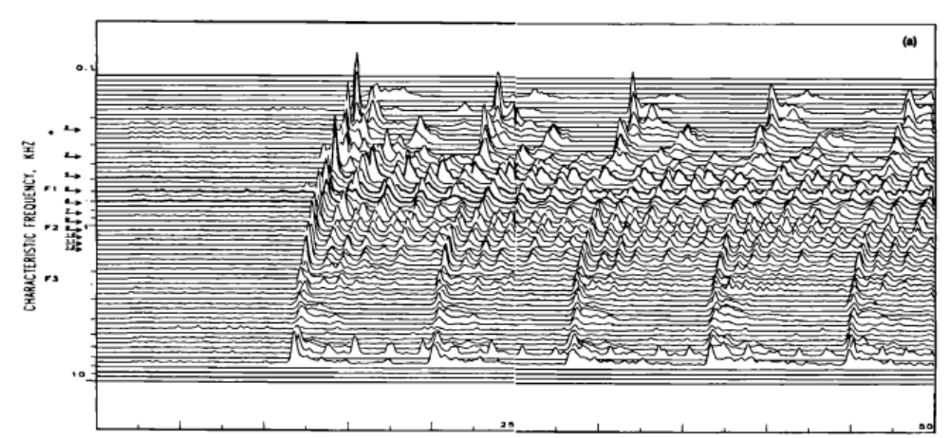
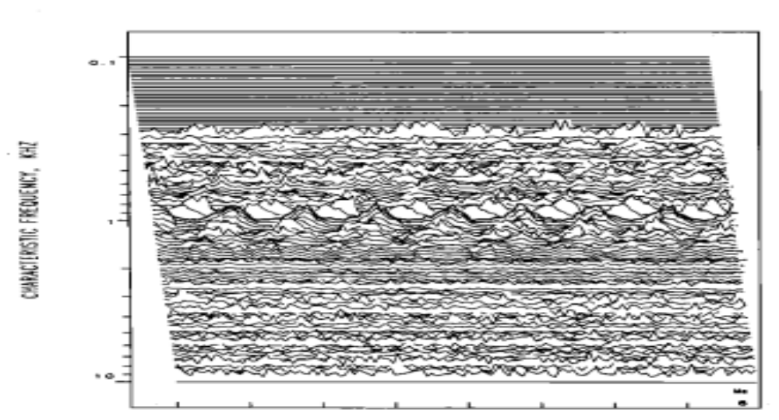
Sachs & Young
1980
/ba/
Lo Spon/
Hi Thresh
Hi Spon/
Low Thresh
1 kHz
In Noise

Slide 38
Relation to Perception
STMI

Slide 39


Perception in Sensory Cortex
Perception is a mirror of the external world
Parmenides
(5th cent. B.C)
There is ‘intelligence’ to perception
Heraclitus
(6th cent. B.C)
Research Questions:
(1) What is the nature of the representation in sensory cortex ?
(2) How is perception of speech and complex sounds orchestrated
by the brain in a world constantly in flux ?

Slide 40
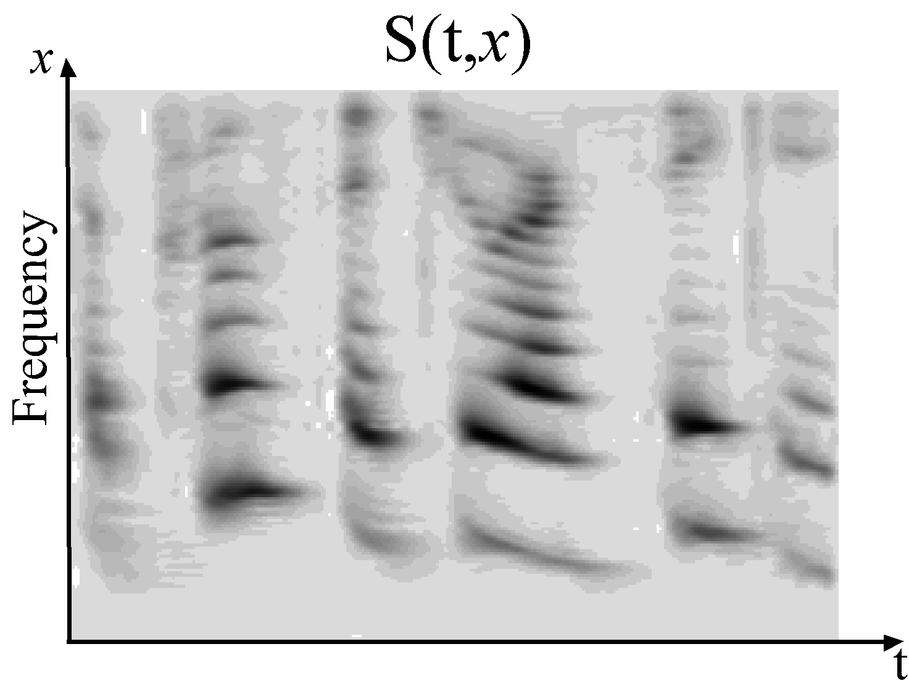
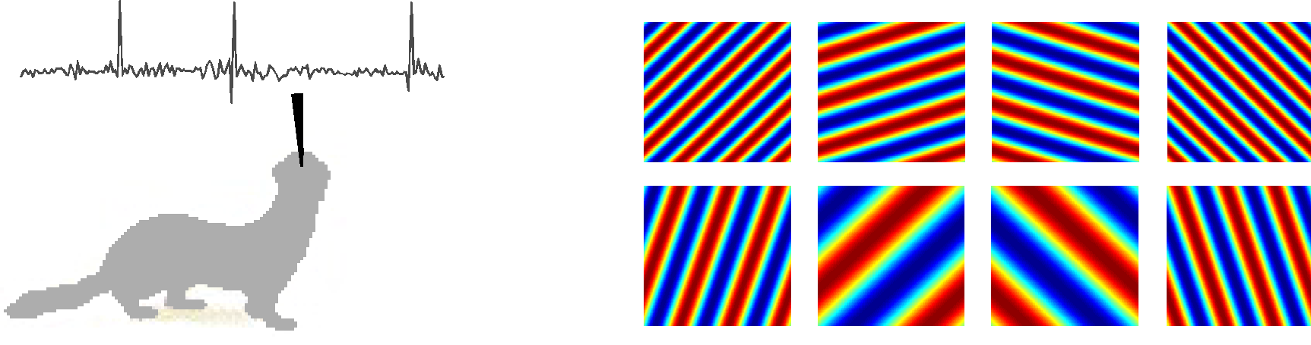
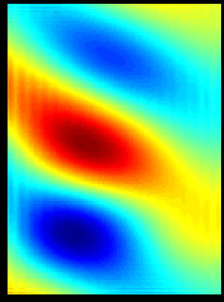

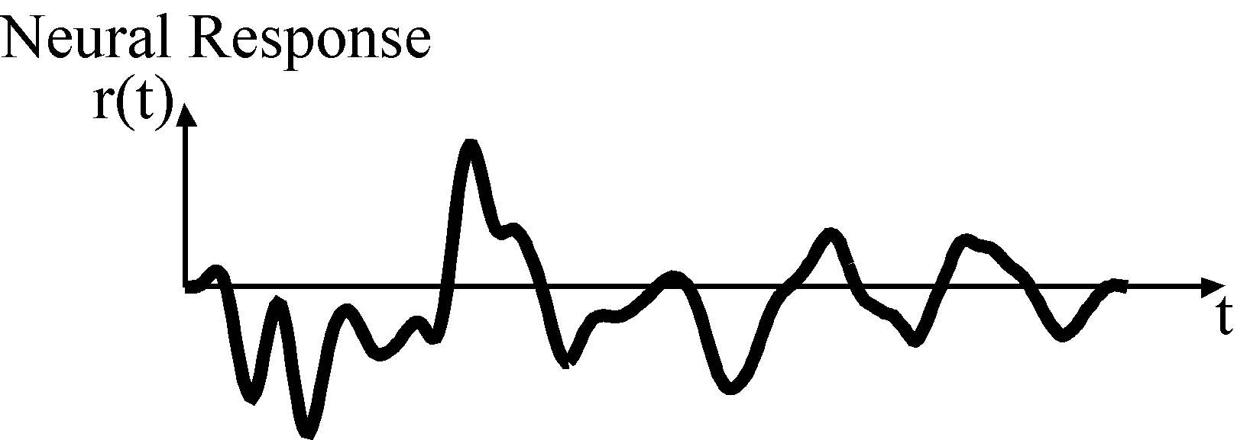
Cortical Receptive Fields
An STRF is a quantitative description of a neuron’s selectivity to specific stimulus patterns
STRF
+
_
Depireux et al., 2001; Elhilali et al., 2003

Slide 41
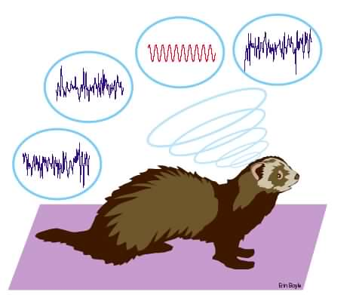
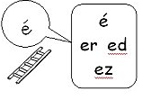

STRF
+
_

Slide 42







Cortical Receptive Fields
+
2
4
8
f (KHz)
f (KHz)
f (KHz)
.5
1
2
0
STRF
+
_
_
50
100
50
100
50
100
4
2
2
f (KHz)
f (KHz)
f (KHz)
1
.5
.5
50
100
50
100
50
100
Loss of temporal dynamics
Emergence of elaborate selectivity
to spectral and temporal features
Time (msec)
Depireux et al., 2001; Elhilali et al., 2003

Slide 43

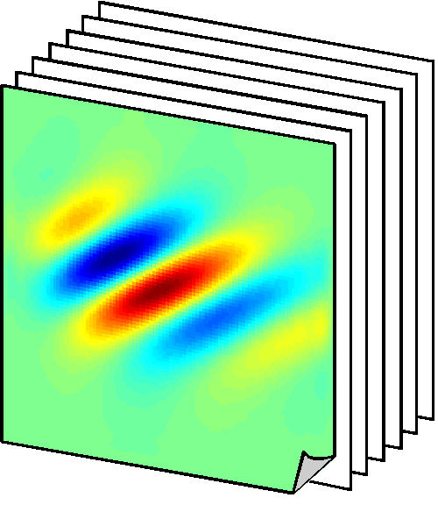
Cortical Multi-resolution Encoding
Bank of
STRF filters
Tonotopic
Frequency
2000
500
Time
Frequency (Hz)
Spectral
Shape and symmetry
125
Temporal
Modulations
250
500
Time (msec)
The cortical model is a multi-resolution representation which combines information about the temporal and spectral modulation content of sound and their distribution in time-frequency.

Slide 44

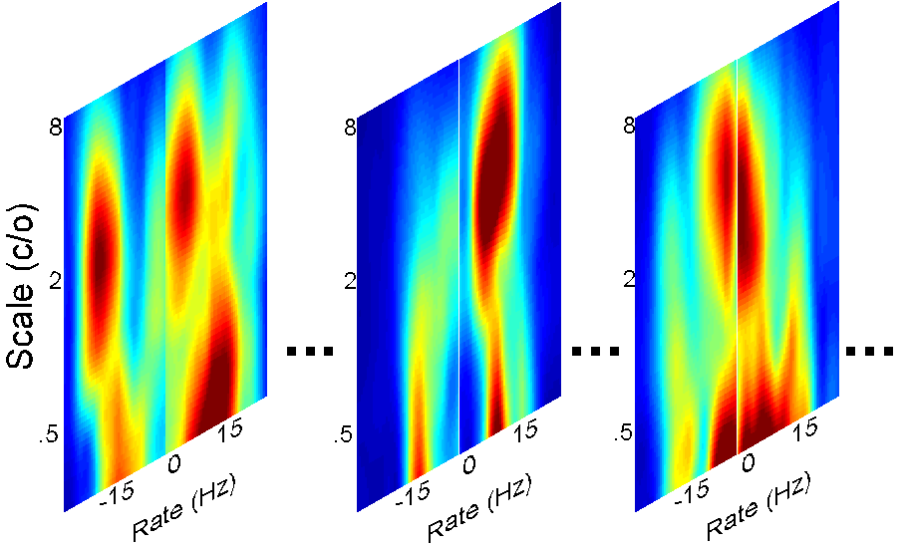



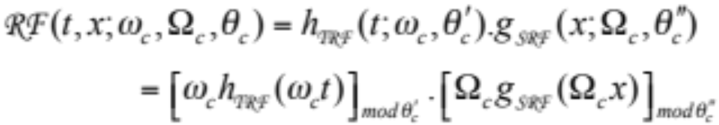
Cortical Multi-resolution Encoding
Peripheral Processing
- Cochlear filtering:
2000
- Hair-cell transduction:
Frequency (Hz)
500
- Cochlear-Nucleus sharpening:
125
250
500
Time (msec)
Time
- Midbrain short-term integration:
Cortical Wavelet Decomposition
- STRF seed function:
- Multiresolution Analysis:

Slide 45
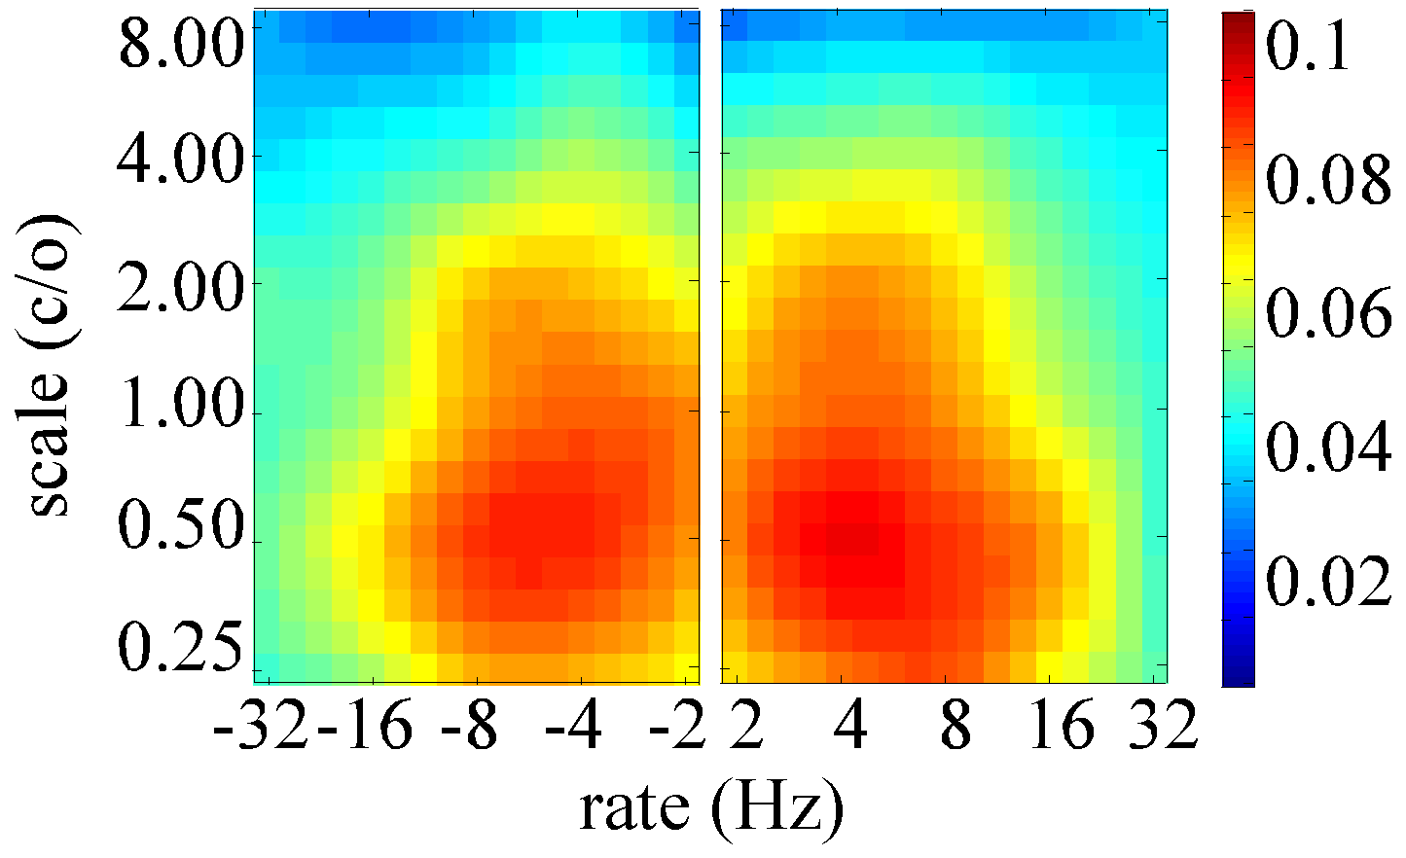


The Spectro-Temporal Modulation Index
Clean Speech Template
Modulation Profile (noise: 10dB)
Template Matching:
Hypothesis:
- Any distortion from the ‘clean speech’ modulation map is a reflection of loss of intelligibility;
- Any manipulation of speech that does not significantly disrupt the integrity of this map would be harmless to intelligibility

Slide 46
The Spectro-Temporal Modulation Index
STMI benefits:
* STMI is sensitive to joint (non-separable) spectro-temporal
modulations;
* This approach allows us to ascribe a biological interpretation
to the role of these spectro-temporal modulation maps in
speech intelligibility.

Slide 47

Intelligibility Testing I
Additive Noise and Reverberation
Elhilali, Chi & Shamma, 2003

Slide 48

Intelligibility Testing I
Additive Noise and Reverberation
Elhilali, Chi & Shamma, 2003

Slide 49

Intelligibility Testing I
Additive Noise and Reverberation
Elhilali, Chi & Shamma, 2003

Slide 50


Intelligibility Testing II
Nonlinear Distortions
Phase Jitter Distortion
Delay Scatter Interference
Bellamy, Digital telephony, 2000
Greenberg & Arai, 1998
Elhilali, Chi & Shamma, 2003

Slide 51





Intelligibility Testing III
Hearing-Impairment
Front Signal
Back Signal
DIR
R-Side Signal
L-Side Signal
OMNI
Grant et al., 2005

Slide 52
Intelligibility Testing III
Hearing-Impairment
Front Signal
Back Signal
DIR
R-Side Signal
L-Side Signal
OMNI
For the tests conducted so far, the STMI appears capable of distinguishing between microphone modes, is sensitive to spatial orientation, and is consistent with behavioral data from hearing-impaired patients.
Grant et al., 2005

Slide 53
Cortical Mapping & Sound Intelligibility
* The physiological data reveal elaborate cortical encoding of spectro-temporal modulation maps.
* Computationally, mimicking such receptive field selectivity is a good model of cortical mapping; relating the intelligibility of speech to the faithful representation of these spectro-temporal modulations.
How does the cortex maintain a stable and consistent representation of the acoustic scene while at the same time, be able to adapt to changing behavioral demands in life?

