Slide 1
Morse code lab
Pseudo code:
Start code; define variables
Read in sentence
Find next letter
Stop if letter is NULL
Convert letter to 0 -25
Look up Mosre code for letter
Blink Morse code on LED
Go to step 3

Slide 2
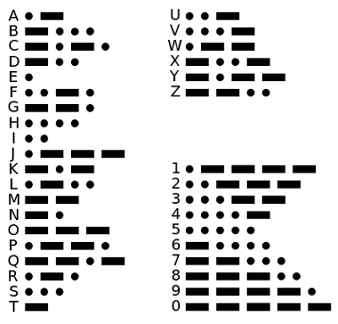
Morse code table
int Morse_code[]=
{21, 1112, 1212,
112, 1, 1211, 122,
1111, 11, 2221, 212, 1121, 22, 12, 222, 1221, 2122, 121, 111, 2, 211, 2111, 221, 2112, 2212, 1122};

Slide 3
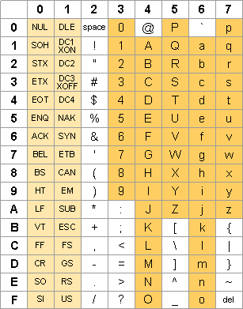
ASCII table in hexadecimal

Slide 4
ASCII Code for table look-up
/* this code converts ASCII characters as follows:
* A or a --> 0
* B or b --> 1
* Z or z --> 25 */
#include <stdio.h>
int char_to_int( char text) { // function converts A-Z or a-z into a number 0 - 25
int text_equiv;
text_equiv=text-0x41; // 0x means hexidecimal and 41 represents "A"
if (text_equiv<0) return (-1);
if (text_equiv>25) text_equiv=text-0x61; //lower case?
if ((text_equiv<0)||(text_equiv>25)) return (-1);
return (text_equiv);
}

Slide 5
ASCII Code for table look-up
int morse_decode(int text_equiv) {
int Morse_code[]= {21, 1112, 1212, 112, 1, 1211, 122, 1111, 11, 2221, 212, 1121, 22, 12,
222, 1221, 2122, 121, 111, 2, 211, 2111, 221, 2112, 2212, 1122};
return Morse_code[text_equiv];
}
int main (void) {
char test_letter, sentence[50];
int numerical_equivalent, i;
printf("Type in a sentence\n");
gets(sentence);
for (i=0;i<50;i++) {
test_letter=sentence[i];
if (test_letter=='\0') {
printf("sentence terminated\n\n\n");
break;
}

Slide 6
End of ASCII Code for table look-up
if (test_letter==' ')
printf("\nspace found\n");
  else {
  numerical_equivalent=char_to_int(test_letter);
if (numerical_equivalent<0)
printf("Error: %c is not a letter\n\n",test_letter);
else
printf ("letter = %c Morse code = %d\n",
test_letter,morse_decode(numerical_equivalent));
}
}
return 0;
}

Slide 7
Morse blink
/* morse_blink.c
* version 1.0
* written 9/17/2014
* author: Wes Lawson
*
* this code reads input that could be the Morse code for some character or number
* use a 2 for a dash and a 1 for a dot. Put them in reverse order, so
* dot-dot-dash should be 211
*
* the code will then blink out dot-dot dash before terminating
* the use of functions is demonstrated in this code */
#include <bcm2835.h>
#include <stdio.h>
// Blinks on RPi Plug P1 pin 12 (which is GPIO pin 18)
#define PIN RPI_GPIO_P1_12

Slide 8
Morse blink functions
void DOT (void) { // blink a DOT
bcm2835_gpio_write(PIN, HIGH);
bcm2835_delay(200);
bcm2835_gpio_write(PIN, LOW);
bcm2835_delay(200);
return;
}
void DASH (void) { // blink a DASH
bcm2835_gpio_write(PIN, HIGH);
bcm2835_delay(600);
bcm2835_gpio_write(PIN, LOW);
bcm2835_delay(200);
return;
}

Slide 9
Another Morse function
void MORSE_decode (int morse) { // blink a MORSE character
int j;
while (morse>0) {
j=morse -(morse/2) * 2;
if (j)
DOT();
else
DASH();
morse/=10;
}
bcm2835_delay(400); // extra delay to show end of character
return;
}

Slide 10
Morse blink main
int main(void) {
int morse;
if (!bcm2835_init()) return 1;
// Set the pin to be an output
bcm2835_gpio_fsel(PIN, BCM2835_GPIO_FSEL_OUTP);
printf("Please enter the MORSE code for a character\n\n");
scanf("%d",&morse);
MORSE_decode(morse);
bcm2835_close();
return 0;
}

