Slide 1
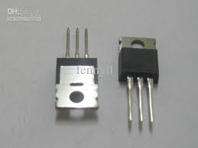
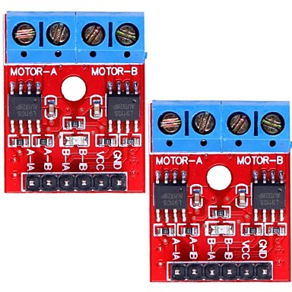
Chapter E –Transistors and H-Bridges

Slide 2
Semiconductors
Conductors – semiconductors – insulators
Impurities
  P-type
  N-type

Slide 3
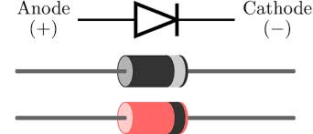
Diodes

Slide 4
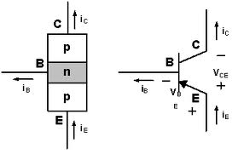
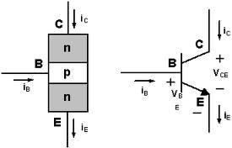
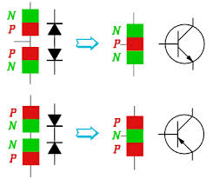
Bipolar Junction Transistors
This is WRONG! →

Slide 5
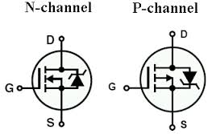
MOSFET OPERATION

Slide 6
Important MOSFET parameters
Maximum Voltage V_{DS}
Maximum current I_{DS}
Turn-on voltage V_{GS}
On resistance R_{DS}

Slide 7
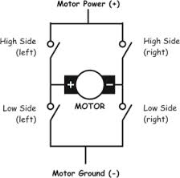
H-Bridge concept

Slide 8
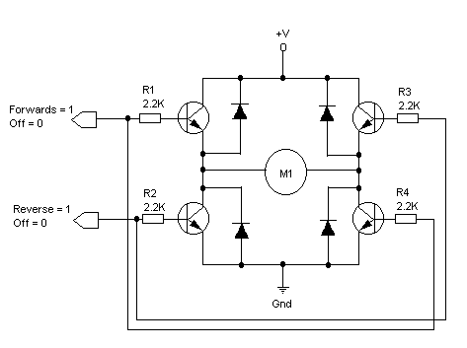
H-Bridge Implementation 1

Slide 9
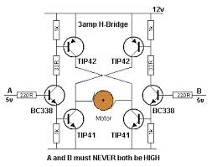
H-Bridge Implementation 2

Slide 10
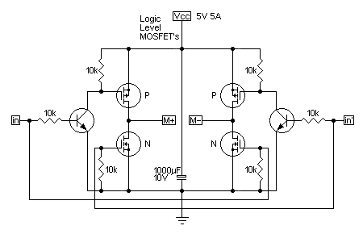
H-Bridge Implementation 3

Slide 11
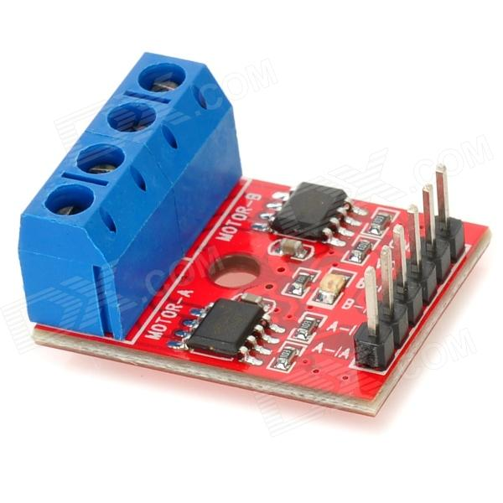
H-Bridge Implementation 4
L9110 Dual-Channel H-Bridge Motor Driver Module
- Dual L9110S chipset motor driver
- Input voltage: 2.5V~12V
- Current: 800mA

Slide 12
Distance Sensor: GP2Y0A21
IR sensor
operating voltage: 4.5 V to 5.5 V
average current consumption: 30 mA (typical)
distance measuring range: 10 cm to 80 cm (4" to 32")
output type: analog voltage
output voltage differential over distance range: 1.9 V (typical)
response time: 38 ± 10 ms

Slide 13
Distance Sensor: HC-SR04
Ultrasonic sensor
Working Voltage: DC 5V
Working Current: 15mA
Working Frequency: 40Hz
Max Range: 4m
Min Range: 2cm
Measuring Angle: 15 degree
Trigger Input Signal: 10µS TTL pulse

Slide 14
Distance measurement
Emit 10 microsecond pulse.
Measure delay for return signal.
Twice distance is speed of sound x delay
Speed of sound = 34 cm /millisecond
            = 13.4 inches / ms
So distance (in) = delay (ms) *6.7

