Slide 1
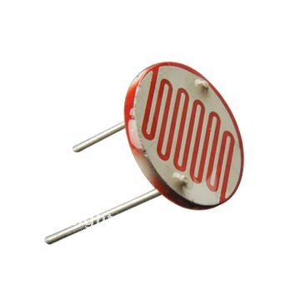
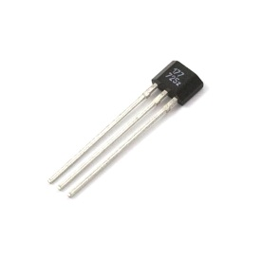
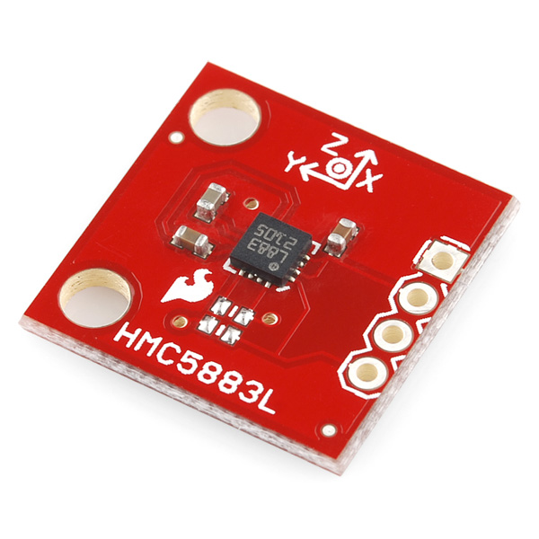
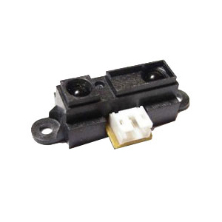

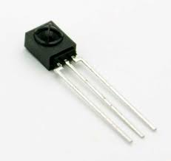
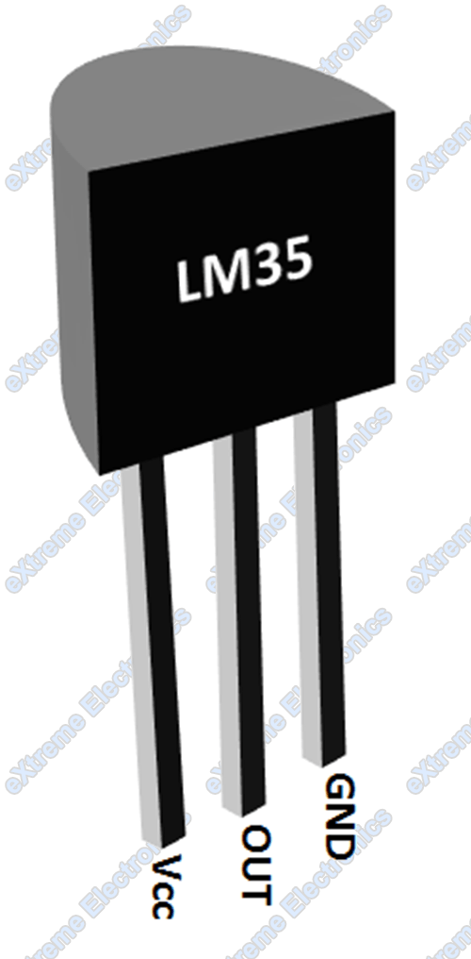
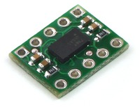
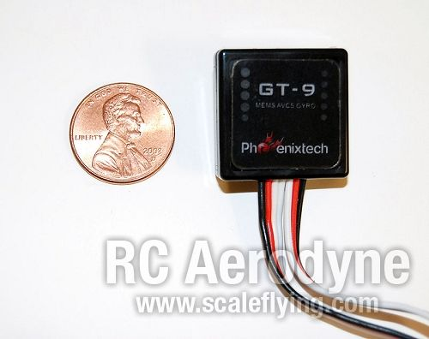
Chapter B – Sensors

Slide 2
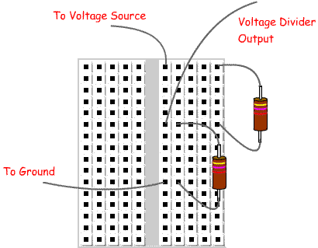

Preliminaries:
The voltage divider rule
Comes from applying KVL and KCL
For Resistors R₁ and R₂:
$\frac{V_{out}}{V_{in}}=\frac{R_{2}}{\left(R_{1}+R_{2}\right)}$
$$or$$
$V_{out}=\frac{R_{2}}{\left(R_{1}+R_{2}\right)}V_{in}$

Slide 3
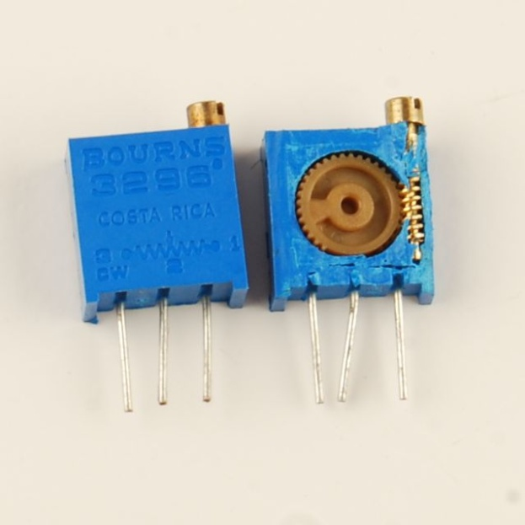
Preliminaries:
The potentiometer
Three terminal device
Fixed resistance between end terminals
Sliding resistance for middle terminal
V_{out} can be adjusted from 0 to V_{in} by turning potentiometer knob

Slide 4
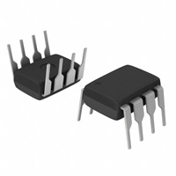
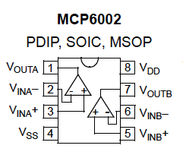
Preliminaries:
The Operational Amplifier MCP6002
Operational amplifier (op-amp):
  two input pins
  one output pin
  Two pins for power -or-
  one power & one ground)
A is the “open-loop” gain and is very large (approaching infinity)
Input resistance is large (→ )
Multiple op-amps can come on a single chip that shares power pins

Slide 5
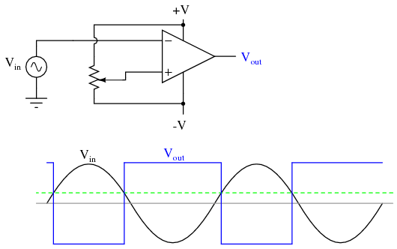
Preliminaries:
The Comparator circuit
Op-amp output will always be between the supply voltages V_{SS} ≤ v_{out}(t) ≤ V_{DD}.
Because of the large open-loop game, most op-amp circuits have feedback.
A comparator has no feedback, so:
  V_{out} = V_{DD} if v₊ > v₋
  V_{out} = V_{SS} if v₊ < v₋
Use potentiometer
on one side to adjust
transition level

Slide 6
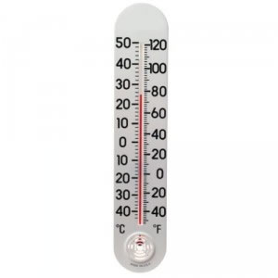
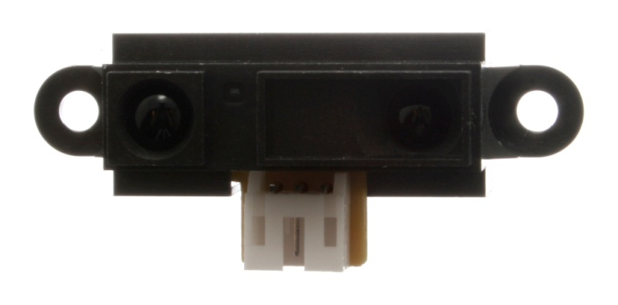
Sensors
A sensor is a device that (quantitatively) measures some physical property and maps the observation into a signal which can be understood by an observer.
Electronic sensors generate a voltage or current that can be interpreted via circuitry and a calibration table or formula to give the quantitative state of the physical property to within some error or tolerance.
The process of calibration and error estimation is critical to successful sensor operation.
Most off-the-shelf sensors come with standard calibration data and error estimates

Slide 7
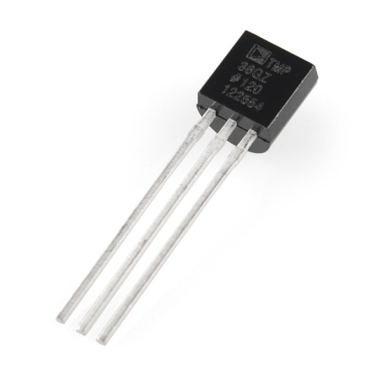
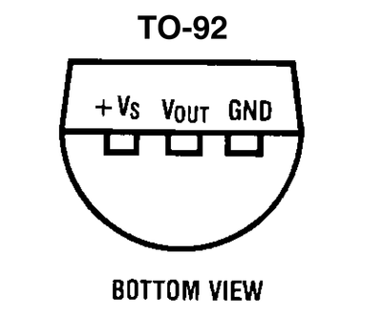
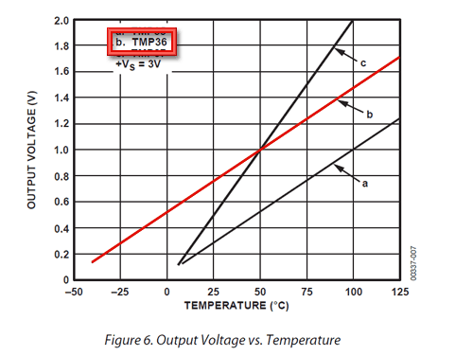
Temperature sensors
We will use the TMP 36
Low voltage operation (2.7 V to 5.5 V)
10 mV/°C scale factor
Temp (°C) = 100*v_{out} - 50
±2°C accuracy over temperature range
±0.5°C linearity
The TMP 36 is a silicon bandgap sensor that works because the forward voltage of a silicon diode is temperature-dependent. A BJT is often used, and so V_{BE} depends ~linearly on the temperature.

Slide 8
Using the TMP36 with an op-amp
One can adjust pot so that V_{out} = V_{DD} for all temperatures above some threshold and V_{out} = V_{SS} for all temperatures below that threshold.

Slide 9
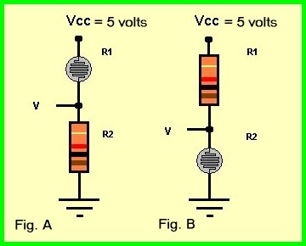
CdS Photoresistor
A photoresistor is a light-controlled variable resistor. The resistance of a photoresistor decreases with increasing incident light intensity. CdS photoresistors are inexpensive and widely used (but are not RoHS-approved because of the Cadmium).
To detect an on/off light situation:
  Measure the on and off CdS resistances. Typically they are a few kΩ.
  Chose a fixed resistor whose resistance is about the average of the two CdS resistances.
  Build a voltage divider with the fixed and photoresistor as in figure→
  Connect the middle connection to a comparator circuit

Slide 10
Using a CdS Photoresistor with an op-amp
One can adjust the potentiometer so that V_{out} = V_{CC} when light is off and V_{out} = V_{DD} when light is on. R should be near the average of the photoresistor’s on and off resistances.

Slide 11
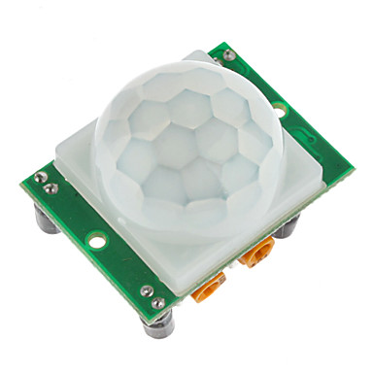
PIR Sensors
Passive (or Pyroelectric) infrared sensors (PIR sensors) are electronic sensors that measure infrared (IR) light radiating from objects in their field of view. They are often used in PIR-based motion detectors.
Example specifications:
  Output: Digital pulse high (3V) when triggered (motion detected) digital low when idle (no motion detected).
  Pulse lengths are determined by resistors and capacitors on the PCB and differ from sensor to sensor.
  Sensitivity range: up to 20 feet (6 meters) 110 degrees x 70 degrees detection range
  Power supply: 3.3V - 5V input voltage,

Slide 12
More on IR sensors
Some IR sensors are designed to work in pairs with transmitters.
That can be designed to :
  detect presence (digital output) - TSSP4038
  determine relative proximity (analog output) – TSOP58P38 – pulse width is linearly proportional to distance
  Both operate at 38 kHz

Slide 13
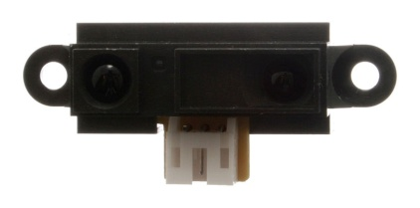
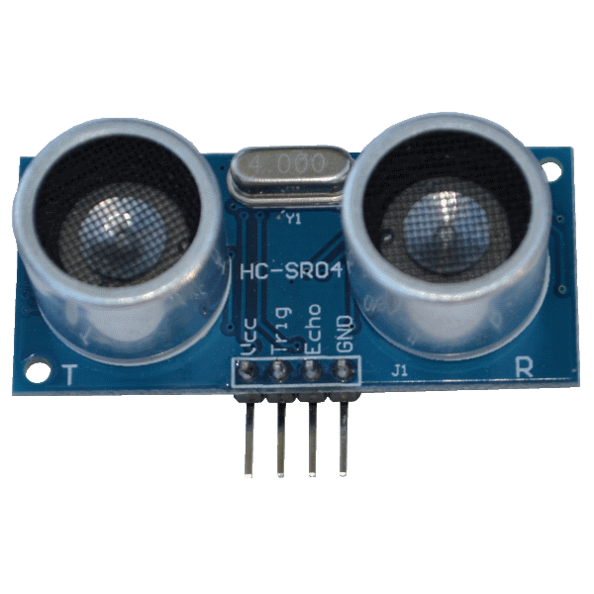
Distance / proximity sensor
Can be:
  Infrared – with Tx/Rx in same package
    Example: GP2Y0A21YK; Range: 5-80 cm
  Ultrasonic
    Example: HC-SR04; Range: 2-450cm ± 3mm
  Capacitive (close range)
  Inductive (close range)

Slide 14
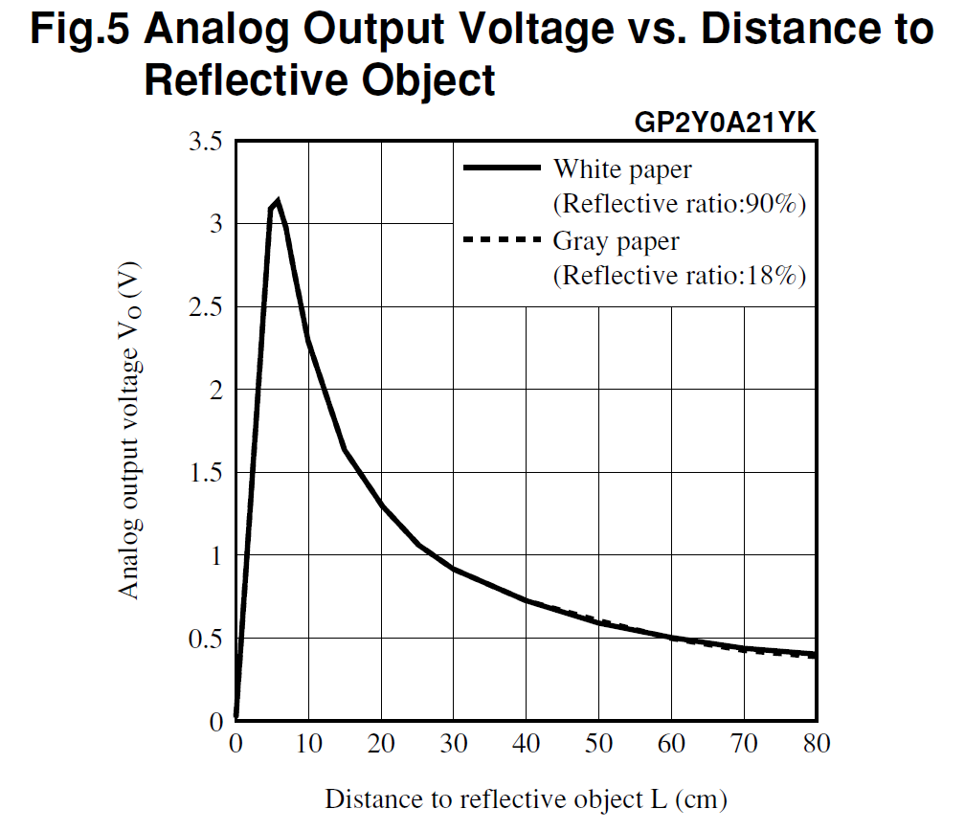
Calibration curve for GP2Y0A21YK

Slide 15
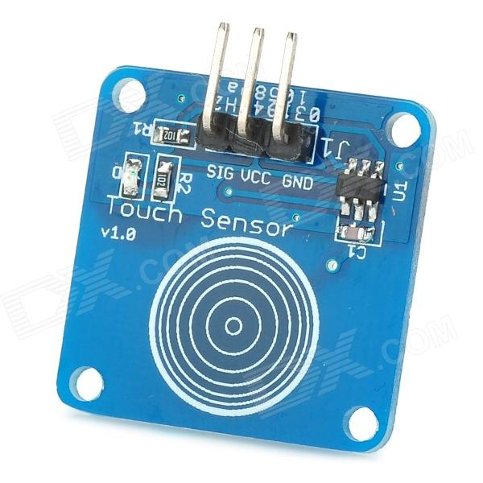
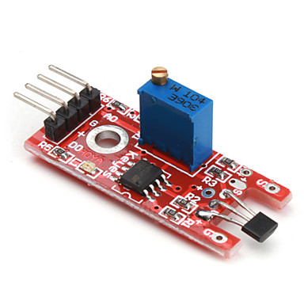
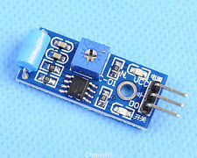
Other sensor types:
Touch sensors
  Mechanical (pushbutton) or capacitive
Magnetic sensors
  Often based on Hall effect
  1, 2, or 3-axis models
  May be digital (switches) or analog
  Saturation level important
Vibration sensors
  Motion detection

Slide 16
Distance Sensor: GP2Y0A21
IR sensor
operating voltage: 4.5 V to 5.5 V
average current consumption: 30 mA (typical)
distance measuring range: 10 cm to 80 cm (4" to 32")
output type: analog voltage
output voltage differential over distance range: 1.9 V (typical)
response time: 38 ± 10 ms

Slide 17
Distance Sensor: HC-SR04
Ultrasonic sensor
Working Voltage: DC 5V
Working Current: 15mA
Working Frequency: 40 kHz
Max Range: 4m
Min Range: 2cm
Resolution: 0.3 cm
Measuring Angle: 15 degree
Trigger Input Signal: 10µS TTL pulse

Slide 18
Distance measurement
Emit 10 microsecond pulse.
Measure delay for return signal.
Twice distance is speed of sound x delay
Speed of sound = 34 cm /millisecond
            = 13.4 inches / ms
So distance (in) = delay (ms) *6.7

Slide 19
Magnetic Sensors
There are many types of sensors
  Hall Effect
  GMR (magneto-resistive)sensors
Different number of axes (1-3)
Analog or Digital outputs
Different ranges of sensitivity, linearity, saturation
Directional vs. total
With or w/o hysterersis

Slide 20
3-Axis Digital Compass IC HMC5883L
Based on Honeywell’s GMR HMC118X sensor
Supply voltage 2.2 – 2.6V
Field range +/- 8 Gauss
Auto Degaussing
12 Bit A/D converter
I2C serial communication

Slide 21
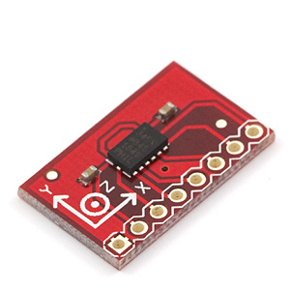
ADXL345 3-axis accelerometer
I²C or SPI output
Programmable from +/- 2 g to +/- 16 g
Can store offset values
13 bit resolution (+/- 4096)
Senses free-fall
Senses lack of motion

Slide 22
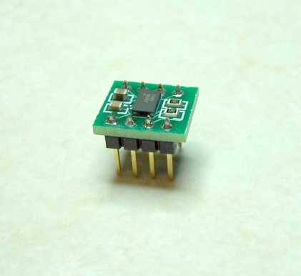
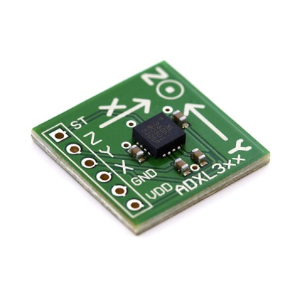
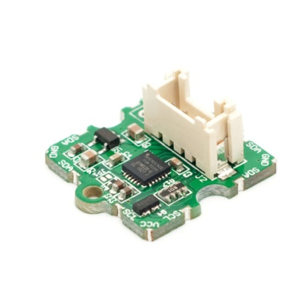
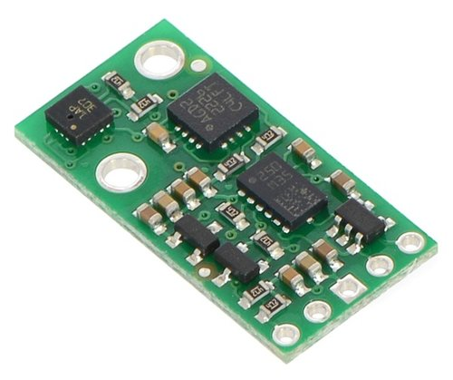
Other sensor types:
Accelerometers (MEMS)
  Up to 3-axis – detect gravitational effects
  Range of sensitivities ±3G, ±9G, etc
  May have digital or analog outputs
Gyros (MEMS)
  Need to integrate data to get angular position
IMU (Inertial Measurement Unit) sensor
  a measurement unit designed to contain accelerometers and gyros, and sometimes magnetic sensors and altimeters

Slide 23
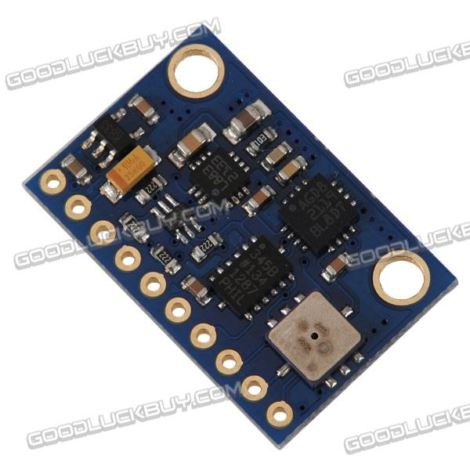
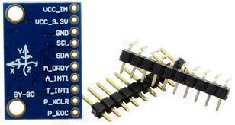
10 degree-of-freedom IMU
Pressure sensor
  BMP085
MEMS gyroscope
  L3G4200D
Accelerometer
  ADXL345 (+/- 2g -→ +/- 16g)
Digital Compass
  HMC5883L

Slide 24
Sample code for light detection
// Light_detect.c
//
// Turns an LED on when the lights go off, and
// Turns an LED off when the lights go on
//
// gcc -o Light_detect Light_detect.c -l bcm2835
// sudo ./Light_detect
//
#include <bcm2835.h>
#include <stdio.h>
// LED on RPi Plug P1 pin 12 (which is GPIO pin 18)
// Sensor on RPi Plug P1 pin 15 (which is GPIO pin 22)
#define LED RPI_GPIO_P1_12
#define Sensor RPI_GPIO_P1_15
//

Slide 25
The light detect program continued
int main(int argc, char **argv)
{
if (!bcm2835_init())
return 1;
// Set RPI pin P1-12 to be an output
bcm2835_gpio_fsel(LED, BCM2835_GPIO_FSEL_OUTP);
// Set RPI pin P1-15 to be an input
bcm2835_gpio_fsel(Sensor, BCM2835_GPIO_FSEL_INPT);
// pull up the output to one when not connected
bcm2835_gpio_set_pud(Sensor, BCM2835_GPIO_PUD_UP);
// And a low detect enable

Slide 26
The light detect program continued
while (1)
{
// Read some data
uint8_t value = bcm2835_gpio_lev(Sensor);
printf("read from pin 15: %d\n", value);
if (value)
{
// Turn on LED
bcm2835_gpio_write(LED, HIGH);
}
else {
// turn off LED
bcm2835_gpio_write(LED, LOW);
}
bcm2835_delay(500);
}
bcm2835_close();
return 0;
}

