Slide 1
First Order Transients
Part 1: Circuits excited by initial conditions
ENEE 205

Slide 2
  TRANSIENT CLASSIFICATION
We divide transient problems in two ways:
  Are there sources present for t>0?
  How many energy-storage elements are in the circuit for t>0?
We will study four cases:
  First-order circuits excited only by initial conditions (only one L or C)
  First-order circuits excited by sources (and perhaps initial conditions)
  Second-order circuits excited only by initial conditions*
  Second-order circuits excited by sources (and perhaps initial conditions)*
We will make extensive use of transfer functions in the solution of transient problems!
*These topics will be in the next set of notes. Circuits have two energy storage elements (1 L & 1 C, or 2 L’s or 2 C’s)

Slide 3
  RL AND RC CIRCUITS EXCITED BY INITIAL CONDITIONS
ALGORITHM:
Get circuit.
Find initial condition on energy storage element (draw circuit for t<0 if needed).
Write complete set of 1st-order differential equations (draw circuit for t>0).
Rearrange equations to get one equation for desired unknown (usually a capacitor voltage or inductor current, irrespective of ultimate goal).
Find characteristic equation and general homogeneous solution.
Plug in initial condition to get specific solution.

Slide 4
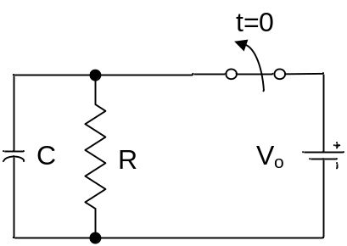
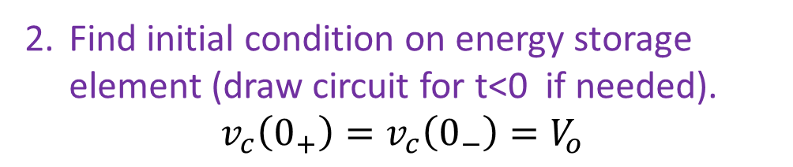
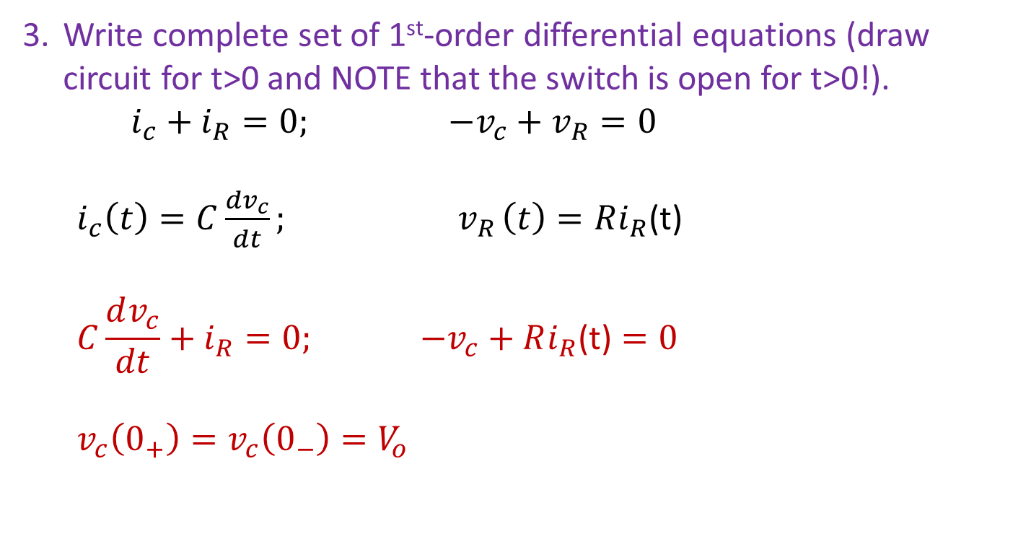
RC example 1 – find the capacitor voltage
Find initial condition on energy storage element (draw circuit for t<0 if needed).
$$v_{c}\left(0_{+}\right)=v_{c}\left(0_{−}\right)=V_{o}$$
Write complete set of 1st-order differential equations (draw circuit for t>0 and NOTE that the switch is open for t>0!).
$i_{c}+i_{R}=0; −v_{c}+v_{R}=0$
  $i_{c}\left(t\right)=C\frac{dv_{c}}{dt}{; v}_{R}\left(t\right)=Ri_{R}$(t)
  $$C\frac{dv_{c}}{dt}+i_{R}=0; −v_{c}+Ri_{R}\text{(}\text{t}\text{)}=0$$
  $$v_{c}\left(0_{+}\right)=v_{c}\left(0_{−}\right)=V_{o}$$
t>0
i_{c}
i_{R}
+
V_{R}
-
+
V_{c}
-

Slide 5
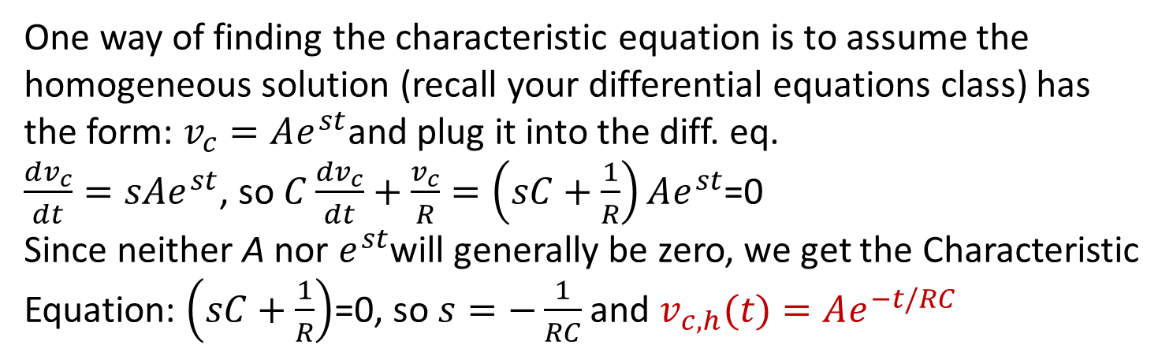
RC example one
Rearrange equations to get one equation for desired unknown (usually a capacitor voltage or inductor current, irrespective of ultimate goal).
$C\frac{dv_{c}}{dt}+i_{R}=0; −v_{c}+Ri_{R}\text{(}\text{t}\text{)}=0⇒i_{R}\text{(}\text{t}\text{)=}\frac{v_{c}}{R}$; So $C\frac{dv_{c}}{dt}+\frac{v_{c}}{R}$=0
Find characteristic equation and general homogeneous solution.
One way of finding the characteristic equation is to assume the homogeneous solution (recall your differential equations class) has the form: $v_{c}=Ae^{st}$and plug it into the diff. eq.
$\frac{dv_{c}}{dt}=sAe^{st}$, so $C\frac{dv_{c}}{dt}+\frac{v_{c}}{R}=\left(sC+\frac{1}{R}\right)Ae^{st}$=0
Since neither A nor $e^{st}$will generally be zero, we get the Characteristic Equation: $\left(sC+\frac{1}{R}\right)$=0, so $s=−\frac{1}{RC}$ and $v_{c,h}(t)=Ae^{−t/RC}$

Slide 6
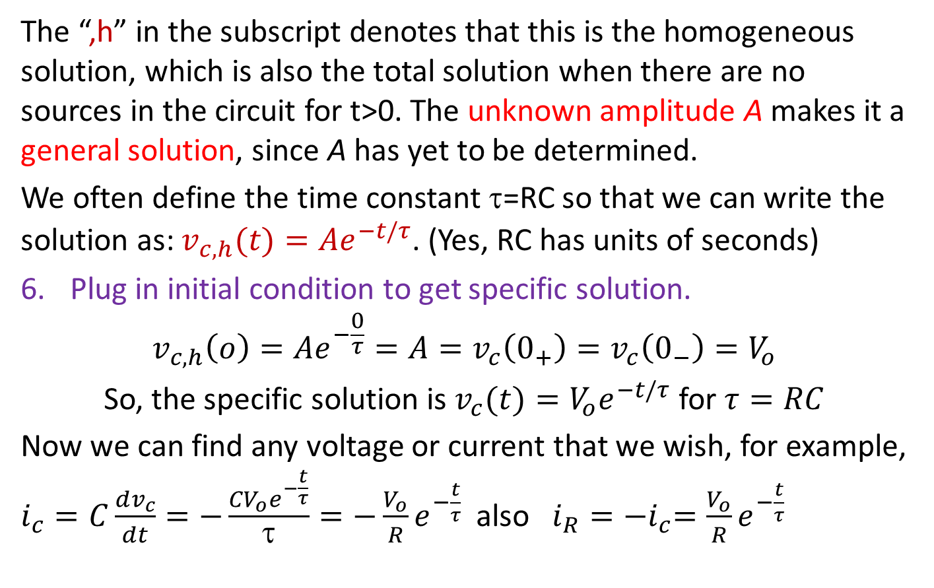
RC example one
The “,h” in the subscript denotes that this is the homogeneous solution, which is also the total solution when there are no sources in the circuit for t>0. The unknown amplitude A makes it a general solution, since A has yet to be determined.
We often define the time constant τ=RC so that we can write the solution as: $v_{c,h}(t)=Ae^{−t/τ}$. (Yes, RC has units of seconds)
Plug in initial condition to get specific solution.
$$v_{c,h}\left(o\right)=Ae^{−\frac{0}{τ}}=A=v_{c}\left(0_{+}\right)=v_{c}\left(0_{−}\right)=V_{o}$$
So, the specific solution is $v_{c}(t)=V_{o}e^{−t/τ}$ for $τ=RC$
Now we can find any voltage or current that we wish, for example, $i_{c}=C\frac{dv_{c}}{dt}=−\frac{{CV}_{o}e^{−\frac{t}{τ}}}{τ}=−\frac{V_{o}}{R}e^{−\frac{t}{τ}}$ also $i_{R}={−i}_{c}=\frac{V_{o}}{R}e^{−\frac{t}{τ}}$

Slide 7
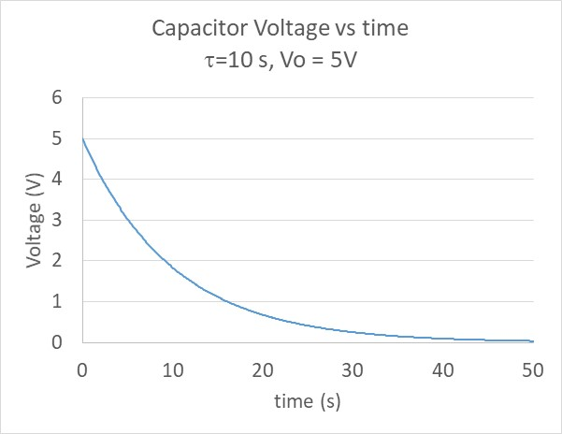
RC example one

Slide 8
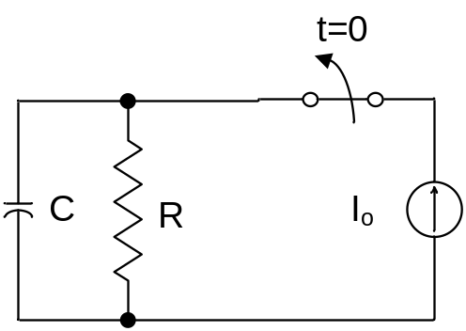
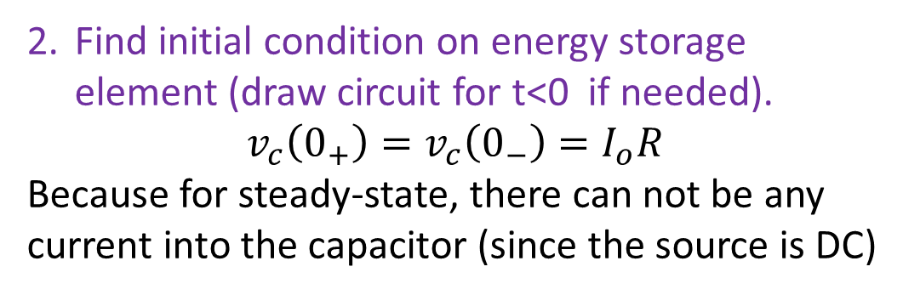
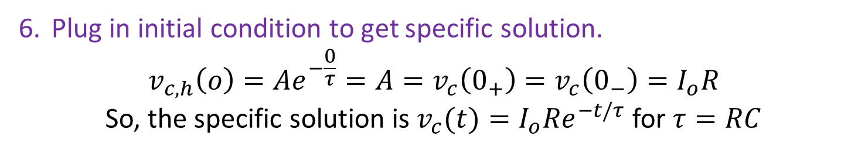
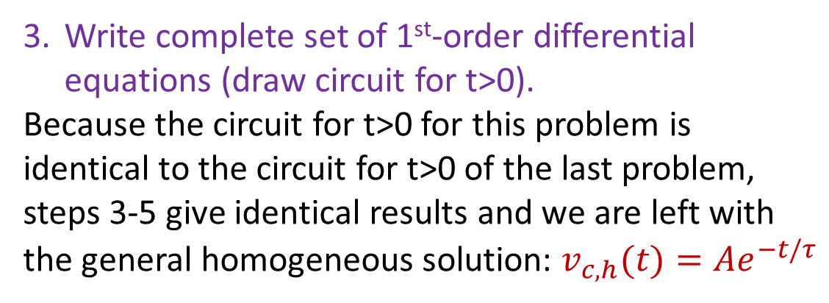
RC example 2
Find initial condition on energy storage element (draw circuit for t<0 if needed).
$$v_{c}\left(0_{+}\right)=v_{c}\left(0_{−}\right)=I_{o}R$$
Because for steady-state, there can not be any current into the capacitor (since the source is DC)
Write complete set of 1st-order differential equations (draw circuit for t>0).
Because the circuit for t>0 for this problem is identical to the circuit for t>0 of the last problem, steps 3-5 give identical results and we are left with the general homogeneous solution: $v_{c,h}(t)=Ae^{−t/τ}$
t>0
i_{c}
i_{R}
+
V_{R}
-
+
V_{c}
-
Plug in initial condition to get specific solution.
$$v_{c,h}\left(o\right)=Ae^{−\frac{0}{τ}}=A=v_{c}\left(0_{+}\right)=v_{c}\left(0_{−}\right)=I_{o}R$$
So, the specific solution is $v_{c}(t)=I_{o}{Re}^{−t/τ}$ for $τ=RC$

Slide 9
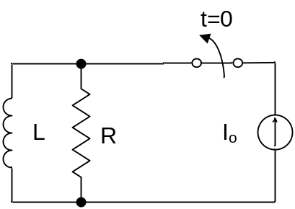
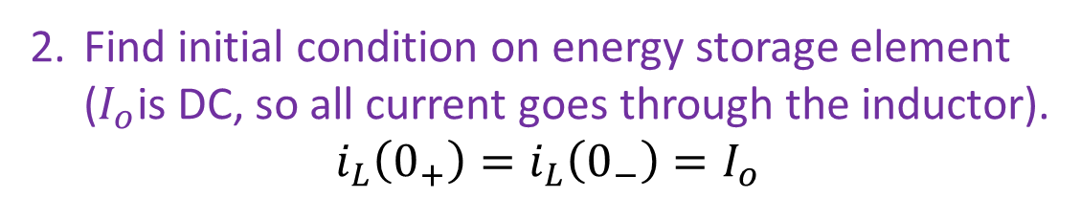
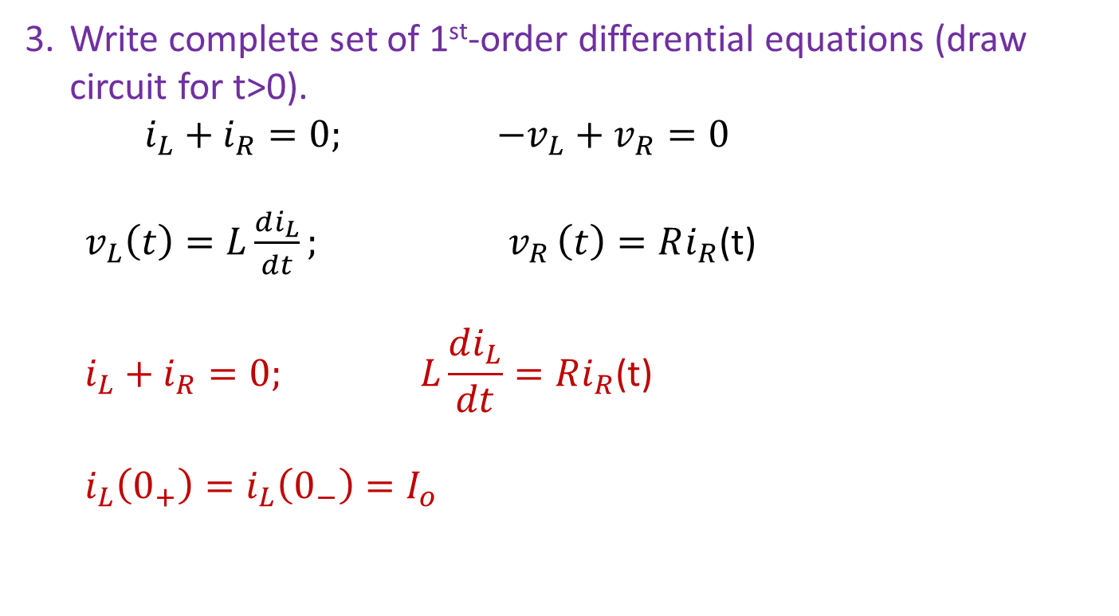
RL example – find the inductor current
Find initial condition on energy storage element ($I_{o}$is DC, so all current goes through the inductor).
$$i_{L}\left(0_{+}\right)=i_{L}\left(0_{−}\right)=I_{o}$$
Write complete set of 1st-order differential equations (draw circuit for t>0).
$i_{L}+i_{R}=0; −v_{L}+v_{R}=0$
  $v_{L}\left(t\right)=L\frac{di_{L}}{dt}{; v}_{R}\left(t\right)=Ri_{R}$(t)
  $$i_{L}+i_{R}=0; L\frac{di_{L}}{dt}=Ri_{R}\text{(}\text{t}\text{)}$$
  $$i_{L}\left(0_{+}\right)=i_{L}\left(0_{−}\right)=I_{o}$$
t>0
i_{R}
+
V_{R}
-
+
V_{L}
-
i_{L}

Slide 10
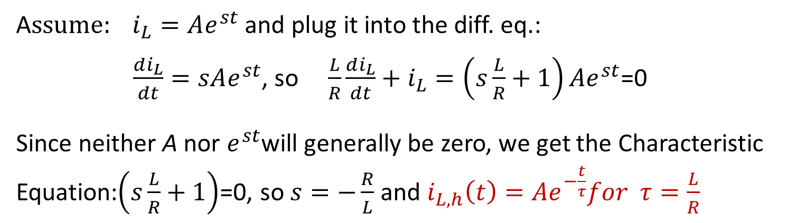
RL example one
Rearrange equations to get one equation for desired unknown (usually a capacitor voltage or inductor current, irrespective of ultimate goal).
$i_{R}+i_{L}=0; i_{R}\text{(}\text{t}\text{)=}\frac{L}{R}\frac{di_{L}}{dt}$; So $\frac{L}{R}\frac{di_{L}}{dt}+i_{L}$=0
Find characteristic equation and general homogeneous solution.
A$ssume: i_{L}=Ae^{st}$ and plug it into the diff. eq.:
$\frac{di_{L}}{dt}=sAe^{st}$, so $\frac{L}{R}\frac{di_{L}}{dt}+i_{L}=\left(s\frac{L}{R}+1\right)Ae^{st}$=0
Since neither A nor $e^{st}$will generally be zero, we get the Characteristic Equation:$\left(s\frac{L}{R}+1\right)$=0, so $s=−\frac{R}{L}$ and $i_{L,h}\left(t\right)=Ae^{−\frac{t}{τ}}for τ=\frac{L}{R}$

Slide 11
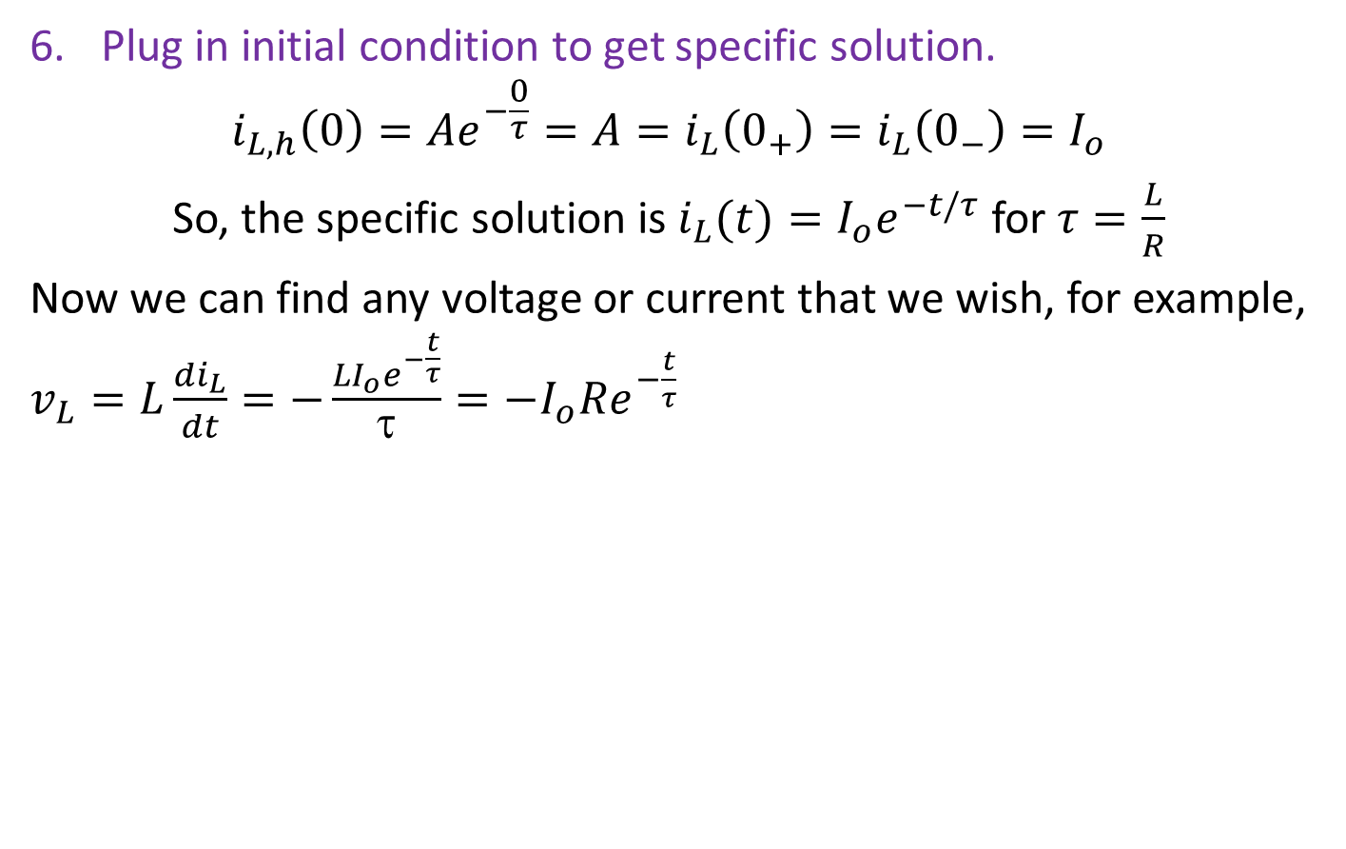
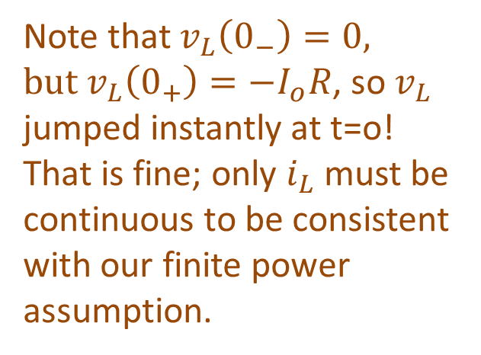
RL example one
Plug in initial condition to get specific solution.
$$i_{L,h}\left(0\right)=Ae^{−\frac{0}{τ}}=A=i_{L}\left(0_{+}\right)=i_{L}\left(0_{−}\right)=I_{o}$$
So, the specific solution is $i_{L}(t)=I_{o}e^{−t/τ}$ for $τ=\frac{L}{R}$
Now we can find any voltage or current that we wish, for example, $v_{L}=L\frac{di_{L}}{dt}=−\frac{{LI}_{o}e^{−\frac{t}{τ}}}{τ}=−I_{o}Re^{−\frac{t}{τ}}$
Note that $v_{L}\left(0_{−}\right)=0, \text{but} v_{L}\left(0_{+}\right)=−I_{o}R$, so $v_{L}$ jumped instantly at t=o! That is fine; only $i_{L}$ must be continuous to be consistent with our finite power assumption.

Slide 12
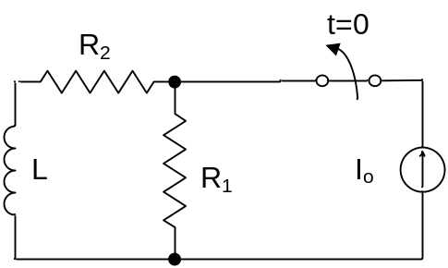
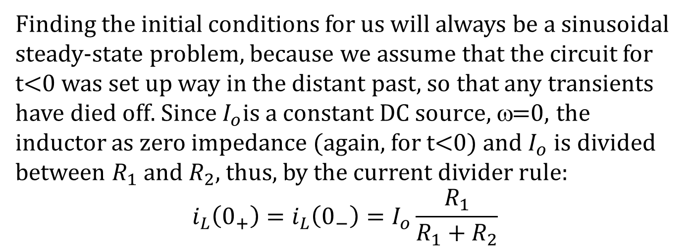
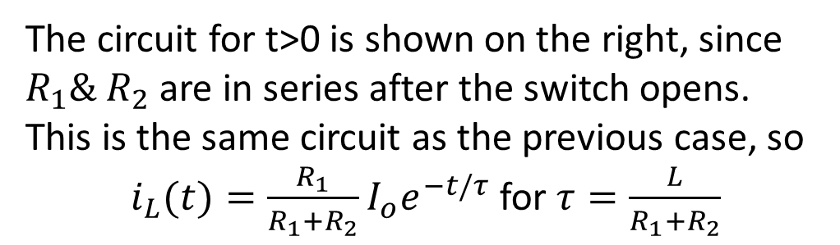

RL example two
Find initial condition on energy storage element (draw circuit for t<0 if needed).
Finding the initial conditions for us will always be a sinusoidal steady-state problem, because we assume that the circuit for t<0 was set up way in the distant past, so that any transients have died off. Since $I_{o}$is $a \text{constant} \text{DC} \text{source}$, ω=0, the inductor as zero impedance (again, for t<0) and $I_{o}$ is divided between $R_{1} \text{and}{ R}_{2}$, thus, by the current divider rule:
$$i_{L}\left(0_{+}\right)=i_{L}\left(0_{−}\right)=I_{o}\frac{R_{1}}{R_{1}+R_{2}}$$
t>0
i_{R}
The circuit for t>0 is shown on the right, since $R_{1}\& R_{2}$ are in series after the switch opens. This is the same circuit as the previous case, so
$i_{L}(t)={\frac{R_{1}}{R_{1}+R_{2}}I}_{o}e^{−t/τ}$ for $τ=\frac{L}{R_{1}+R_{2}}$
+
V_{R}
-
+
V_{L}
-
L
$$R_{1}+R_{2}$$
i_{L}

Slide 13
First Order Transients
Part 2: Circuits excited by sources
ENEE 205

Slide 14
  CIRCUITS EXCITED BY SOURCES
ALGORITHM (Note that steps 1-5 are identical with last algorithm):
Get circuit.
Find initial condition on energy storage element (draw circuit for t<0 if needed).
Write complete set of 1st-order differential equations (draw circuit for t>0 .)
Rearrange equations to get one equation for desired unknown (usually a capacitor voltage or inductor current, irrespective of ultimate goal)
Find characteristic equation and general homogeneous solution
Find the particular solution by method of undetermined coefficients or SSS analysis.
Plug in initial condition to COMPLETE solution (general homogeneous plus particular) to get specific solution.

Slide 15
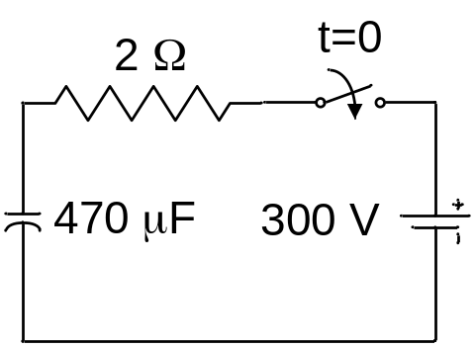
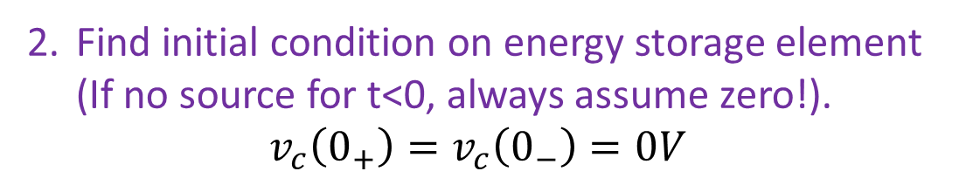
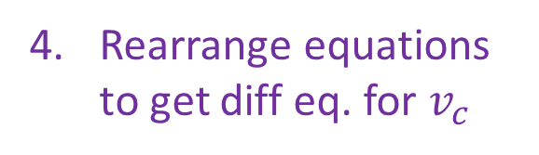
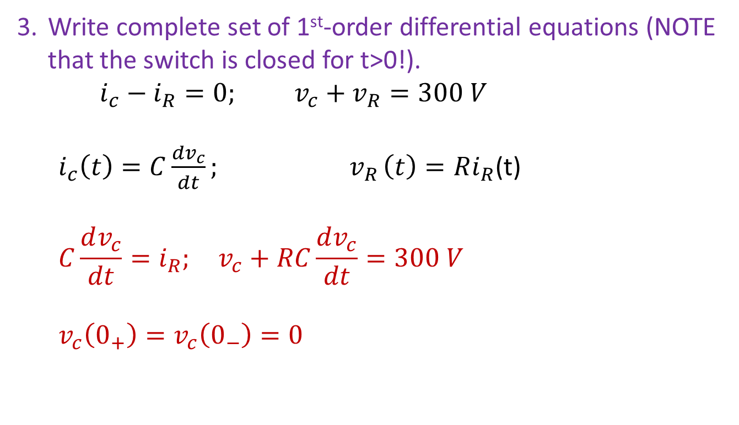
  RC Circuits excited by sources
  Find the voltage across the capacitor for t>0.
Find initial condition on energy storage element (If no source for t<0, always assume zero!).
$$v_{c}\left(0_{+}\right)=v_{c}\left(0_{−}\right)=0V$$
Write complete set of 1st-order differential equations (NOTE that the switch is closed for t>0!).
$i_{c}−i_{R}=0; v_{c}+v_{R}=300 V$
  $i_{c}\left(t\right)=C\frac{dv_{c}}{dt}{; v}_{R}\left(t\right)=Ri_{R}$(t)
  $$C\frac{dv_{c}}{dt}=i_{R}; v_{c}+RC\frac{dv_{c}}{dt}=300 V$$
  $$v_{c}\left(0_{+}\right)=v_{c}\left(0_{−}\right)=0$$
- V_{r} +
i_{r}
i_{c}
+
V_{c}
-
+
300
-
Rearrange equations to get diff eq. for $v_{c}$

Slide 16
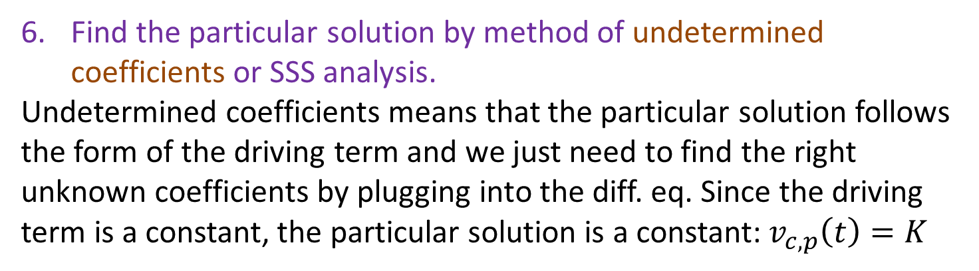
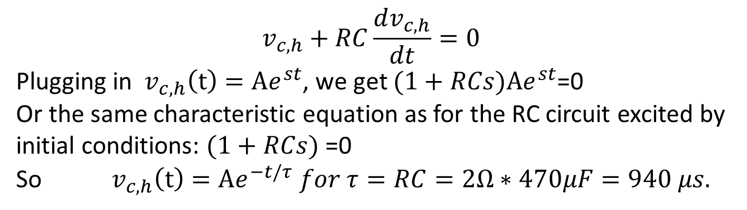
  RC Circuits excited by sources
Find characteristic equation and general homogeneous solution. One needs to set the driving term to zero to do this:
$$v_{c,h}+RC\frac{dv_{c,h}}{dt}=0$$
Plugging in $v_{c,h}\left(t\right)=Ae^{st}$, we get $(1+RCs)Ae^{st}$=0
Or the same characteristic equation as for the RC circuit excited by initial conditions: $(1+RCs)$=0
So${ v}_{c,h}\left(t\right)=Ae^{−t/τ} for τ=RC=2Ω∗470μF=940 μs.$
Find the particular solution by method of undetermined coefficients or SSS analysis.
Undetermined coefficients means that the particular solution follows the form of the driving term and we just need to find the right unknown coefficients by plugging into the diff. eq. Since the driving term is a constant, the particular solution is a constant: $v_{c,p}\left(t\right)=K$

Slide 17
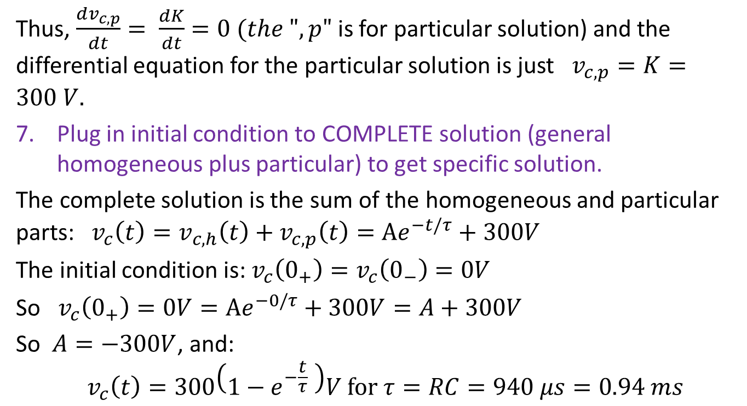
RC Circuits excited by sources
Thus, $\frac{dv_{c,p}}{dt}= \frac{dK}{dt}=0 (the ",p"$ is for particular solution) and the differential equation for the particular solution is just $v_{c,p}=K=300 V.$
Plug in initial condition to COMPLETE solution (general homogeneous plus particular) to get specific solution.
The complete solution is the sum of the homogeneous and particular parts:${ v}_{c}\left(t\right)=v_{c,h}\left(t\right)+v_{c,p}\left(t\right)=Ae^{−t/τ}+300V$
The initial condition is: $v_{c}\left(0_{+}\right)=v_{c}\left(0_{−}\right)=0V$
So $v_{c}\left(0_{+}\right)=0V=Ae^{−0/τ}+300V=A+300V$
So $A=−300V$, and:
$${ v}_{c}\left(t\right)=300\left(1−e^{−\frac{t}{τ}} \right)V \text{for} τ=RC=940 μs=0.94 ms$$

Slide 18
RC Circuits excited by sources
τ=0.94 ms

Slide 19
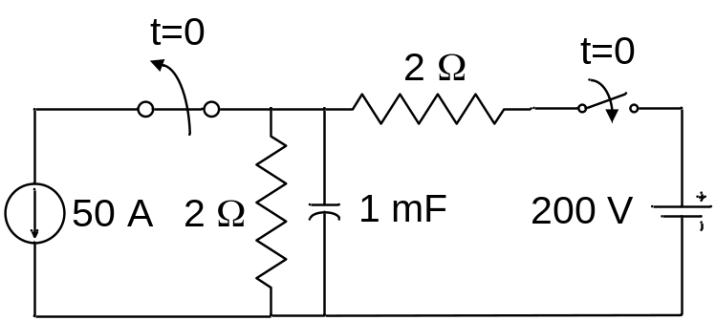
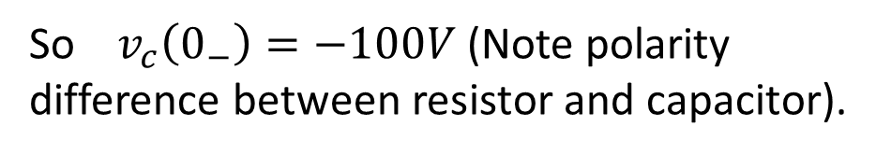
  RC Circuits excited by sources
  Find the time T>0 when the voltage across the capacitor equals 0V. We have to follow the algorithm and use the answer to find the zero crossing!
Find initial condition on energy storage element. Here drawing the circuit for t<0 might be useful. A constant 50 A is to divide between the resistor and the capacitor, but because ω=0, the capacitor impedance is infinity and all 50 A goes through the resistor. Ohms Law tells use that the voltage is 100V as shown,
So $v_{c}\left(0_{−}\right)=−100V$ (Note polarity difference between resistor and capacitor).
2 Ω
-
100V
+
+
Vc
-
50 A
t<0

Slide 20
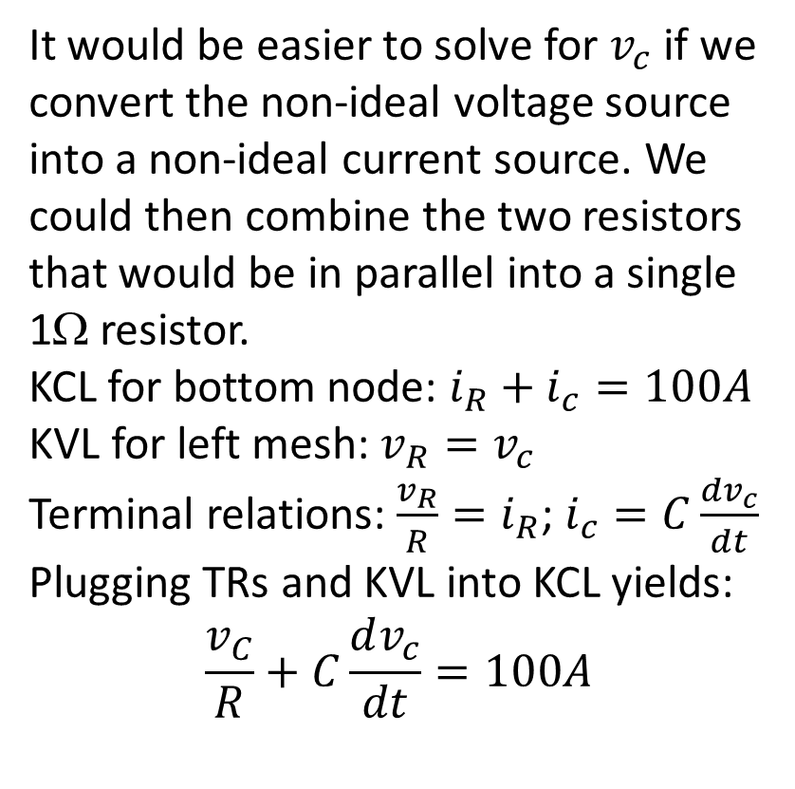
RC Circuits excited by sources
Write complete set of 1st-order differential equations. Draw the circuit for t>0.
2 Ω
It would be easier to solve for $v_{c}$ if we convert the non-ideal voltage source into a non-ideal current source. We could then combine the two resistors that would be in parallel into a single 1Ω resistor.
KCL for bottom node: $i_{R}+i_{c}=100A$
KVL for left mesh: $v_{R}=v_{c}$
Terminal relations: $\frac{v_{R}}{R}=i_{R}$; $i_{c}=C\frac{dv_{c}}{dt}$
Plugging TRs and KVL into KCL yields:
$$\frac{v_{C}}{R}+C\frac{dv_{c}}{dt}=100A$$
2 Ω
1 mF
- 200 V +
1 mF
- V_{R} +
- V_{c} +
100 A
1 Ω
i_{R}
i_{C}
(Step 4 was combined in the process)

Slide 21
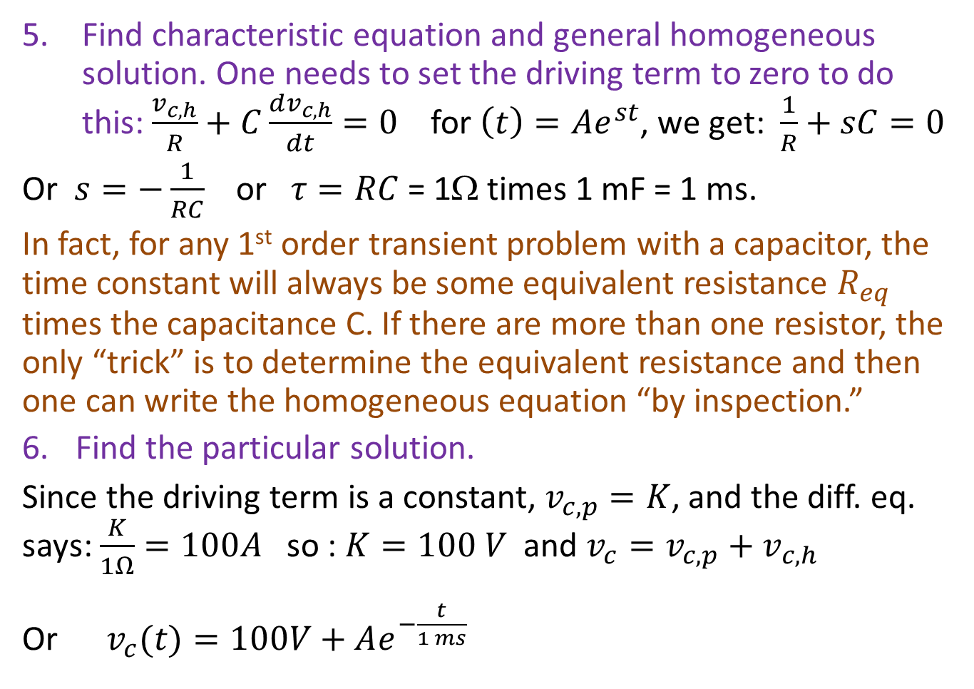
RC Circuits excited by sources
Find characteristic equation and general homogeneous solution. One needs to set the driving term to zero to do this: $\frac{v_{c,h}}{R}+C\frac{dv_{c,h}}{dt}=0$ for $\left(t\right)=Ae^{st}$, we get: $\frac{1}{R}+sC=0$
Or $s=−\frac{1}{RC}$ or $τ=RC$ = 1Ω times 1 mF = 1 ms.
In fact, for any 1st order transient problem with a capacitor, the time constant will always be some equivalent resistance $R_{eq}$ times the capacitance C. If there are more than one resistor, the only “trick” is to determine the equivalent resistance and then one can write the homogeneous equation “by inspection.”
Find the particular solution.
Since the driving term is a constant, $v_{c,p}=K$, and the diff. eq. says: $\frac{K}{1Ω}=100A$ so : $K=100 V$ and $v_{c}=v_{c,p}+v_{c,h}$
Or $v_{c}(t)=100V+Ae^{−\frac{t}{1 ms}}$

Slide 22
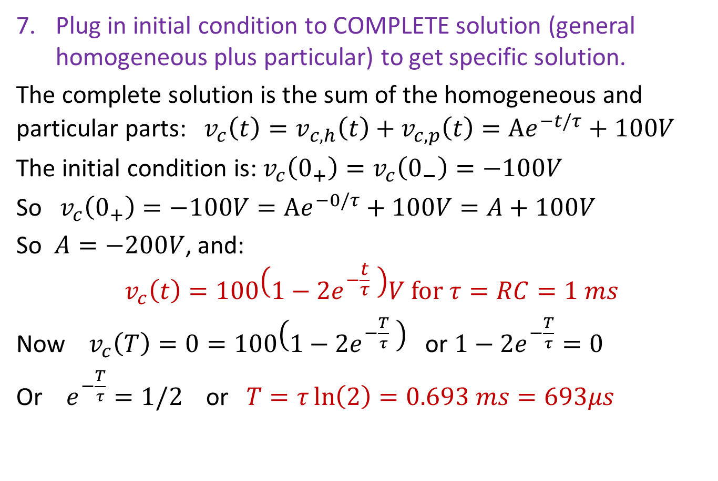
RC Circuits excited by sources
Plug in initial condition to COMPLETE solution (general homogeneous plus particular) to get specific solution.
The complete solution is the sum of the homogeneous and particular parts:${ v}_{c}\left(t\right)=v_{c,h}\left(t\right)+v_{c,p}\left(t\right)=Ae^{−t/τ}+100V$
The initial condition is: $v_{c}\left(0_{+}\right)=v_{c}\left(0_{−}\right)=−100V$
So $v_{c}\left(0_{+}\right)=−100V=Ae^{−0/τ}+100V=A+100V$
So $A=−200V$, and:
$${ v}_{c}\left(t\right)=100\left(1−{2e}^{−\frac{t}{τ}} \right)V \text{for} τ=RC=1 ms$$
Now ${ v}_{c}\left(T\right)=0=100\left(1−{2e}^{−\frac{T}{τ}} \right)$ or $1−{2e}^{−\frac{T}{τ}}=0$
Or $e^{−\frac{T}{τ}}=1/2$ or $T=τ\ln\left(2\right)=0.693 ms=693μs$

Slide 23
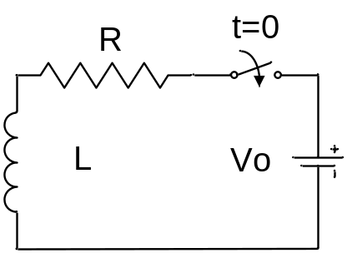
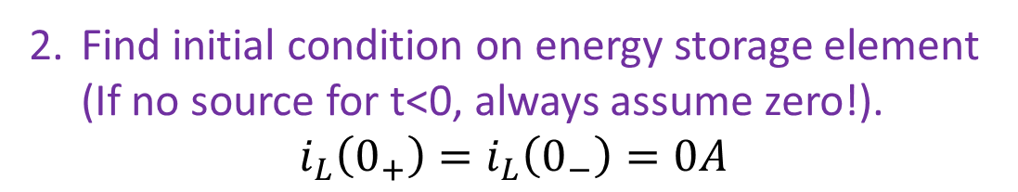

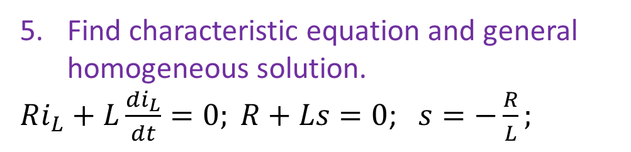
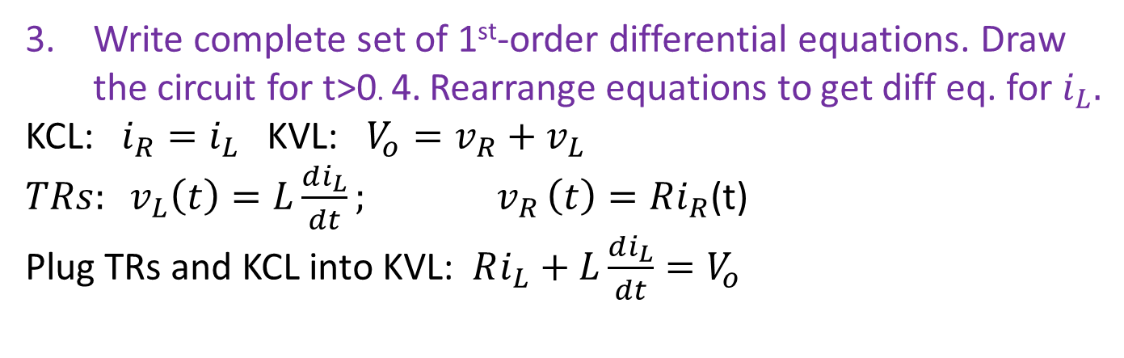
RL Circuits excited by sources
  Find the current through the inductor for t>0.
Find initial condition on energy storage element (If no source for t<0, always assume zero!).
$$i_{L}\left(0_{+}\right)=i_{L}\left(0_{−}\right)=0A$$
Write complete set of 1st-order differential equations. Draw the circuit for t>0. 4. Rearrange equations to get diff eq. for $i_{L}.$
KCL: $i_{R}=i_{L}$ KVL: $V_{o}=v_{R}+v_{L}$
$TRs: v_{L}\left(t\right)=L\frac{di_{L}}{dt}{; v}_{R}\left(t\right)=Ri_{R}$(t)
Plug TRs and KCL into KVL: $Ri_{L}+L\frac{di_{L}}{dt}=V_{o}$
- v_{R} +
i_{R}
+
v_{L}
-
R
+
V_{o}
-
L
i_{L}
Find characteristic equation and general homogeneous solution.
$Ri_{L}+L\frac{di_{L}}{dt}=0; R+Ls=0$; $s=−\frac{R}{L};$
$$i_{L}\left(t\right)=Ae^{−tR/L}$$

Slide 24
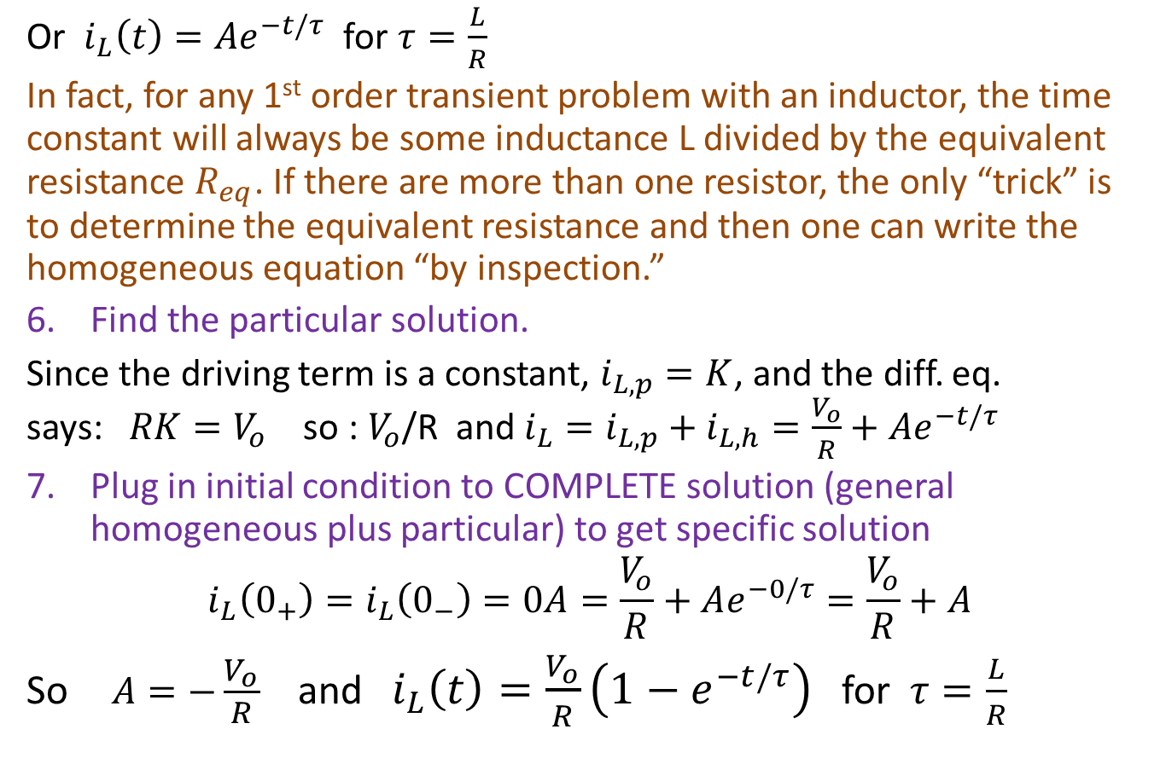
RL Circuits excited by sources
Or $i_{L}\left(t\right)=Ae^{−t/τ}$ for $τ=\frac{L}{R}$
In fact, for any 1st order transient problem with an inductor, the time constant will always be some inductance L divided by the equivalent resistance $R_{eq}$. If there are more than one resistor, the only “trick” is to determine the equivalent resistance and then one can write the homogeneous equation “by inspection.”
Find the particular solution.
Since the driving term is a constant, $i_{L,p}=K$, and the diff. eq. says:$RK=V_{o}$ so : $V_{o}$/R and $i_{L}=i_{L,p}+i_{L,h}=\frac{V_{o}}{R}+Ae^{−t/τ}$
Plug in initial condition to COMPLETE solution (general homogeneous plus particular) to get specific solution
$$i_{L}\left(0_{+}\right)=i_{L}\left(0_{−}\right)=0A=\frac{V_{o}}{R}+Ae^{−0/τ}=\frac{V_{o}}{R}+A$$
So$A=−\frac{V_{o}}{R}$ and $i_{L}\left(t\right)=\frac{V_{o}}{R}\left(1−e^{−t/τ}\right)$ for $τ=\frac{L}{R}$

Slide 25
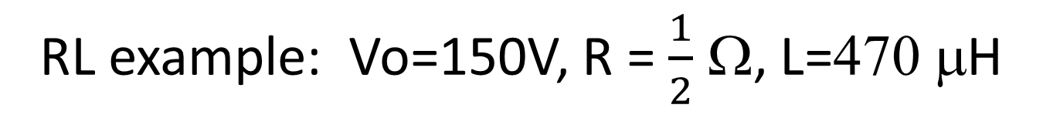
RL example: Vo=150V, R = $\frac{1}{2}$ Ω, L=470 μH
τ=0.94 ms

Slide 26
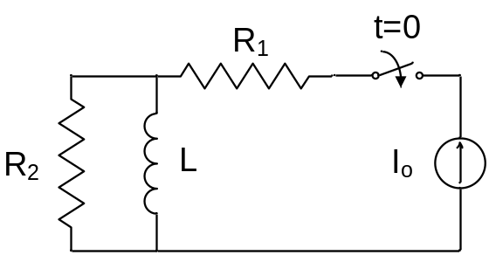
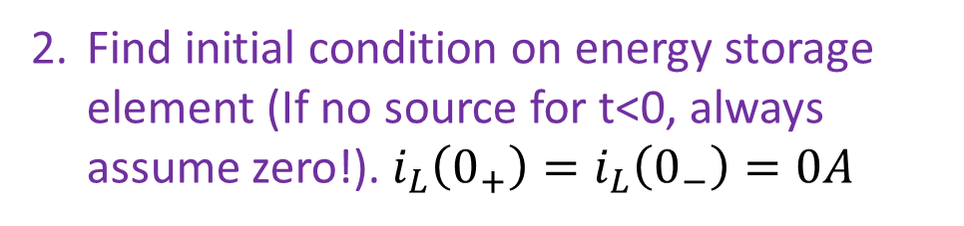
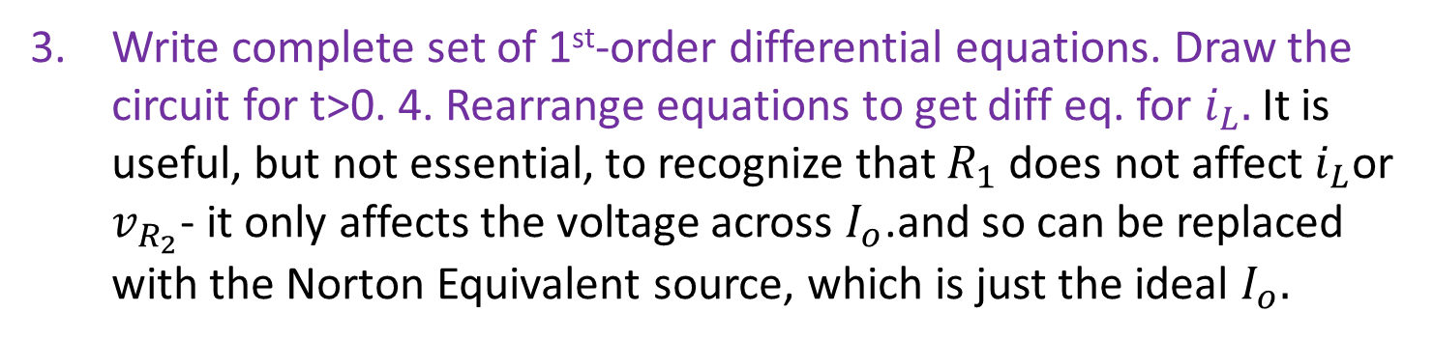
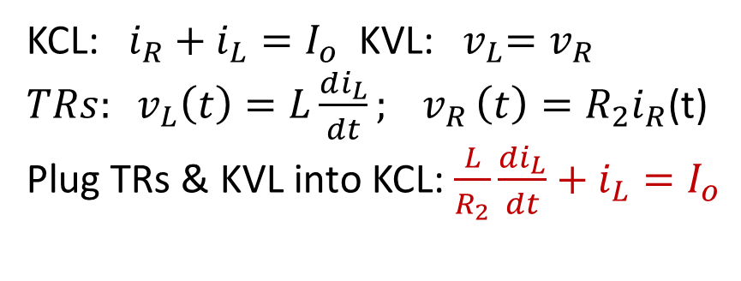
RL Circuits excited by sources
  Find the voltage across R₂ for t>0. Note: find inductor current first!
Find initial condition on energy storage element (If no source for t<0, always assume zero!).$i_{L}\left(0_{+}\right)=i_{L}\left(0_{−}\right)=0A$
Write complete set of 1st-order differential equations. Draw the circuit for t>0. 4. Rearrange equations to get diff eq. for $i_{L}.$It is useful, but not essential, to recognize that $R_{1}$ does not affect $i_{L}$or $v_{R_{2}}$- it only affects the voltage across $I_{o}$.and so can be replaced with the Norton Equivalent source, which is just the ideal $I_{o}.$
KCL: $i_{R}+i_{L}=I_{o}$ KVL:${ v}_{L}=v_{R}$
$TRs: v_{L}\left(t\right)=L\frac{di_{L}}{dt}{; v}_{R}\left(t\right)=R_{2}i_{R}$(t)
Plug TRs & KVL into KCL: $\frac{L}{R_{2}}\frac{di_{L}}{dt}+i_{L}=I_{o}$
R₂
- V_{R} +
- V_{L} +
I_{o}
L
i_{R}
i_{L}

Slide 27
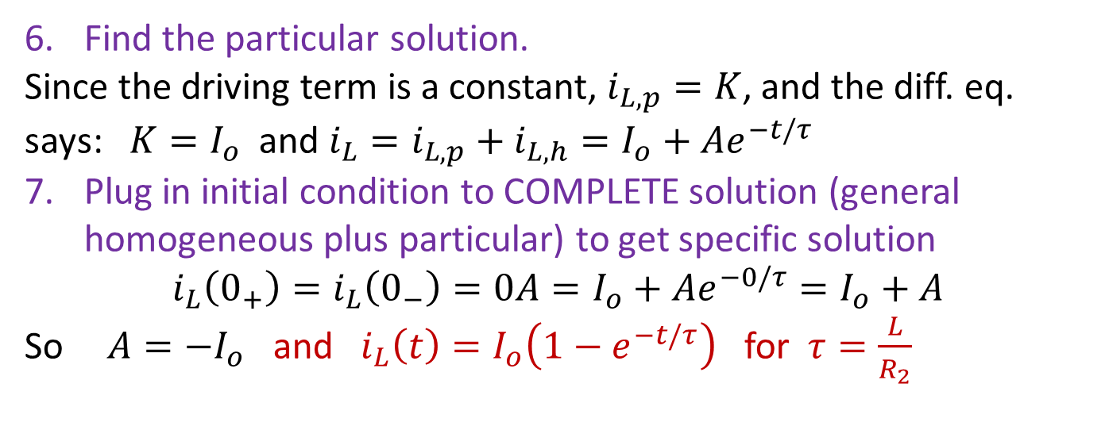
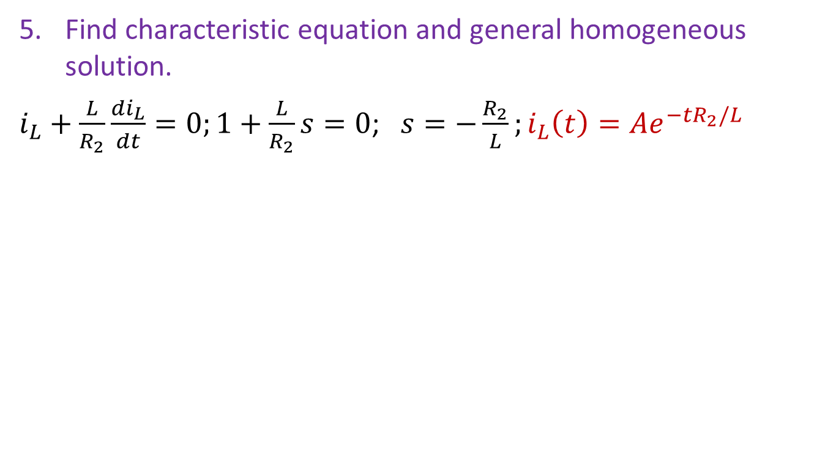
RL Circuits excited by sources
Find characteristic equation and general homogeneous solution.
$i_{L}+\frac{L}{R_{2}}\frac{di_{L}}{dt}=0;1+\frac{L}{R_{2}}s=0$; $s=−\frac{R_{2}}{L};i_{L}\left(t\right)=Ae^{−tR_{2}/L}$
Find the particular solution.
Since the driving term is a constant, $i_{L,p}=K$, and the diff. eq. says:$K=I_{o}$ and $i_{L}=i_{L,p}+i_{L,h}=I_{o}+Ae^{−t/τ}$
Plug in initial condition to COMPLETE solution (general homogeneous plus particular) to get specific solution
$$i_{L}\left(0_{+}\right)=i_{L}\left(0_{−}\right)=0A=I_{o}+Ae^{−0/τ}=I_{o}+A$$
So$A=−I_{o}$ and $i_{L}\left(t\right)=I_{o}\left(1−e^{−t/τ}\right)$ for $τ=\frac{L}{R_{2}}$

Slide 28
First Order Transients
Part 3: Transfer functions in transient problems
ENEE 205

Slide 29
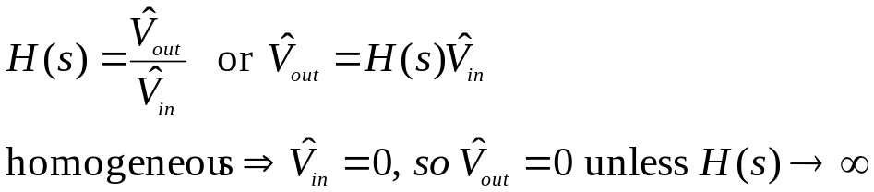
Transfer functions in transient problems
Why might transfer functions be useful for the solution of transient problems?
When the source is sinusoidal (for t>0), the particular solution to the problem is the sinusoidal, steady-state solution, which can be found via transfer functions.
The general homogeneous solution can always be found from the transfer function (for concreteness assume input and output signals are voltages):
So, the only way to have a non-zero solution for the desired voltage or current when the source is equal to zero, is to have the transfer function go to infinity, which is to say “s” must be a pole of the transfer function, or that the characteristic equation for the circuit can be found by setting the denominator of the transfer function equal to zero.

Slide 30
  SOLVING 1st-ORDER PROBLEMS WITH TRANSFER FUNCTIONS
ALGORITHM (circuits excited by sinusoidal sources):
Get circuit.
Find initial condition on energy storage element (draw circuit for t<0 if needed).
Find transfer function of desired output in terms of source (draw circuit for t>0 .)
Find characteristic equation by setting denominator of transfer function to zero. Obtain general homogeneous solution.
Find the particular solution by inserting s=jω into transfer function and solving.
Plug in initial condition to COMPLETE solution (general homogeneous plus particular) to get specific solution

Slide 31
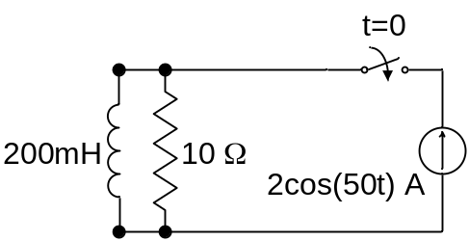
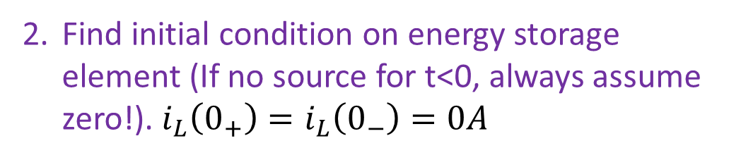
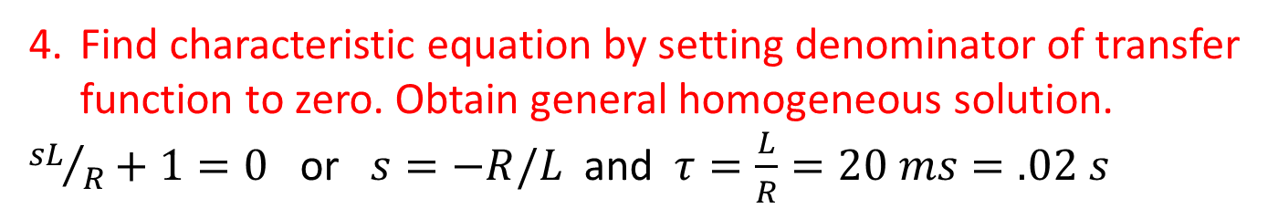
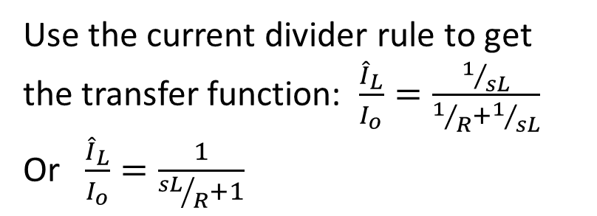


Find the current through the inductor for t>0.
Solving first-order problems with transfer functions
Find initial condition on energy storage element (If no source for t<0, always assume zero!).$i_{L}\left(0_{+}\right)=i_{L}\left(0_{−}\right)=0A$
Find transfer function of desired output in terms of source (draw circuit for t>0 .)
Use the current divider rule to get the transfer function: $\frac{{\hat{I}}_{L}}{I_{o}}=\frac{1/{sL}}{1/R+1/{sL}}$
Or $\frac{{\hat{I}}_{L}}{I_{o}}=\frac{1}{{sL}/R+1}$
- V_{R} +
$$\frac{1}{R}$$
$$\frac{1}{sL}$$
I_{o}
- V_{L} +
i_{R}
i_{L}
Find characteristic equation by setting denominator of transfer function to zero. Obtain general homogeneous solution.
${sL}/R+1=0$ or $s=−R/L$ and $τ=\frac{L}{R}=20 ms=.02 s$

Slide 32
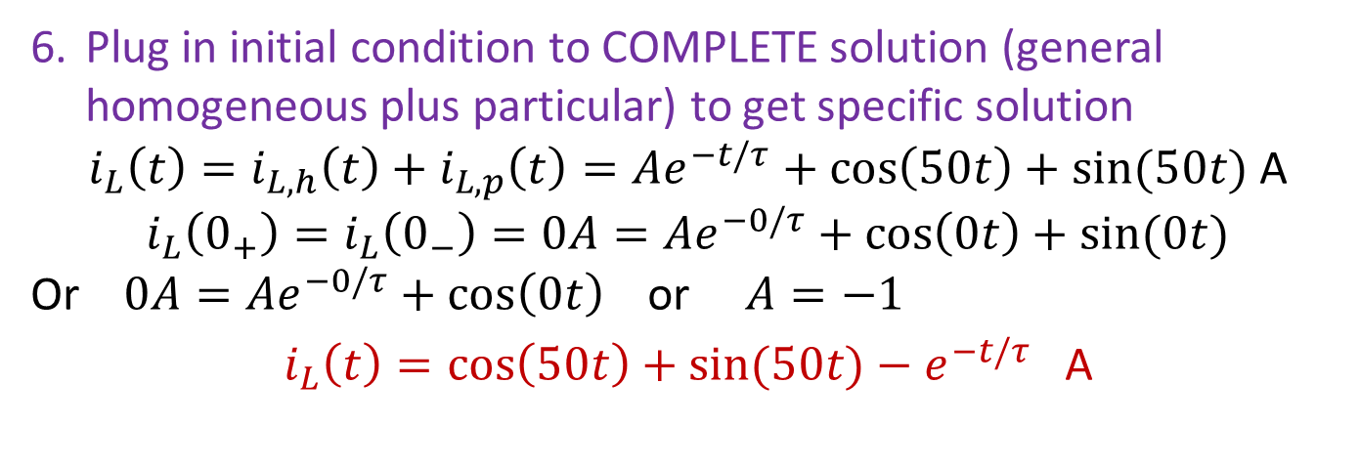
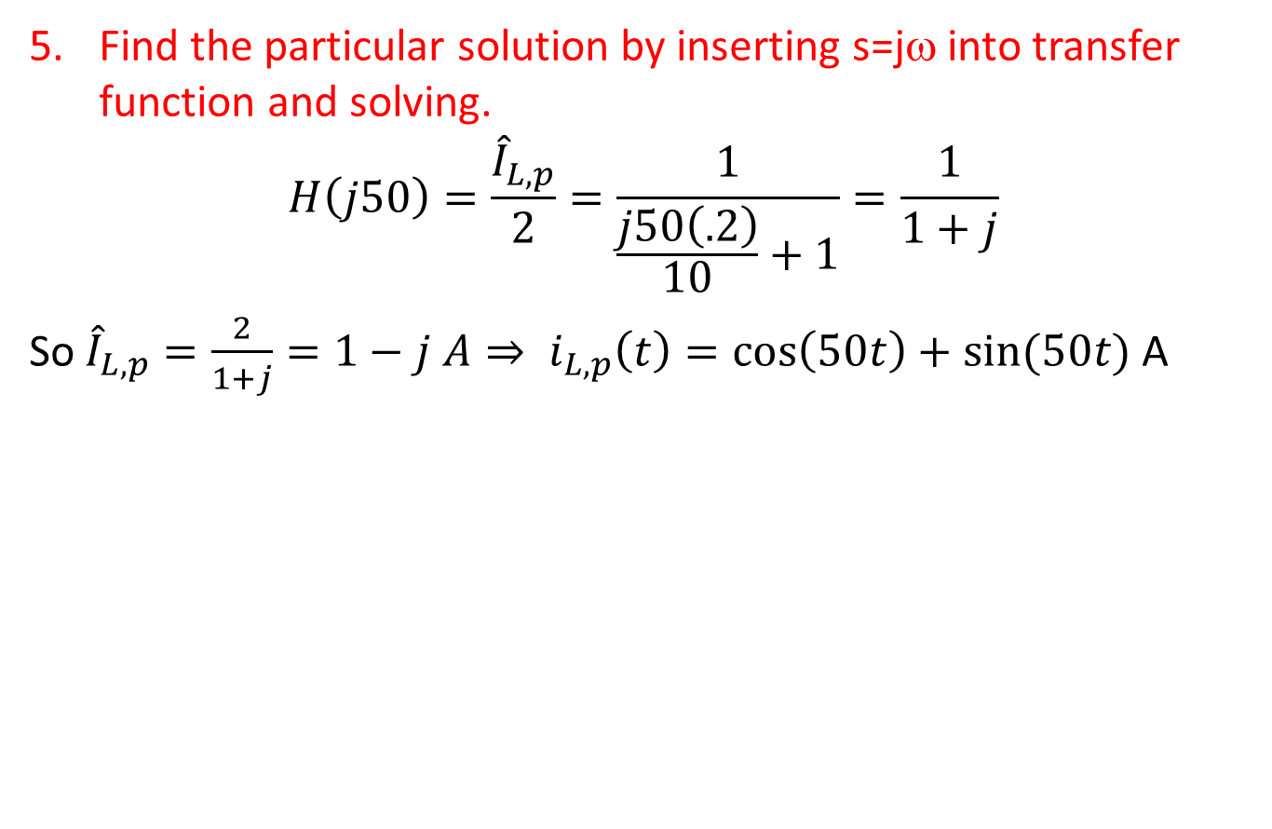
Solving first-order problems with transfer functions
Find the particular solution by inserting s=jω into transfer function and solving.
$$H\left(j50\right)=\frac{{\hat{I}}_{L,p}}{2}=\frac{1}{\frac{j50\left(.2\right)}{10}+1}=\frac{1}{1+j}$$
So ${\hat{I}}_{L,p}=\frac{2}{1+j}=1−j A⇒ i_{L,p}\left(t\right)=\cos\left(50t\right)+sin⁡(50t)$ A
Plug in initial condition to COMPLETE solution (general homogeneous plus particular) to get specific solution
$$i_{L}\left(t\right)=i_{L,h}\left(t\right)+i_{L,p}\left(t\right)=Ae^{−t/τ}+\cos\left(50t\right)+sin⁡(50t) \text{A}$$
$$i_{L}\left(0_{+}\right)=i_{L}\left(0_{−}\right)=0A=Ae^{−0/τ}+\cos\left(0t\right)+sin⁡(0t)$$
Or $0A=Ae^{−0/τ}+\cos\left(0t\right)$ or $A=−1$
$$i_{L}\left(t\right)=\cos\left(50t\right)+sin⁡(50t)−e^{−t/τ} \text{A}$$

Slide 33
  TRANSFER FUNCTION EXAMPLES FOR CIRCUITS EXCITED ONLY BY INITIAL CONDITIONS
ALGORITHM (circuits excited by initial conditions):
Get circuit.
Find initial condition on energy storage element (draw circuit for t<0 if needed).
Add a source to the circuit so that you recover the original circuit when you set the source to zero!
Find transfer function of desired output in terms of source (draw circuit for t>0 .)
Find characteristic equation by setting denominator of transfer function to zero. Obtain general homogeneous solution.
Plug in initial condition to the general homogeneous solution to get specific solution. (The particular solution is zero.)

Slide 34



Method 1 – add a voltage source
  Find the voltage across the capacitor for t>0.
We’ll only concentrate on the step where we add the fictitious source. For t>0 the circuit looks like this on the right.
t>0
t>0
We add a series voltage source as shown on the left. If the source is set to zero, we recover the circuit on the right.
i_{R}
i_{c}
+
V_{R}
-
i_{R}
-
V_{c}
+
i_{c}
+
V_{R}
-
R
$$\frac{1}{sC}$$
-
V_{c}
+
R
$$\frac{1}{sC}$$
+ V_{o} -
We use the voltage divider rule to get: $\frac{{\hat{V}}_{c}}{V_{o}}=\frac{1/{sC}}{R+1/{sC}}=\frac{1}{1+sRC}$. We only care about the denominator to get the Characteristic equation: $1+sRC$=0, so $s=−\frac{1}{RC}.$

Slide 35


Method 2 – add a current source
  Find the voltage across the capacitor for t>0.
We’ll only concentrate on the step where we add the fictitious source. For t>0 the circuit looks like this on the right.
t>0
t>0
i_{R}
We add a parallel current source as shown on the left. If the source is set to zero, we recover the circuit on the right.
i_{c}
i_{c}
+
V_{R}
-
i_{R}
+
V_{R}
-
-
V_{c}
+
R
-
V_{c}
+
$$\frac{1}{sC}$$
$$\frac{1}{R}$$
I_{o}
sC
We use the current divider rule to get: $\frac{{\hat{I}}_{c}}{I_{o}}=\frac{sC}{sC+1/R}=\frac{sCR}{1+sRC}$. We want $\frac{{\hat{V}}_{c}}{I_{o}}$ , and ${\hat{I}}_{c}=sC{\hat{V}}_{c}$, so: $\frac{sC{\hat{V}}_{c}}{I_{o}}=\frac{sCR}{1+sRC}$ or $\frac{{\hat{V}}_{c}}{I_{o}}=\frac{R}{1+sRC}$. We care about the Characteristic equation: $1+sRC$=0, so $s=−\frac{1}{RC}.$

