Slide 1
Filters
1: Definitions
ENEE 205

Slide 2
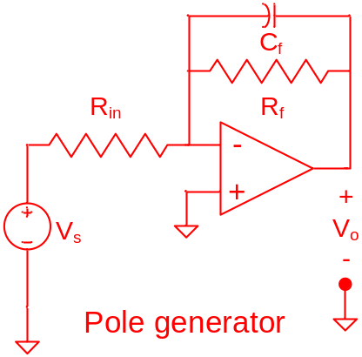
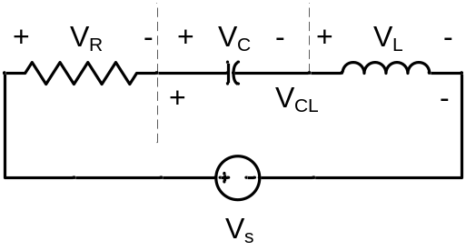
Filter Definitions
Filter Circuit - A circuit that conditions an input signal, usually by allowing only a range of frequencies to pass through the circuit to the output. The purpose of a filter is often to separate a desired signal from undesired signals (e.g. noise).
Normalized Filter Circuit - A circuit whose parameters are adjusted so that the corner frequency is 1 radian/sec and the output impedance is 1 Ω.
Passive Filter – filters constructed without op-amps.
Active Filter – filters constructed with op-amps.
Butterworth Filter - A type of filter that is "maximally flat", i.e. as many derivatives of the magnitude of the transfer function as possible are equal to zero at some frequency.

Slide 3
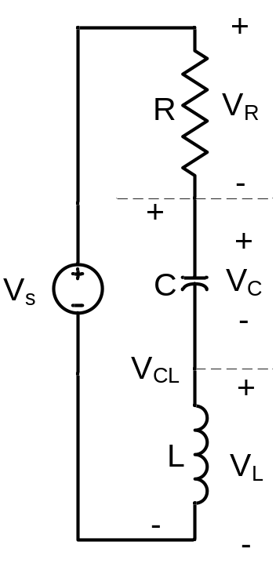
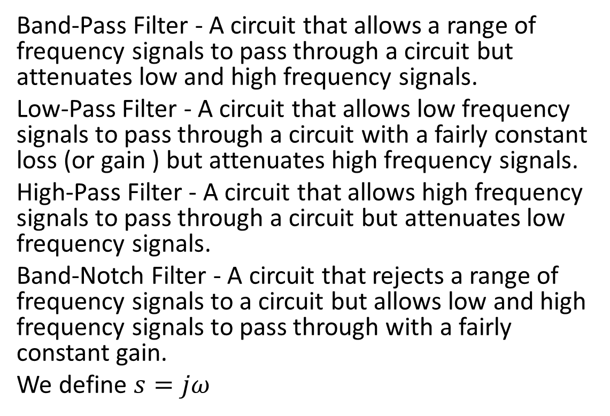
Filter Classification
Band-Pass Filter - A circuit that allows a range of frequency signals to pass through a circuit but attenuates low and high frequency signals.
Low-Pass Filter - A circuit that allows low frequency signals to pass through a circuit with a fairly constant loss (or gain ) but attenuates high frequency signals.
High-Pass Filter - A circuit that allows high frequency signals to pass through a circuit but attenuates low frequency signals.
Band-Notch Filter - A circuit that rejects a range of frequency signals to a circuit but allows low and high frequency signals to pass through with a fairly constant gain.
We define $s=jω$
Band pass Low pass High pass Band notch

Slide 4
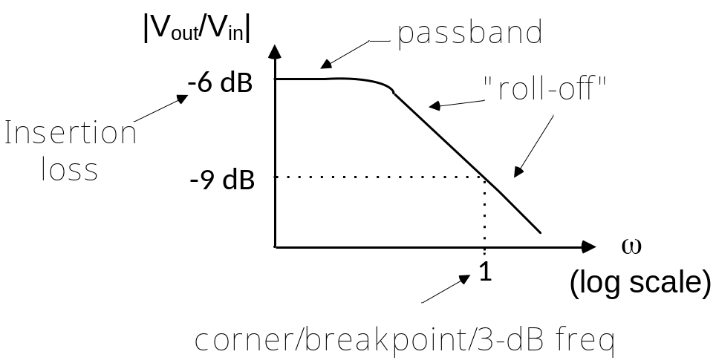
More Filter Definitions
Passband - The range of frequencies that passes through a filter relatively unattenuated (or at least fairly uniformly attenuated).
Insertion loss – The amount of attenuation (in dB) in the passband. This is typically -6dB for passive filters, because the maximum output voltage is ½ the input voltage. Active filters may actually have insertion gain (or loss).
Corner Frequency - The frequency where the power in the output signal is 50% of the output power in the passband. This is also known as the 3dB frequency and the breakpoint frequency.
Roll Off - The rate (in dB/decade) that the power in a signal is attenuated outside of the passband as a function of frequency.

Slide 5
Filters:
Part 2: Bode Plots and Frequency Response
ENEE 205

Slide 6
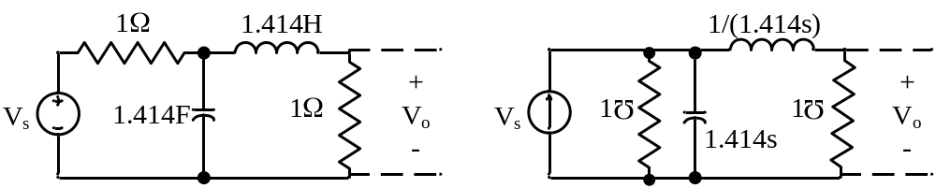
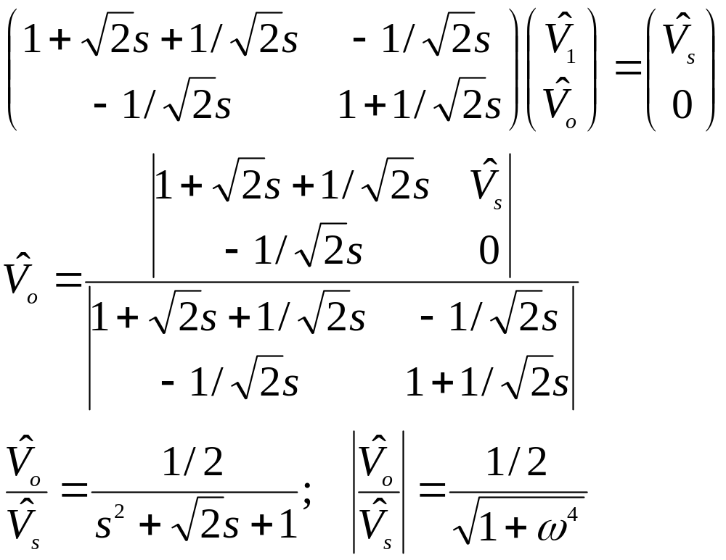
  Example: a passive 2nd order low-pass filter
  The output voltage found with Nodal Analysis

Slide 7
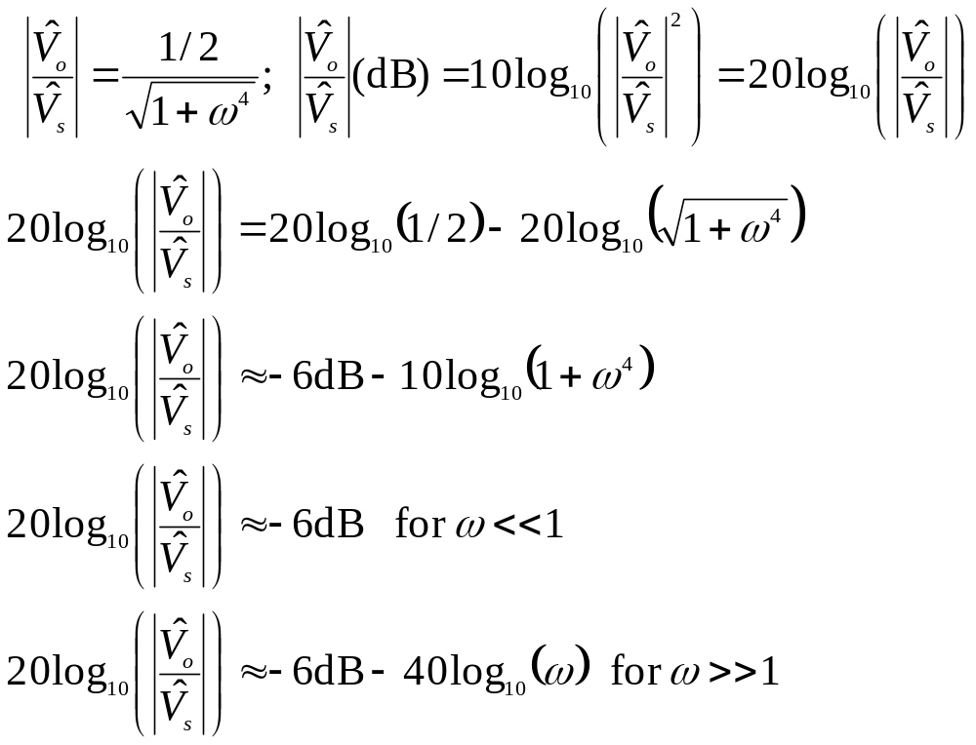
BODE PLOTS – approximate frequency response for our second-order low-pass filter
Exact frequency response
Worst case: off from approximation by 3 dB
Bode Approximation

Slide 8
Filters
Part 3: passive filters
ENEE 205

Slide 9
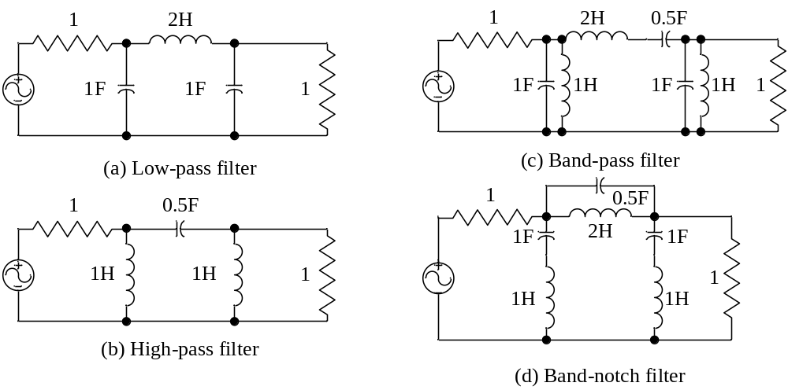
  Passive 3rd order filters

Slide 10
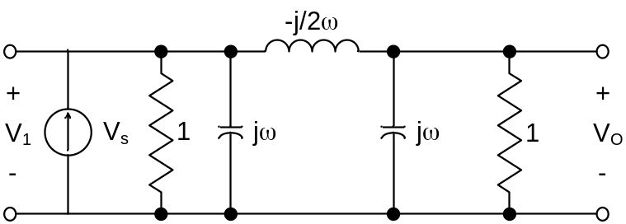
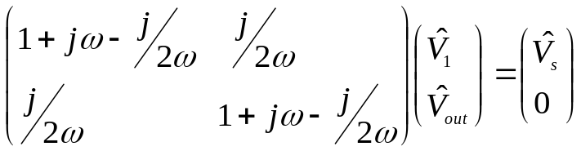
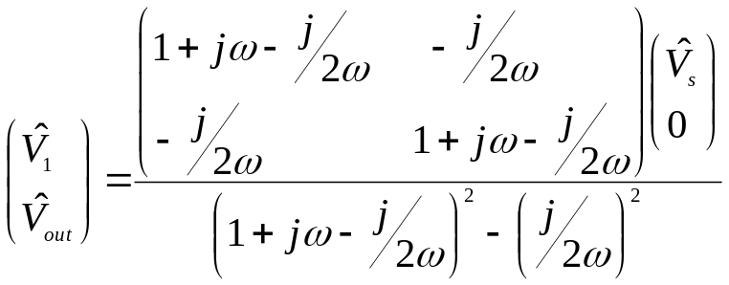
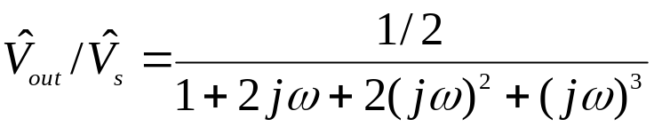
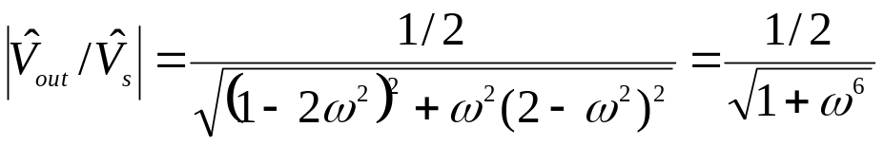
Passive 3rd order low-pass filter
Solved with Nodal Analysis to show that it is a Butterworth Filter.

Slide 11

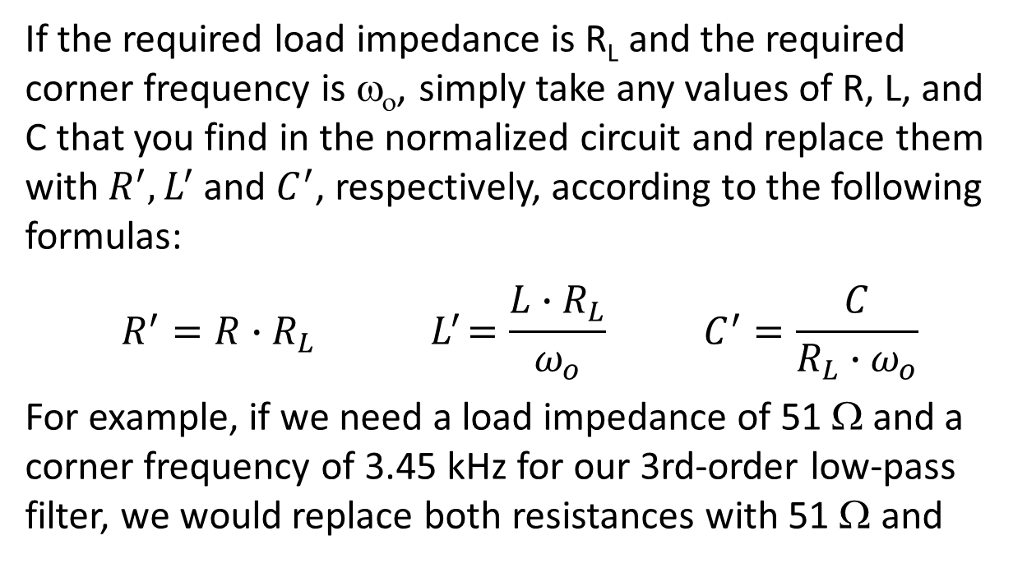
Filter frequency and load scaling
If the required load impedance is R_{L} and the required corner frequency is ω_{ο}, simply take any values of R, L, and C that you find in the normalized circuit and replace them with${ R}^{′}, L^{′}$and $C^{′}$, respectively, according to the following formulas:
$$R^{′}=R∙R_{L}{ L}^{′}=\frac{L∙R_{L}}{ω_{o}} C^{′}=\frac{C}{{R_{L}∙ω}_{o}}$$
For example, if we need a load impedance of 51 Ω and a corner frequency of 3.45 kHz for our 3rd-order low-pass filter, we would replace both resistances with 51 Ω and

Slide 12
Filters
Part 4: Active Filters
ENEE 205

Slide 13
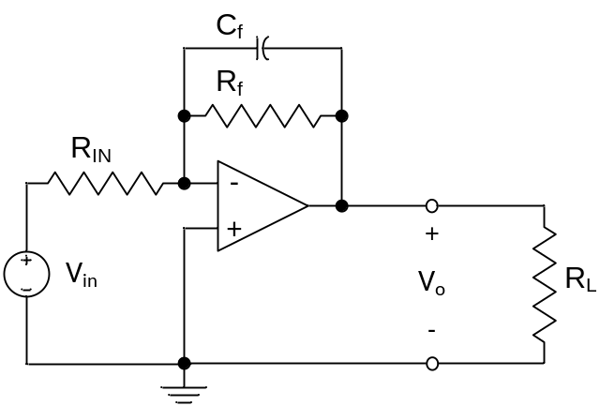
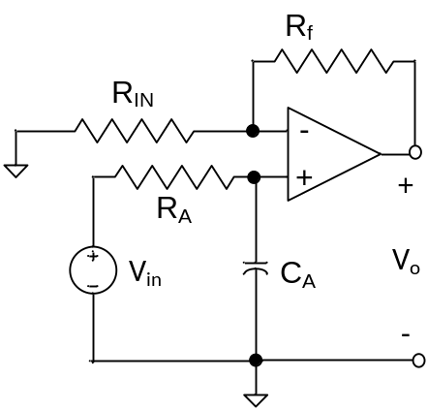
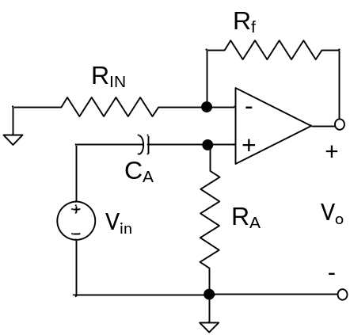
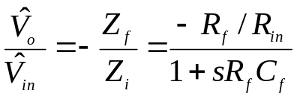
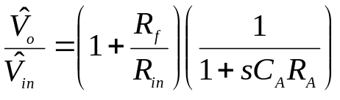
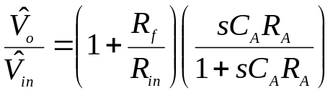
  Active first order filters
For 1st order circuits there are only low-pass and high-pass filters.
Low pass inverting
Low pass non-inverting
High pass non-inverting

Slide 14
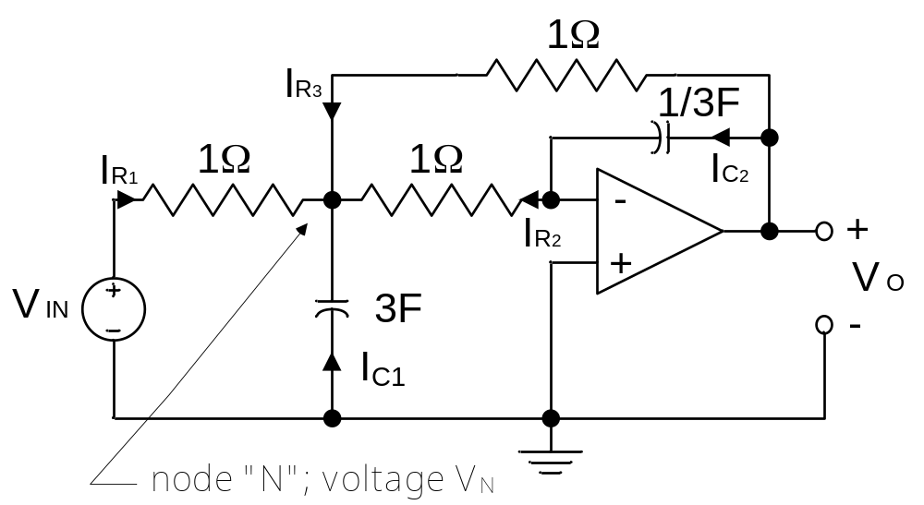
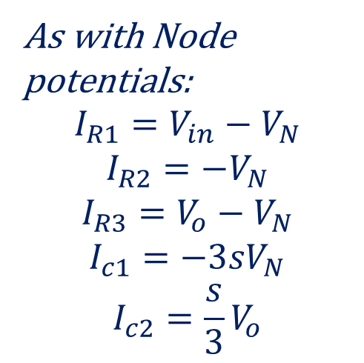
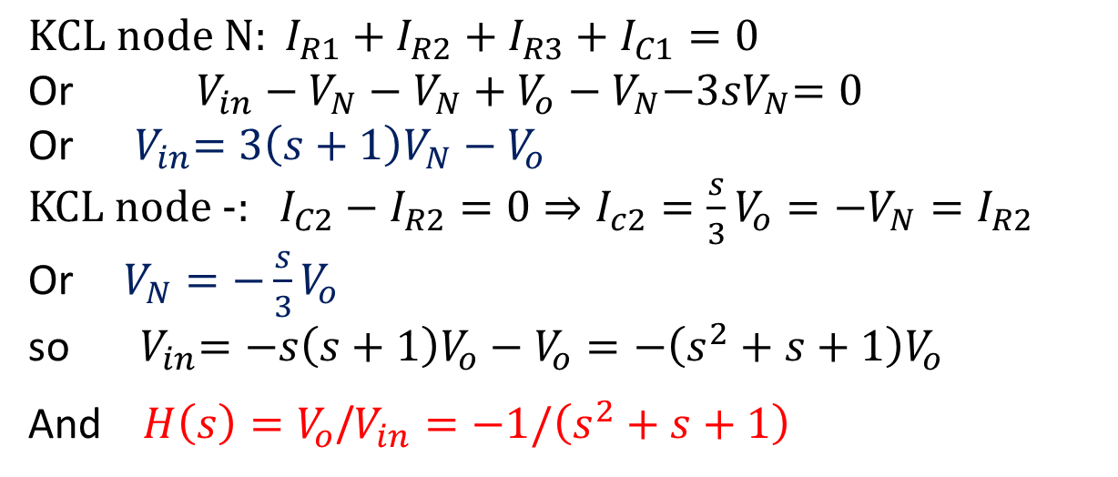
  Normalized Low-pass 2nd-order Multi-feedback (MFB)
As with Node potentials:
$$I_{R1}=V_{in}−V_{N}$$
$$I_{R2}=−V_{N}$$
$$I_{R3}=V_{o}−V_{N}$$
$$I_{c1}={−3sV}_{N}$$
$$I_{c2}={\frac{s}{3}V}_{o}$$
$$KCL node N: I_{R1}+I_{R2}+I_{R3}+I_{C1}=0$$
Or $V_{in}−V_{N}−V_{N}+V_{o}−V_{N}{−3sV}_{N}=0$
Or ${ V}_{in}=3\left(s+1\right)V_{N}−V_{o}$
KCL node -: $I_{C2}−I_{R2}=0⇒I_{c2}={\frac{s}{3}V}_{o}=−V_{N}=I_{R2}$
Or${V_{N}=−\frac{s}{3}V}_{o}$
so ${ V}_{in}=−s\left(s+1\right)V_{o}−V_{o}=−\left(s^{2}+s+1\right)V_{o}$
And $H\left(s\right)=V_{o}$/$V_{in}=−1/\left(s^{2}+s+1\right)$

Slide 15
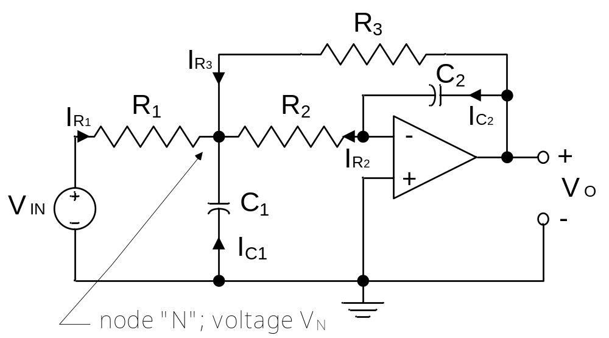
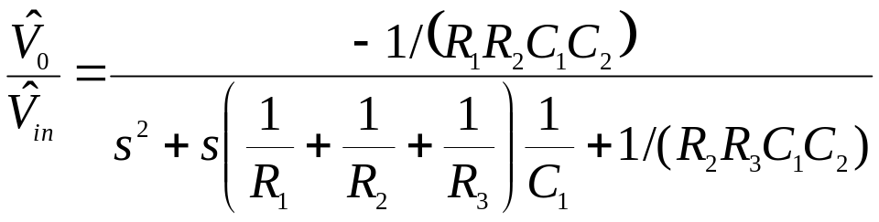
  More general MFB 2nd order Low-pass filter

Slide 16
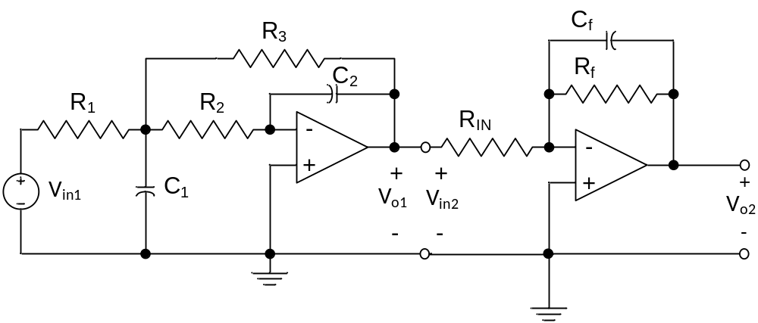
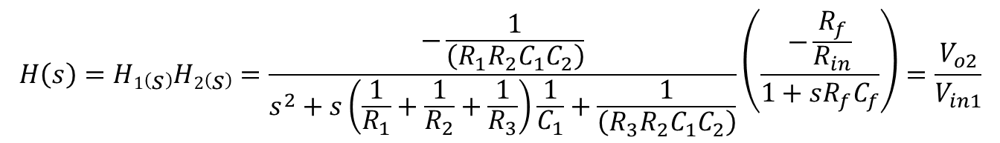
How to make a 3rd-order Low-pass filter
$$H\left(s\right)=H1\left(s\right)H2\left(s\right)=\frac{−\frac{1}{\left(R_{1}R_{2}C_{1}C_{2}\right)}}{s^{2}+s\left(\frac{1}{R_{1}}+\frac{1}{R_{2}}+\frac{1}{R_{3}}\right)\frac{1}{C_{1}}+\frac{1}{\left(R_{3}R_{2}C_{1}C_{2}\right)}}\left(\frac{−\frac{R_{f}}{R_{in}}}{1+sR_{f}C_{f}}\right)=\frac{V_{o2}}{V_{in1}}$$

Slide 17
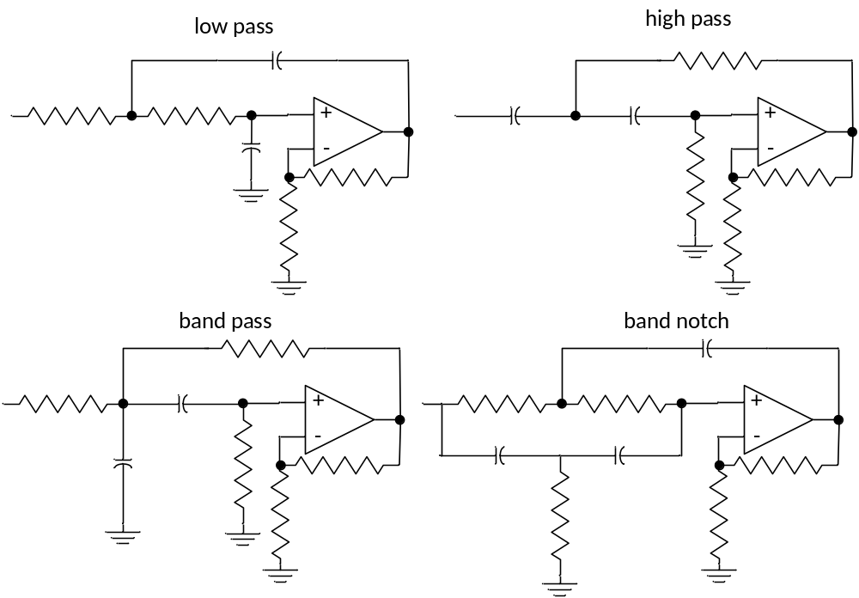
Active 2nd-order circuits –Sallen-Key

Slide 18
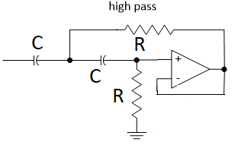

Slide 19
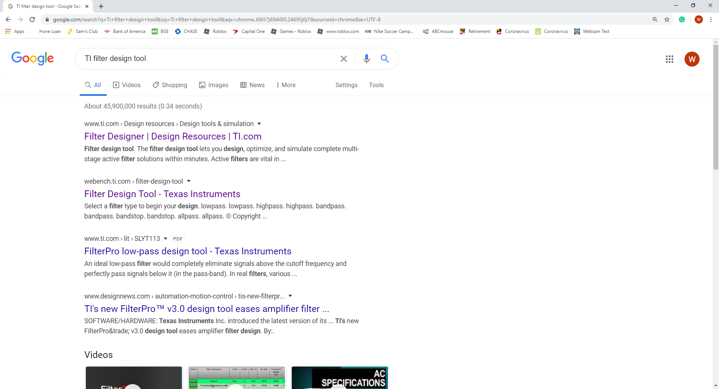

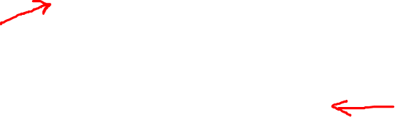
Designing an active filter!

Slide 20
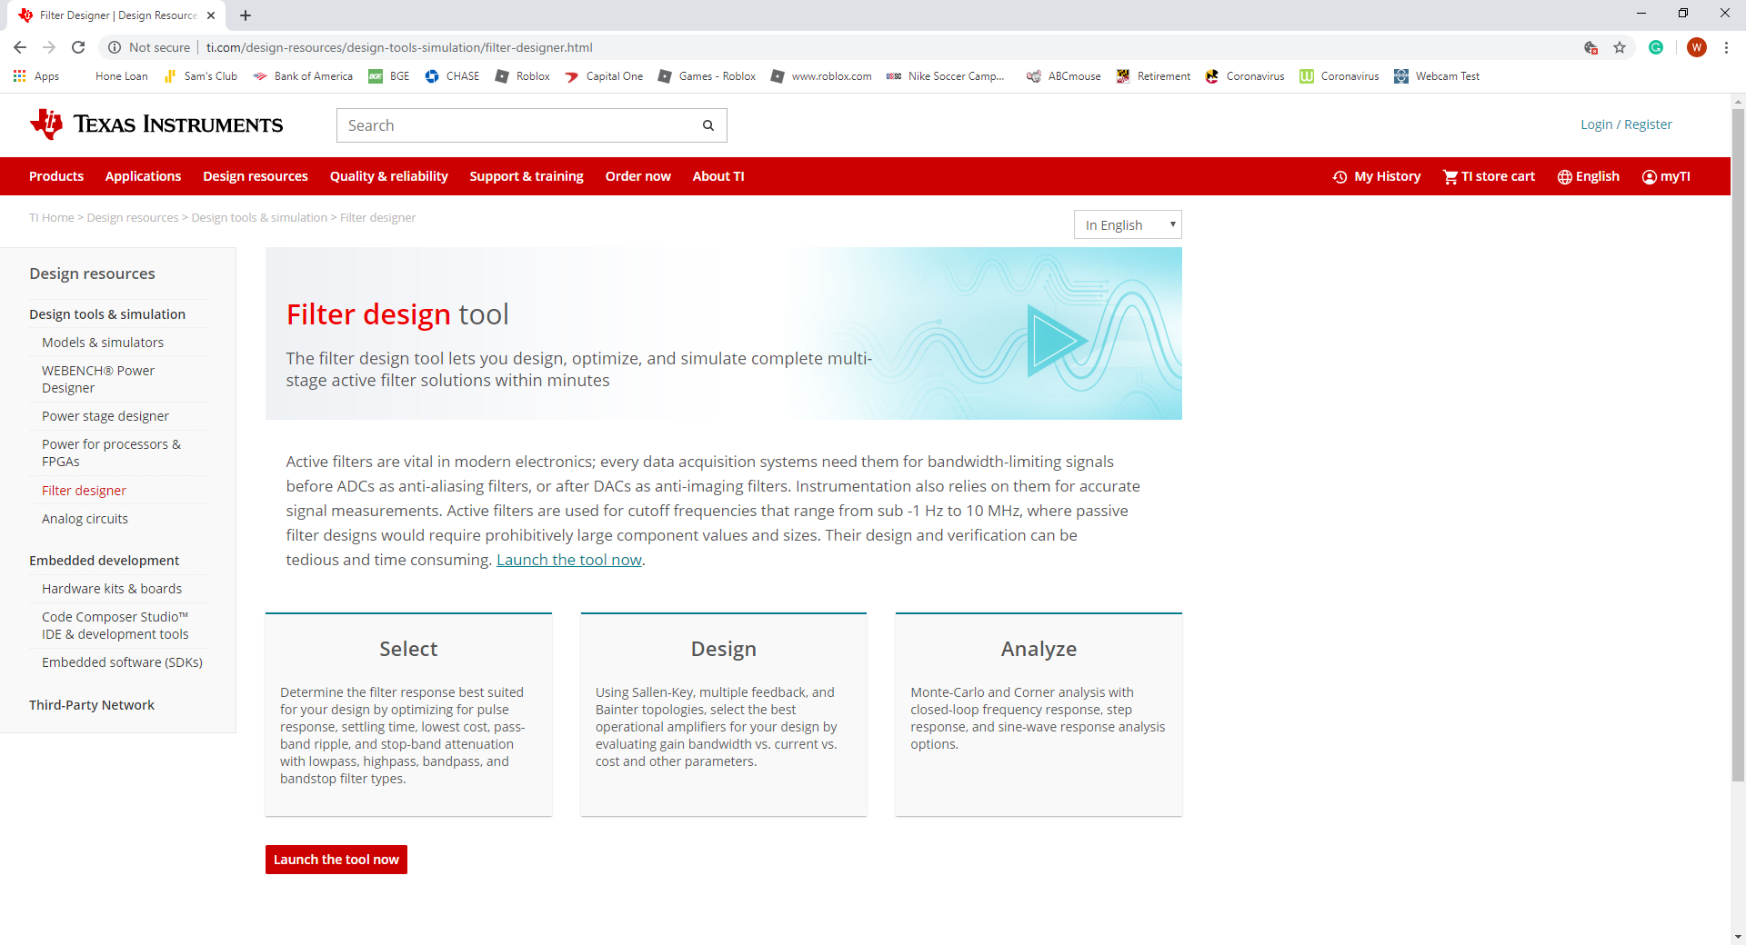
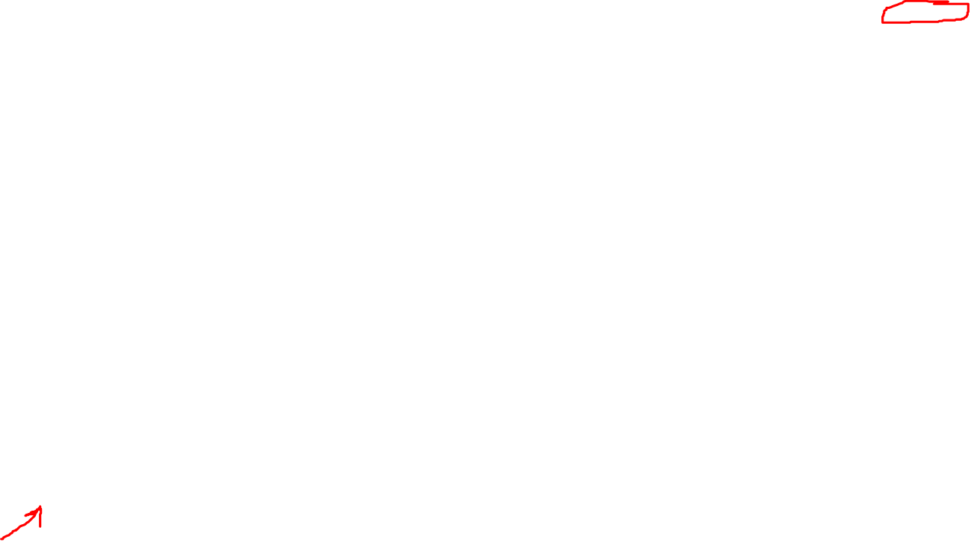

Slide 21
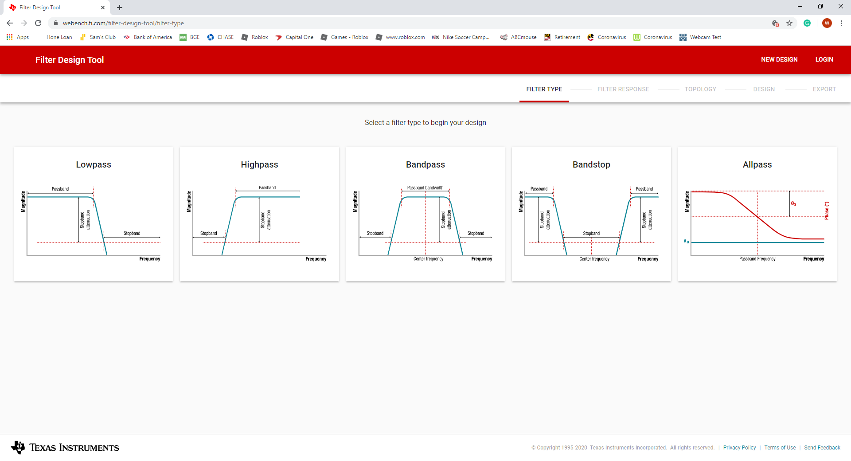
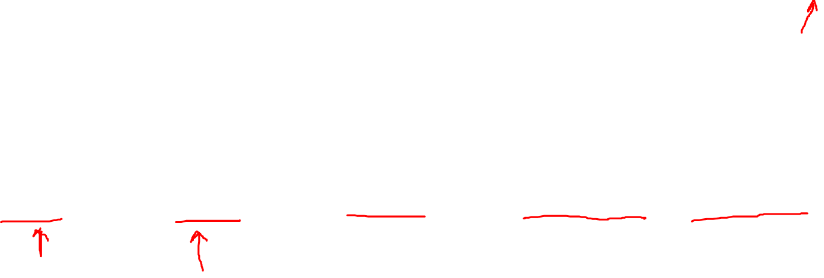

Slide 22
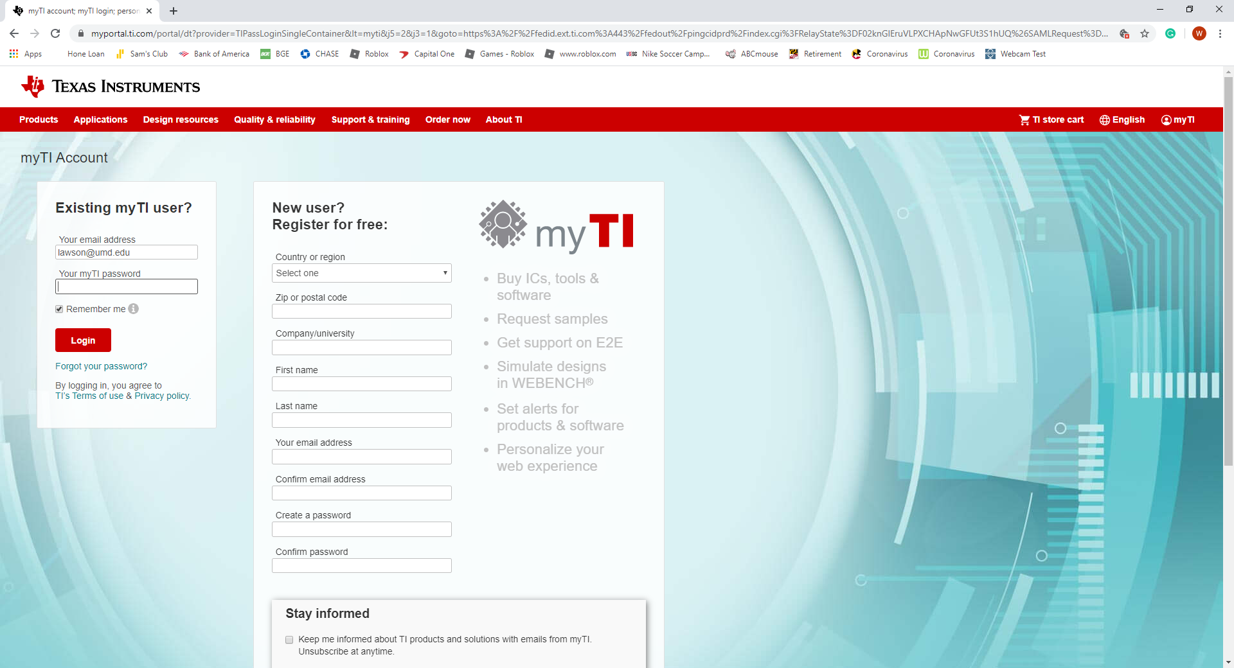
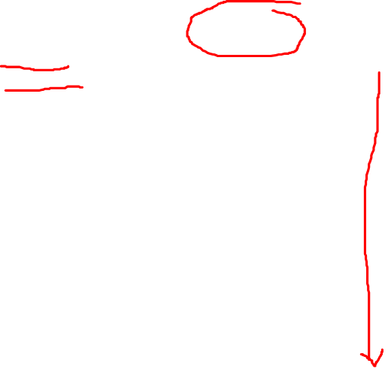

Slide 23
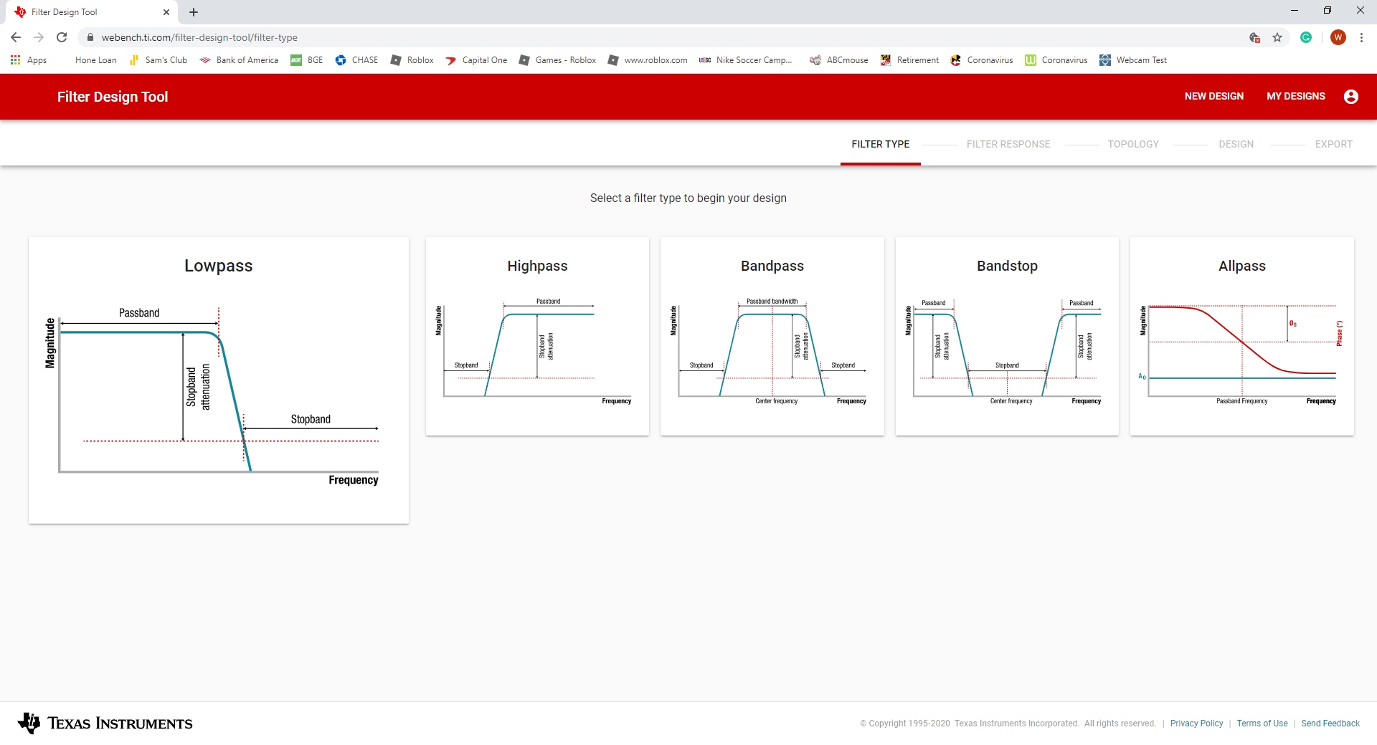

Slide 24
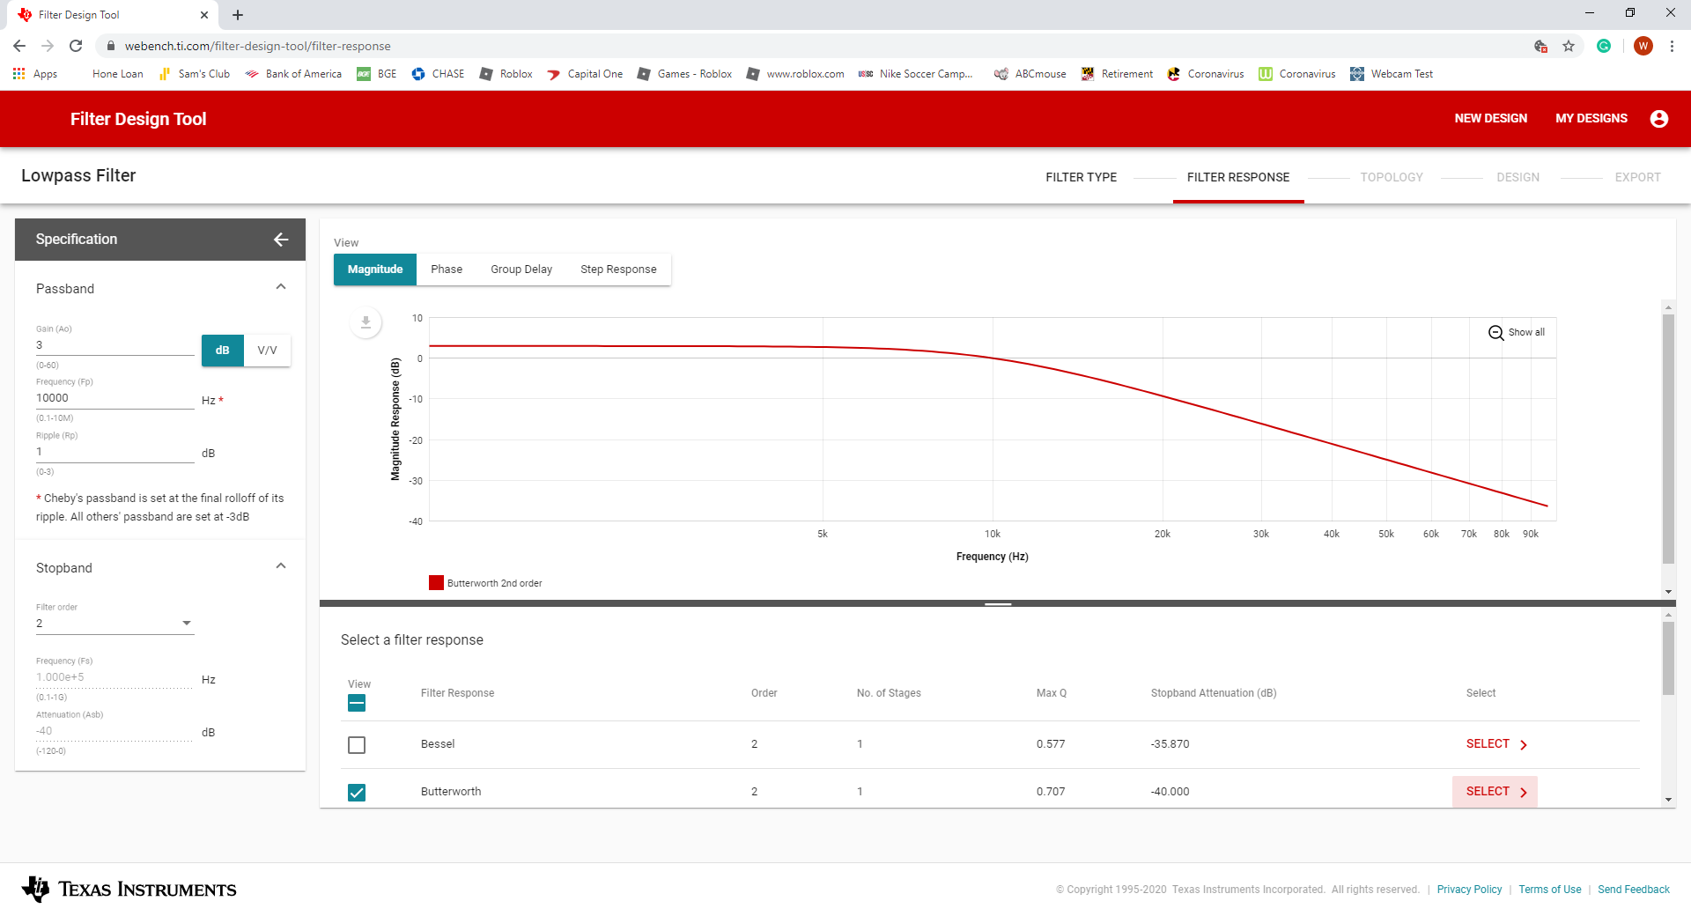
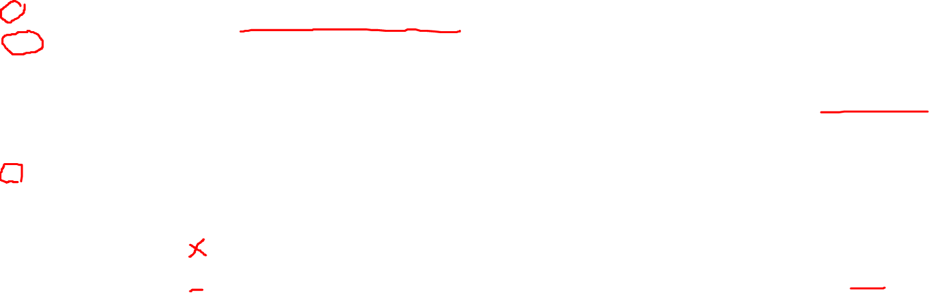

Slide 25
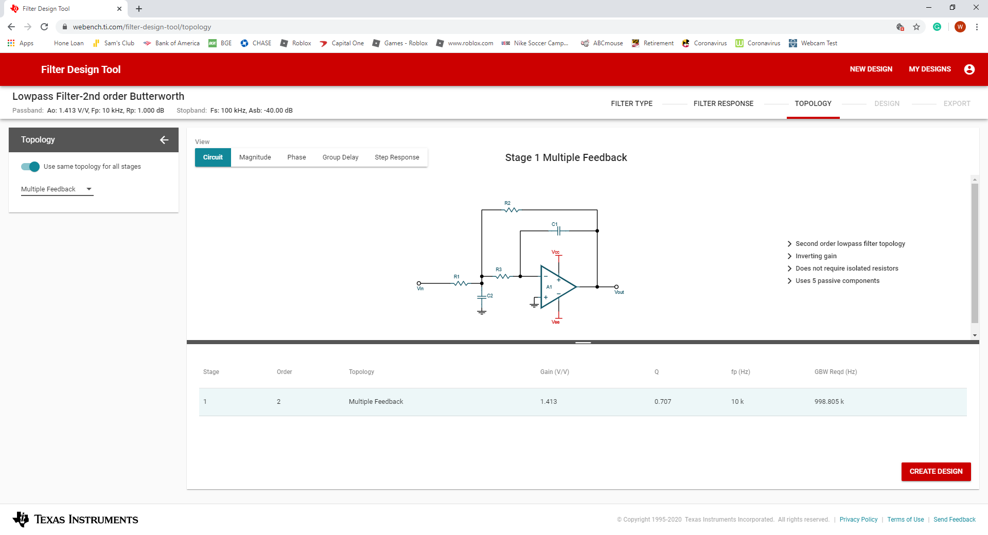
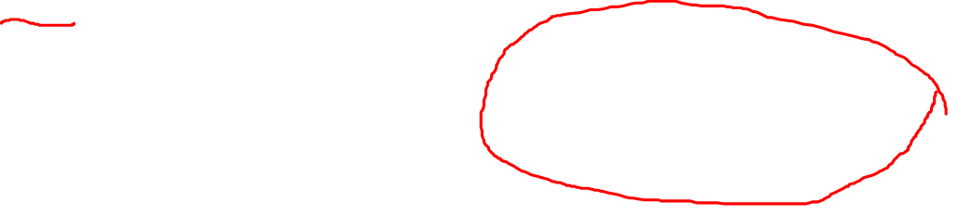

Slide 26
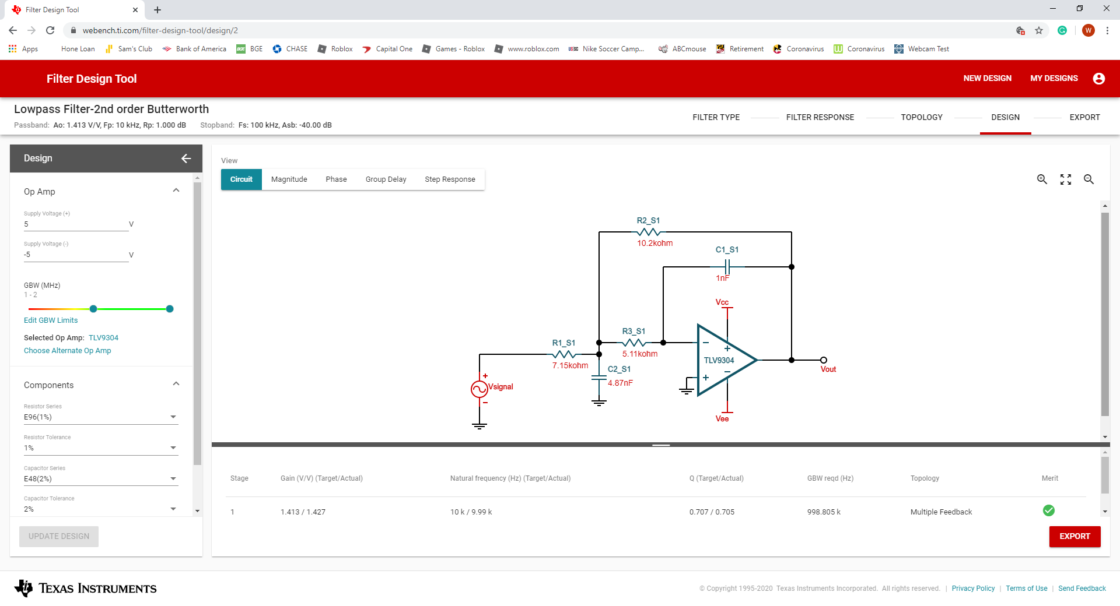
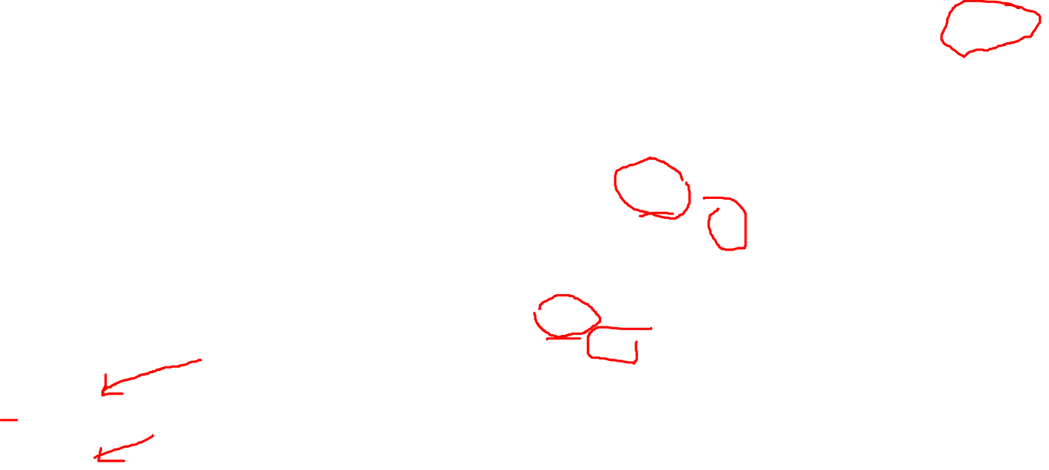

Slide 27
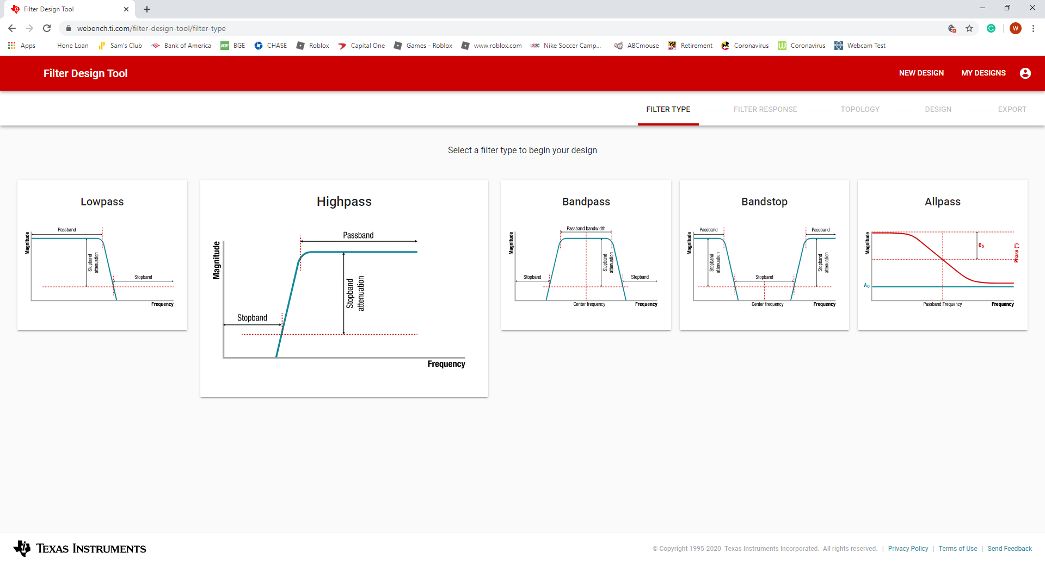


Slide 28
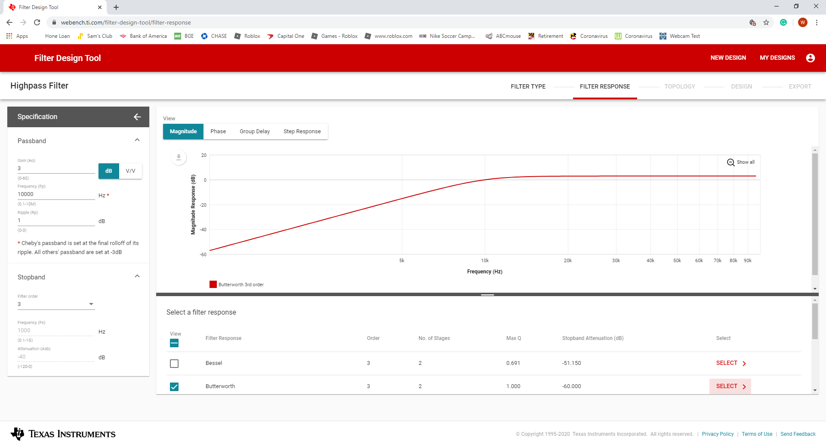
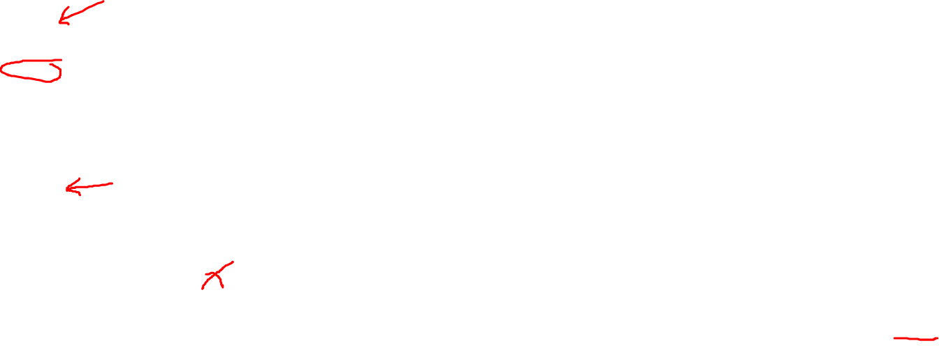

Slide 30
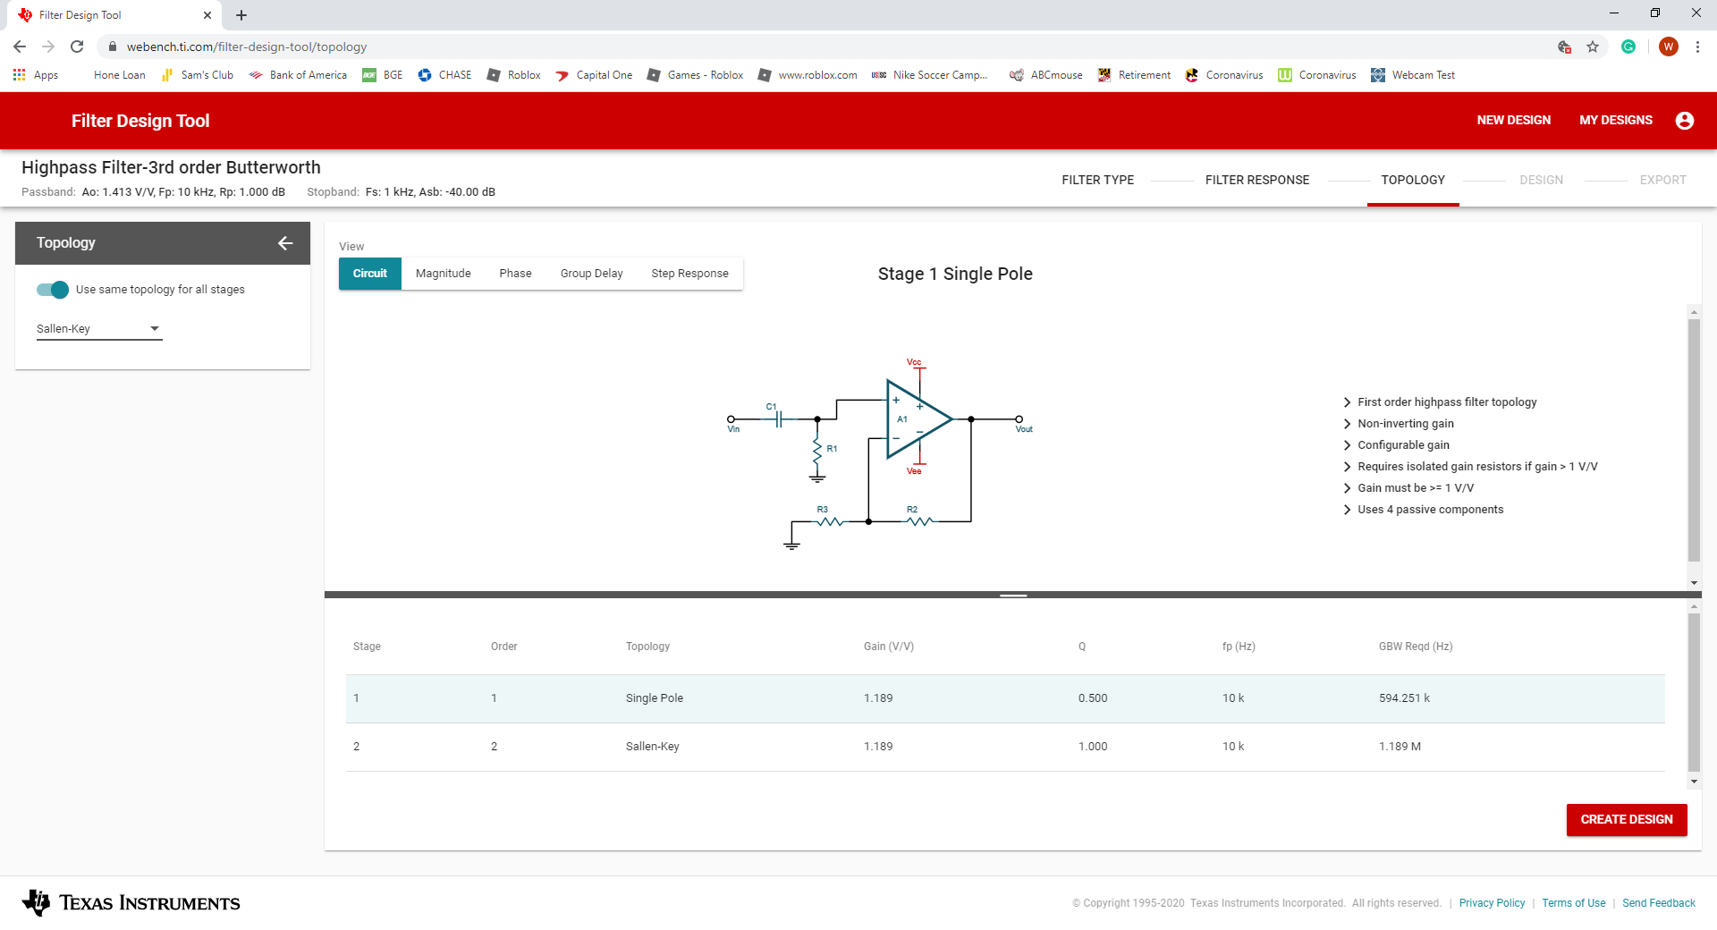
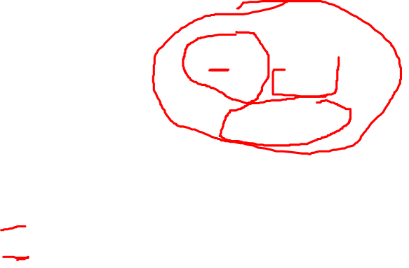

Slide 31



Slide 32



Slide 33



