Slide 1
Equivalent Transformations
Part 1: Series and Parallel Connections
ENEE 205

Slide 2
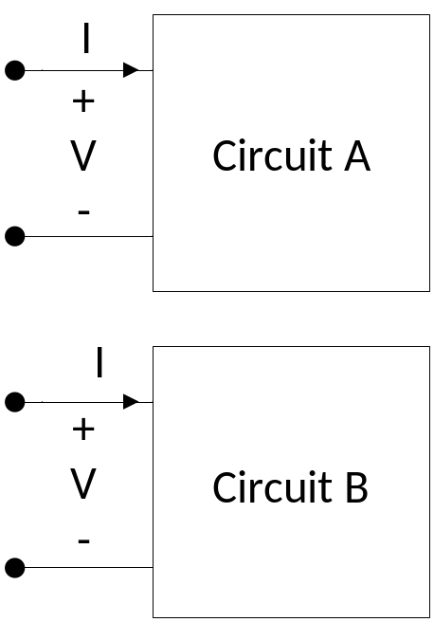
  EQUIVALENT TRANSFORMATIONS AND INPUT IMPEDANCE
Consider the two sub-circuits shown to the right. One circuit is said to be an equivalent transformation of the other if the relation between the voltage across the two terminals to the current entering the corresponding terminal is the same for the two sub-circuits.
Claim: If a sub-circuit is comprised of only linear, passive components, that sub-circuit can be replaced under sinusoidal steady-state conditions by a single passive branch.
If the replacement is done across the input terminals of the sub-circuit, the equivalent impedance is called the input impedance.

Slide 3
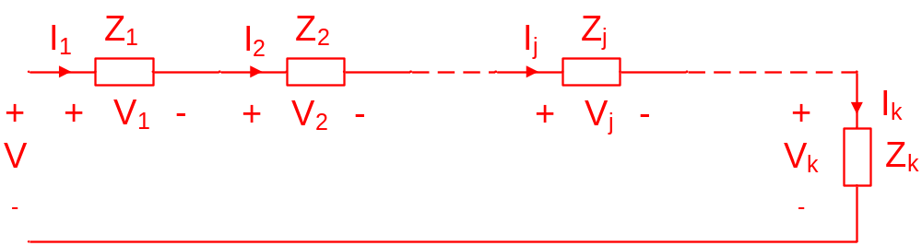
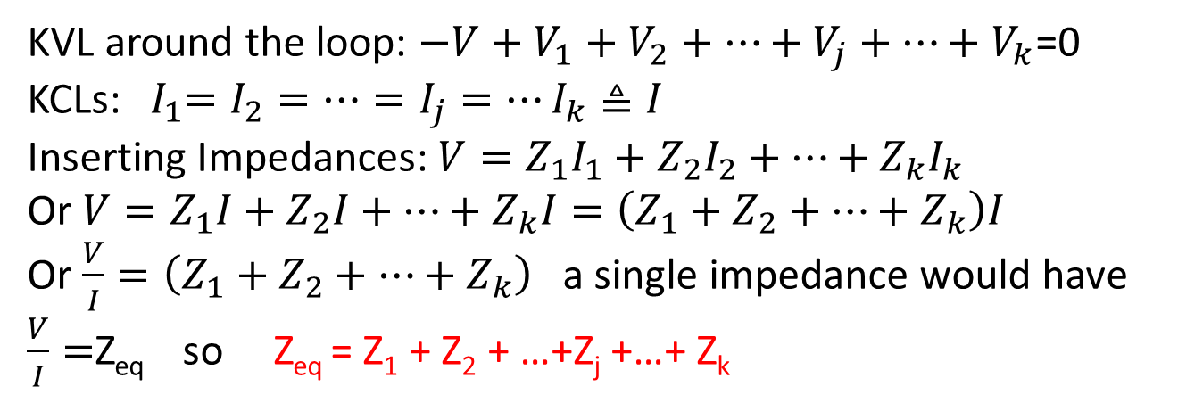
Series connections of passive components
k components are said to be connected in series if they are all connected together by trivial nodes. Thus, they always share the same current!
KVL around the loop: $−V+V_{1}+V_{2}+…+V_{j}+…+V_{k}$=0
KCLs:${ I}_{1}=I_{2}=…=I_{j}=…I_{k}≜I$
Inserting Impedances: $V=Z_{1}I_{1}+Z_{2}I_{2}+…+Z_{k}I_{k}$
Or $V=Z_{1}I+Z_{2}I+…+Z_{k}I=\left(Z_{1}+Z_{2}+…+Z_{k}\right)I$
Or $\frac{V}{I}=\left(Z_{1}+Z_{2}+…+Z_{k}\right)$ a single impedance would have
$\frac{V}{I}=$Z_{eq} so Z_{eq} = Z₁ + Z₂ + …+Z_{j} +…+ Z_{k}

Slide 4
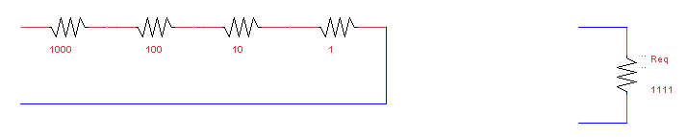
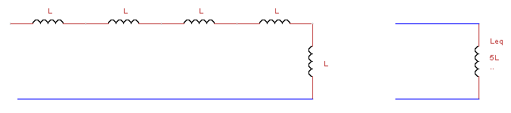

Series connection examples
Impedances add in series: Z_{eq} = Z₁ + Z₂ + Z₃ +…+ Z_{k}
Resistances add in series:
Inductances add in series
Voltage sources add in series

Slide 5
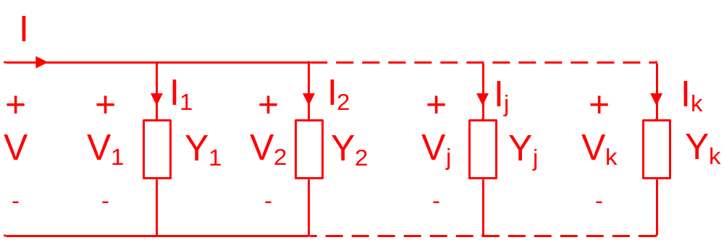
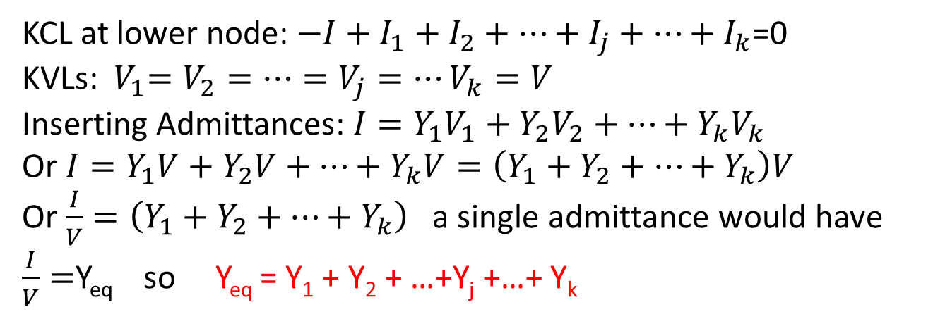
Parallel connections of passive components
k components are said to be connected in parallel if they are all connected together by trivial meshes. Thus, they always share the same voltage!
KCL at lower node: $−I+I_{1}+I_{2}+…+I_{j}+…+I_{k}$=0
KVLs:${ V}_{1}=V_{2}=…=V_{j}=…V_{k}=V$
Inserting Admittances: $I=Y_{1}V_{1}+Y_{2}V_{2}+…+Y_{k}V_{k}$
Or $I=Y_{1}V+Y_{2}V+…+Y_{k}V=\left(Y_{1}+Y_{2}+…+Y_{k}\right)V$
Or $\frac{I}{V}=\left(Y_{1}+Y_{2}+…+Y_{k}\right)$ a single admittance would have
$\frac{I}{V}=$Y_{eq} so Y_{eq} = Y₁ + Y₂ + …+Y_{j} +…+ Y_{k}

Slide 6
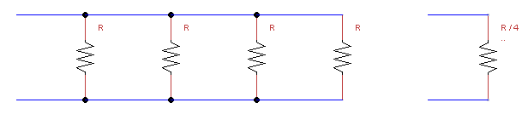
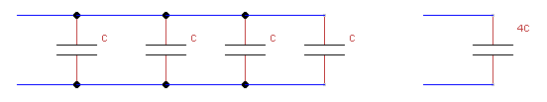
Parallel connection examples
Admittances add in parallel : Y_{eq} = Y₁ + Y₂ + Y₃ +…+ Y_{k}
Conductances add in parallel
Capacitances add in parallel
Current sources add in parallel
10 mA
10 mA
10 mA
Ieq=30 mA

Slide 7
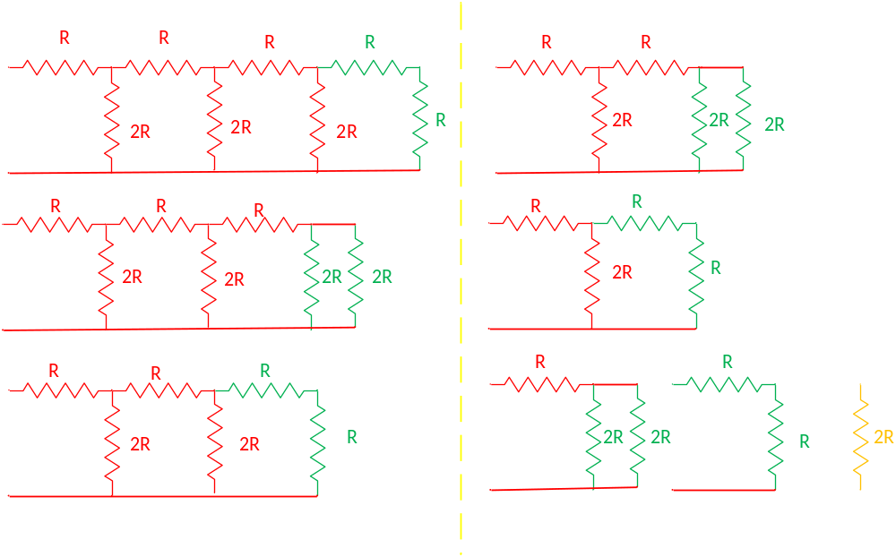
An R-2R ladder example

Slide 8
Equivalent Transformations
Part 2: Voltage and Current Divider Rules
ENEE 205

Slide 9
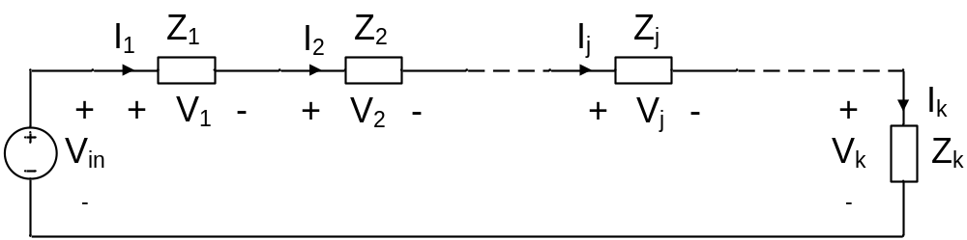
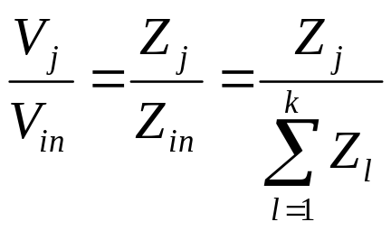
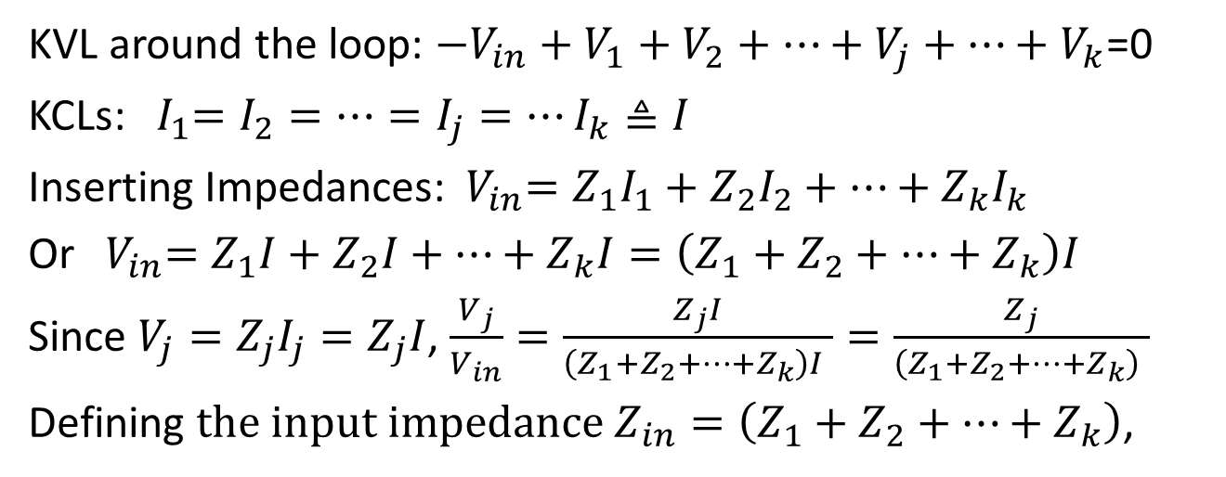
  VOLTAGE DIVIDER RULE
KVL around the loop: $−V_{in}+V_{1}+V_{2}+…+V_{j}+…+V_{k}$=0
KCLs:${ I}_{1}=I_{2}=…=I_{j}=…I_{k}≜I$
Inserting Impedances:${ V}_{in}=Z_{1}I_{1}+Z_{2}I_{2}+…+Z_{k}I_{k}$
Or${ V}_{in}=Z_{1}I+Z_{2}I+…+Z_{k}I=\left(Z_{1}+Z_{2}+…+Z_{k}\right)I$
Since $V_{j}=Z_{j}I_{j}=Z_{j}I$, $\frac{V_{j}}{V_{in}}=\frac{Z_{j}I}{\left(Z_{1}+Z_{2}+…+Z_{k}\right)I }=\frac{Z_{j}}{\left(Z_{1}+Z_{2}+…+Z_{k}\right) }$
Defining ${\text{the} \text{input} \text{impedance} Z}_{in}=\left(Z_{1}+Z_{2}+…+Z_{k}\right)$,

Slide 10
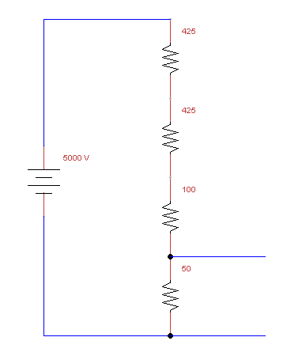
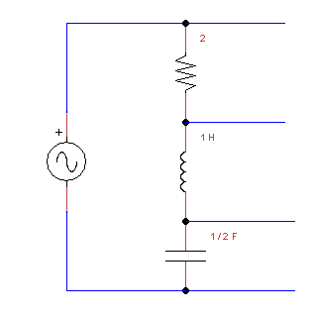

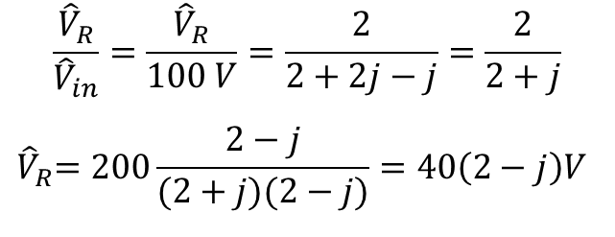

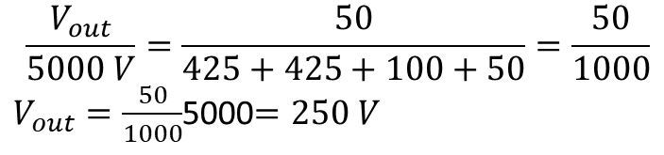



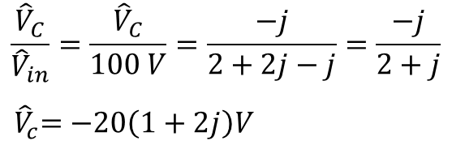
VOLTAGE DIVIDER RULE analysis
$$ω=2 Rad/s$$
$$+$$
$${\hat{V}}_{R}$$
-
2
V(t)=100cos(2t) V
$$+$$
$${\hat{V}}_{L}$$
-
$${\hat{V}}_{in}=100 V$$
2j
$$+$$
$${\hat{V}}_{c}$$
-
-j
+
Vout
-
$$\frac{{\hat{V}}_{R}}{{\hat{V}}_{in}}=\frac{{\hat{V}}_{R}}{100 V}=\frac{2}{2+2j−j}=\frac{2}{2+j}$$
$${ \hat{V}}_{R}=200\frac{2−j}{(2+j)(2−j)}=40\left(2−j\right)V$$
$$\frac{V_{out}}{5000 V}=\frac{50}{425+425+100+50}=\frac{50}{1000}$$
$V_{out}=\frac{50}{1000}$5000$=250 V$
$$\frac{{\hat{V}}_{C}}{{\hat{V}}_{in}}=\frac{{\hat{V}}_{C}}{100 V}=\frac{−j}{2+2j−j}=\frac{−j}{2+j}$$
$${ \hat{V}}_{c}=−20\left(1+2j\right)V$$

Slide 11
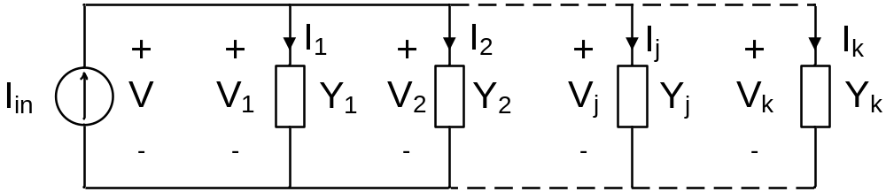
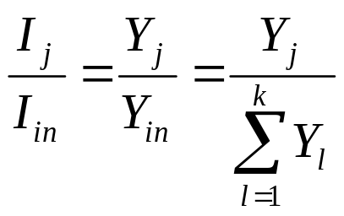
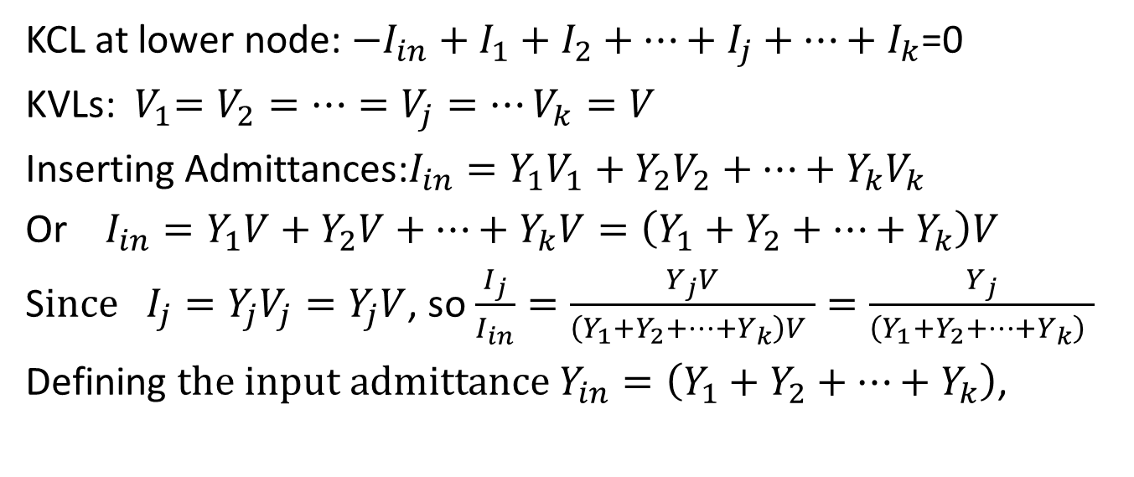
  CURRENT DIVIDER RULE
KCL at lower node: $−I_{in}+I_{1}+I_{2}+…+I_{j}+…+I_{k}$=0
KVLs:${ V}_{1}=V_{2}=…=V_{j}=…V_{k}=V$
Inserting Admittances:$I_{in}=Y_{1}V_{1}+Y_{2}V_{2}+…+Y_{k}V_{k}$
Or $I_{in}=Y_{1}V+Y_{2}V+…+Y_{k}V=\left(Y_{1}+Y_{2}+…+Y_{k}\right)V$
S$ince I_{j}=Y_{j}V_{j}=Y_{j}V$, so $\frac{I_{j}}{I_{in}}=\frac{Y_{j}V}{\left(Y_{1}+Y_{2}+…+Y_{k}\right)V }=\frac{Y_{j}}{\left(Y_{1}+Y_{2}+…+Y_{k}\right) }$
Defining ${\text{the} \text{input} \text{admitt}\text{ance} Y}_{in}=\left(Y_{1}+Y_{2}+…+Y_{k}\right)$,

Slide 12
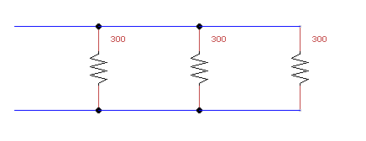
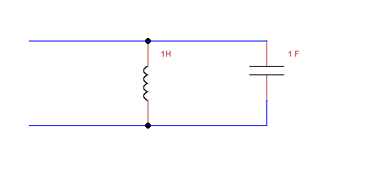

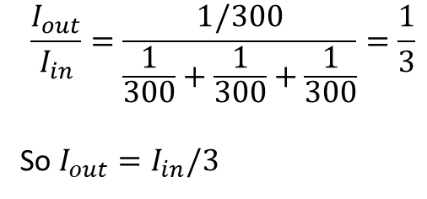
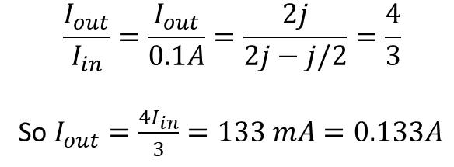
Current DIVIDER RULE analysis
I_{in}
I_{out}
$$\frac{I_{out}}{I_{in}}=\frac{1/300}{\frac{1}{300}+\frac{1}{300}+\frac{1}{300}}=\frac{1}{3}$$
So $I_{out}=I_{in}/3$
$$ω=2 Rad/s$$
-j/2
2j
i(t)=100cos(2t) mA
I_{in}
I_{out}
$$\frac{I_{out}}{I_{in}}=\frac{I_{out}}{0.1A}=\frac{2j}{2j−j/2}=\frac{4}{3}$$
So $I_{out}=\frac{{4I}_{in}}{3}=133 mA=0.133A$

Slide 13
Equivalent Transformations
Part 3: Voltage and Current Divider Designs
ENEE 205

Slide 14
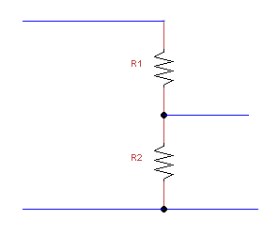
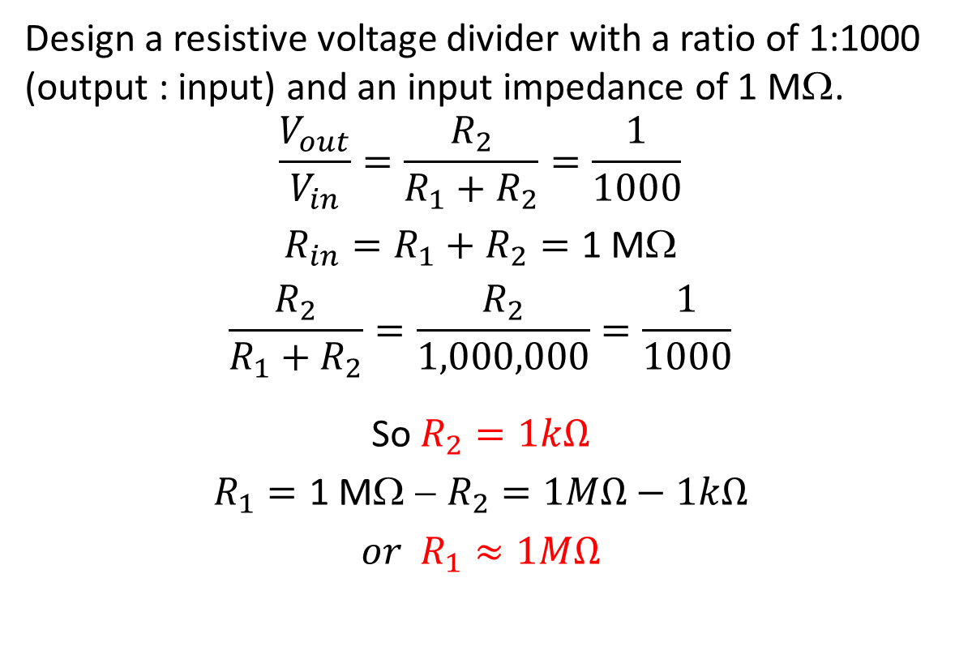
Voltage divider DESIGN example
Design a resistive voltage divider with a ratio of 1:1000 (output : input) and an input impedance of 1 MΩ.
$$\frac{V_{out}}{V_{in}}=\frac{R_{2}}{R_{1}+R_{2}}=\frac{1}{1000}$$
$$R_{in}=R_{1}+R_{2}=\text{1 }\text{M}\text{W}$$
$$\frac{R_{2}}{R_{1}+R_{2}}=\frac{R_{2}}{1,000,000}=\frac{1}{1000}$$
So $R_{2}=1kΩ$
$$R_{1}=\text{1 }\text{M}\text{W}\text{ − }R_{2}=1MΩ−1kΩ$$
$$or R_{1}≈1MΩ$$
+
V_{in}
-
+
V_{out}
-

Slide 15
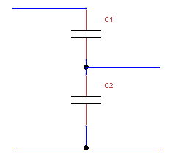
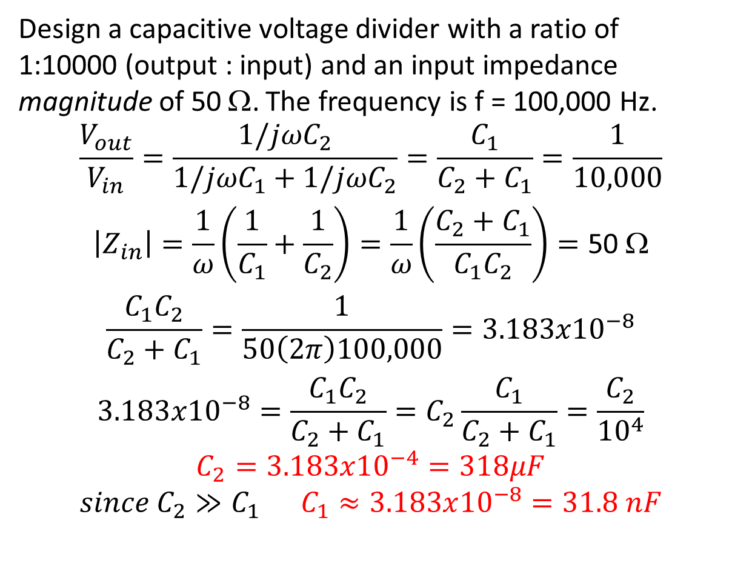
Voltage divider DESIGN example
Design a capacitive voltage divider with a ratio of 1:10000 (output : input) and an input impedance magnitude of 50 Ω. The frequency is f = 100,000 Hz.
$$\frac{V_{out}}{V_{in}}=\frac{{1/jωC}_{2}}{{1/jωC}_{1}+{1/jωC}_{2}}=\frac{C_{1}}{C_{2}+C_{1}}=\frac{1}{10,000}$$
$$\left|Z_{in}\right|=\frac{1}{ω}\left(\frac{1}{C_{1}}+\frac{1}{C_{2}}\right)=\frac{1}{ω}\left(\frac{C_{2}+C_{1}}{C_{1}C_{2}}\right)=\text{50 }\text{W}$$
$$\frac{{C_{1}C}_{2}}{C_{2}+C_{1}}=\frac{1}{50\left(2π\right)100,000}=3.183x{10}^{−8}$$
$$3.183x{10}^{−8}=\frac{{C_{1}C}_{2}}{C_{2}+C_{1}}=C_{2}\frac{C_{1}}{C_{2}+C_{1}}=\frac{C_{2}}{{10}^{4}}$$
$$C_{2}=3.183x{10}^{−4}=318μF$$
$$since C_{2}≫C_{1} C_{1}≈3.183x{10}^{−8}=31.8 nF$$
+
V_{in}
-
+
V_{out}
-

Slide 16
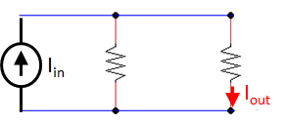
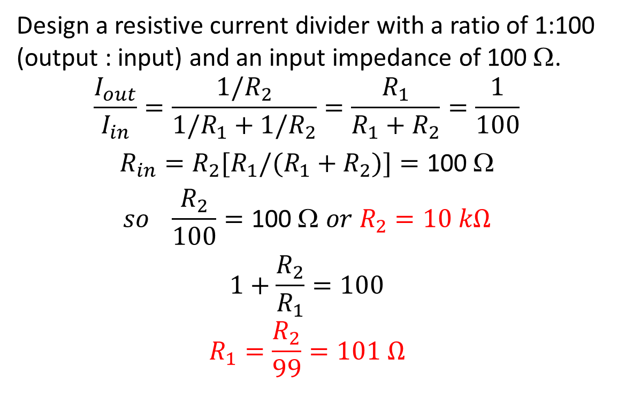
Current divider DESIGN example
Design a resistive current divider with a ratio of 1:100 (output : input) and an input impedance of 100 Ω.
$$\frac{I_{out}}{I_{in}}=\frac{{1/R}_{2}}{{1/R}_{1}+{1/R}_{2}}=\frac{R_{1}}{R_{1}+R_{2}}=\frac{1}{100}$$
$$R_{in}={R_{2}{[R}_{1}/(R}_{1}+R_{2})]=\text{100 }\text{W}$$
$$so \frac{R_{2}}{100}=\text{100 }\text{W} or R_{2}=10 kΩ$$
$$1+\frac{R_{2}}{R_{1}}=100$$
$$R_{1}=\frac{R_{2}}{99}=101 Ω$$
R₁
R₂

Slide 17
Equivalent Transformations
Part 4: The Superposition Principle
ENEE 205

Slide 18
  SUPERPOSITION PRINCIPLE
SUPERPOSITION ALGORITHM
Start with a circuit that contains M sources.
Divide the circuit into N sub-problems (often N=M, but that is not a necessary requirement.)
Make sure each source is “on” in exactly one of the sub-problems
Solve each sub-problem for the desired voltages and currents.
Find the desired voltages and currents for the original problem by summing up the respective voltages and currents for each of the sub-problems.
If you change reference directions for any of the sub-problems (not recommended, but possible), take that into account when summing the sub-problem results.
NOTE: Superposition works because all the SSS equations are linear (no diodes!)

Slide 19
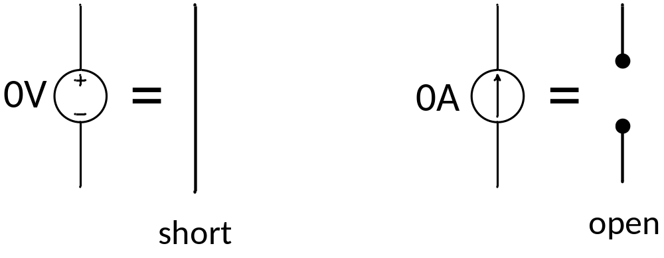
Setting a source to zero
This is only done with independent sources. Dependent sources and passive components remain the same in each sub-problem.

Slide 20
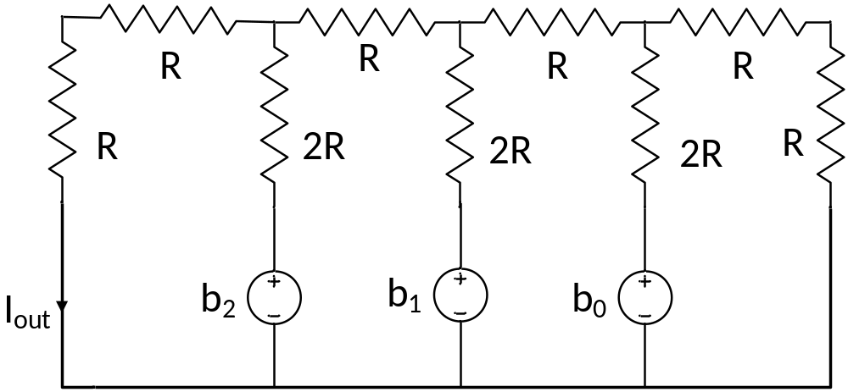
3 bit D-to-A converter example

Slide 21
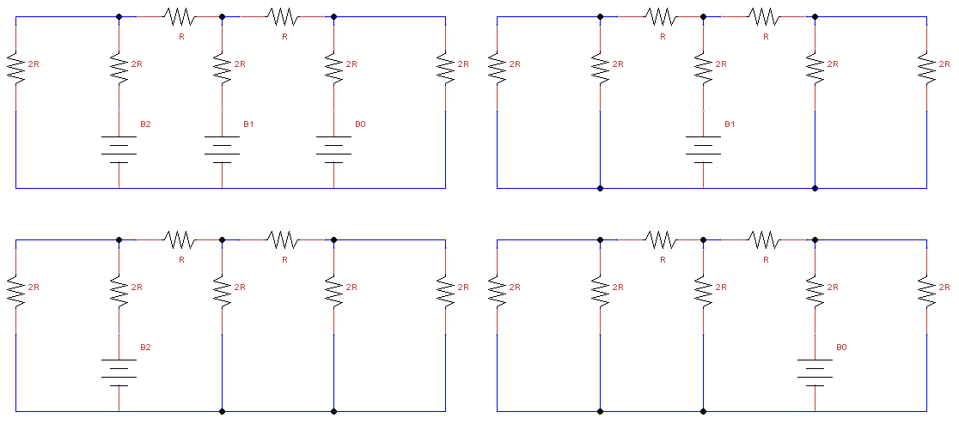

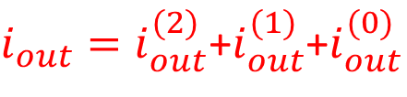



Original problem
Case (1)
$$i_{out}^{(1)}$$
$$i_{out}$$
$$i_{out}^{(2)}$$
$$i_{out}^{(0)}$$
Case (2)
Case (0)
$i_{out}=i_{out}^{(2)}$+$i_{out}^{(1)}$+$i_{out}^{(0)}$

Slide 22
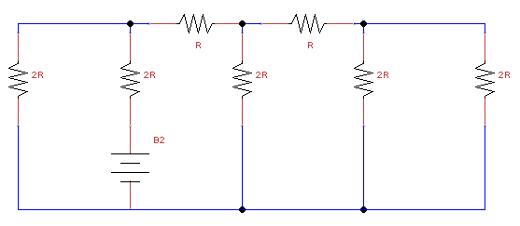
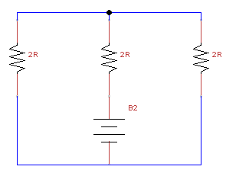


Case (2)
R-2R ladder, so the equivalent resistance is 2R
$$i_{out}^{(2)}$$
$$i_{out}^{(2)}$$

Slide 23
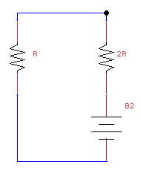


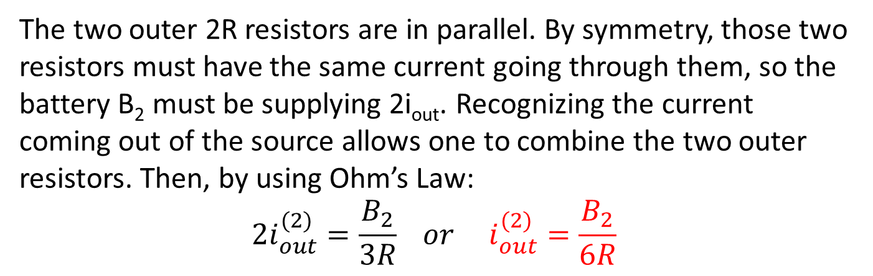


Case 2, continued
The two outer 2R resistors are in parallel. By symmetry, those two resistors must have the same current going through them, so the battery B₂ must be supplying 2i_{out}. Recognizing the current coming out of the source allows one to combine the two outer resistors. Then, by using Ohm’s Law:
$$2i_{out}^{(2)}=\frac{B_{2}}{3R} or{ i}_{out}^{(2)}=\frac{B_{2}}{6R}$$
$${2i}_{out}^{(2)}$$
$${2i}_{out}^{(2)}$$
$$i_{out}^{(2)}$$
$$i_{out}^{(2)}$$

Slide 24
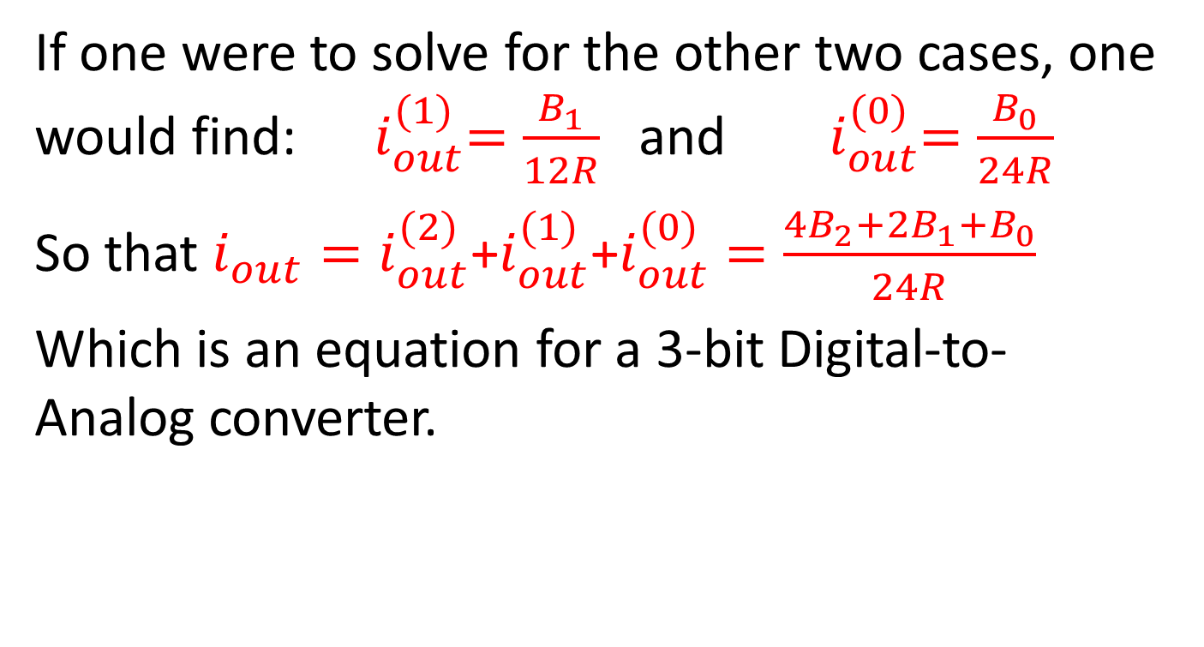
Case 2, the end
If one were to solve for the other two cases, one would find: ${ i}_{out}^{(1)}=\frac{B_{1}}{12R}$ and ${ i}_{out}^{(0)}=\frac{B_{0}}{24R}$
So that $i_{out}=i_{out}^{(2)}\text{+}i_{out}^{(1)}\text{+}i_{out}^{(0)}=\frac{{4B}_{2}+{2B}_{1}+B_{0}}{24R}$
Which is an equation for a 3-bit Digital-to-Analog converter.

Slide 25
Equivalent Transformations
Part 5: Op-amp Circuits with multiple input sources
ENEE 205

Slide 26
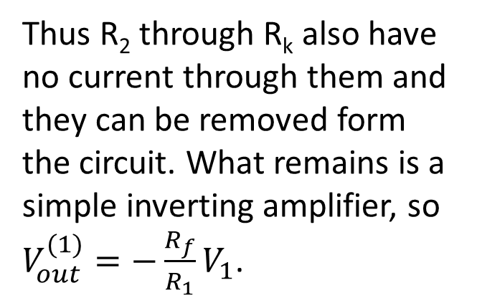
Inverting Summing Amplifier
R_{f}
One can use superposition here. Let V₁ be on and all other sources off. Then R₂ through R_{k} are connected between the inverting and non-inverting terminals, and so have no voltage across them.
-
+
R_{k}
R₂
R₁
+
V_{out}
-
…
+
V_{k}
-
+
V₂
-
+
V₁
-
R_{f}
Thus R₂ through R_{k} also have no current through them and they can be removed form the circuit. What remains is a simple inverting amplifier, so $V_{out}^{(1)}=−\frac{R_{f}}{R_{1}}V_{1}$.
-
+
R_{k}
R₂
R₁
+
V_{out}
-
…
+
V₁
-

Slide 27
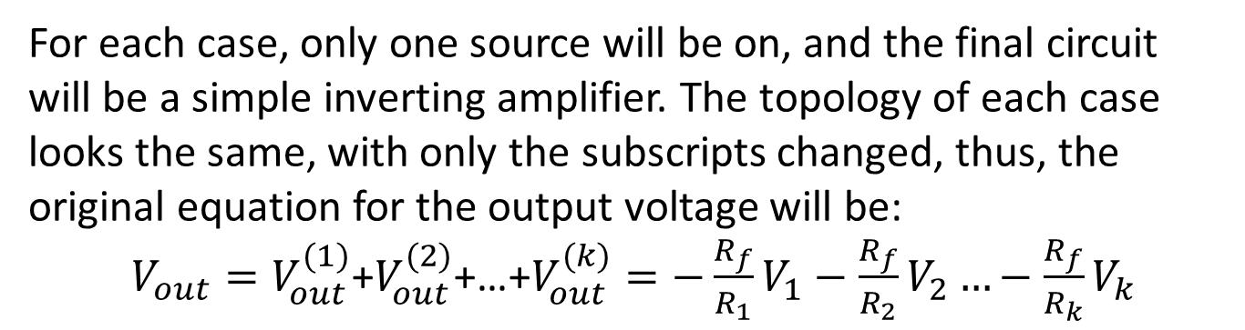
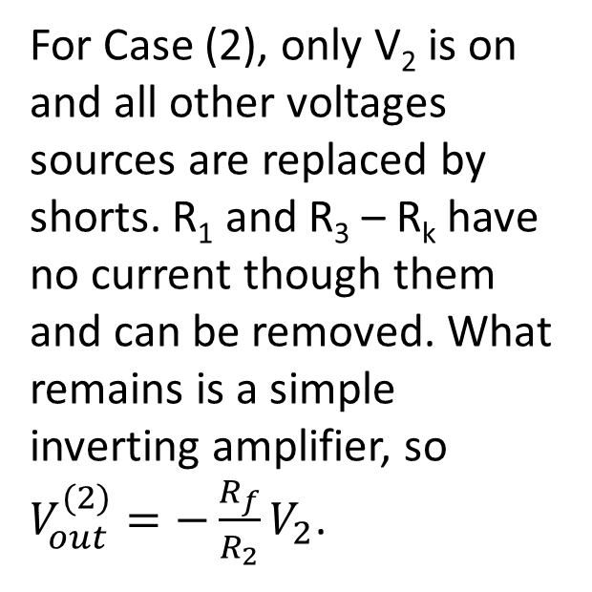
Inverting summing amplifier
R_{f}
For Case (2), only V₂ is on and all other voltages sources are replaced by shorts. R₁ and R₃ – R_{k} have no current though them and can be removed. What remains is a simple inverting amplifier, so $V_{out}^{(2)}=−\frac{R_{f}}{R_{2}}V_{2}$.
-
+
R_{k}
R₂
R₁
+
V_{out}
-
…
+
V₂
-
For each case, only one source will be on, and the final circuit will be a simple inverting amplifier. The topology of each case looks the same, with only the subscripts changed, thus, the original equation for the output voltage will be:
$V_{out}=V_{out}^{(1)}$+$V_{out}^{(2)}$+…+$V_{out}^{(k)}=−\frac{R_{f}}{R_{1}}V_{1}−\frac{R_{f}}{R_{2}}V_{2}…−\frac{R_{f}}{R_{k}}V_{k}$

Slide 28
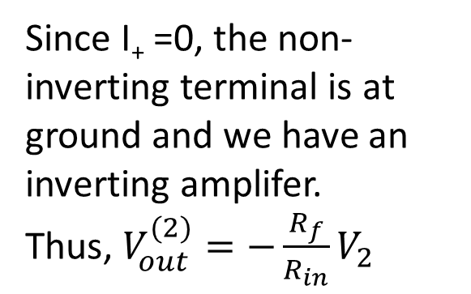
Subtraction Circuit
R_{f}
One can use superposition here. Let V₂ be on and V₁ be off. Then R_{f} and R_{in} are in parallel and can be replaced with an equivalent resistor.
-
+
R_{in}
+
V_{out}
-
R_{in}
R_{f}
+
V₂
-
+
V₁
-
R_{f}
Since I₊ =0, the non-inverting terminal is at ground and we have an inverting amplifer.
Thus, $V_{out}^{(2)}=−\frac{R_{f}}{R_{in}}V_{2}$
-
+
R_{in}
+
V_{out}
-
R_{in}
R_{f}
+
V₂
-
(2)

Slide 29
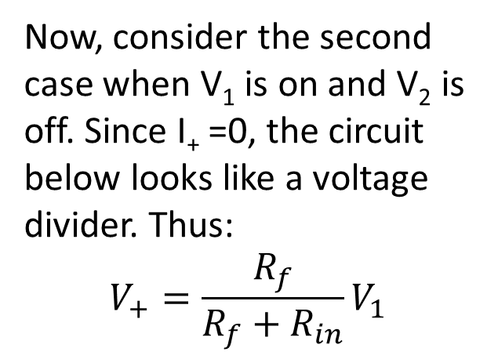
Subtraction circuit, continued
R_{f}
Now, consider the second case when V₁ is on and V₂ is off. Since I₊ =0, the circuit below looks like a voltage divider. Thus:
$$V_{+}=\frac{R_{f}}{R_{f}+R_{in}}V_{1}$$
-
+
R_{in}
+
V₊
-
+
V_{out}
-
R_{in}
R_{f}
+
V₁
-
(1)
+
V₊
-
R_{in}
R_{f}
+
V₁
-

Slide 30
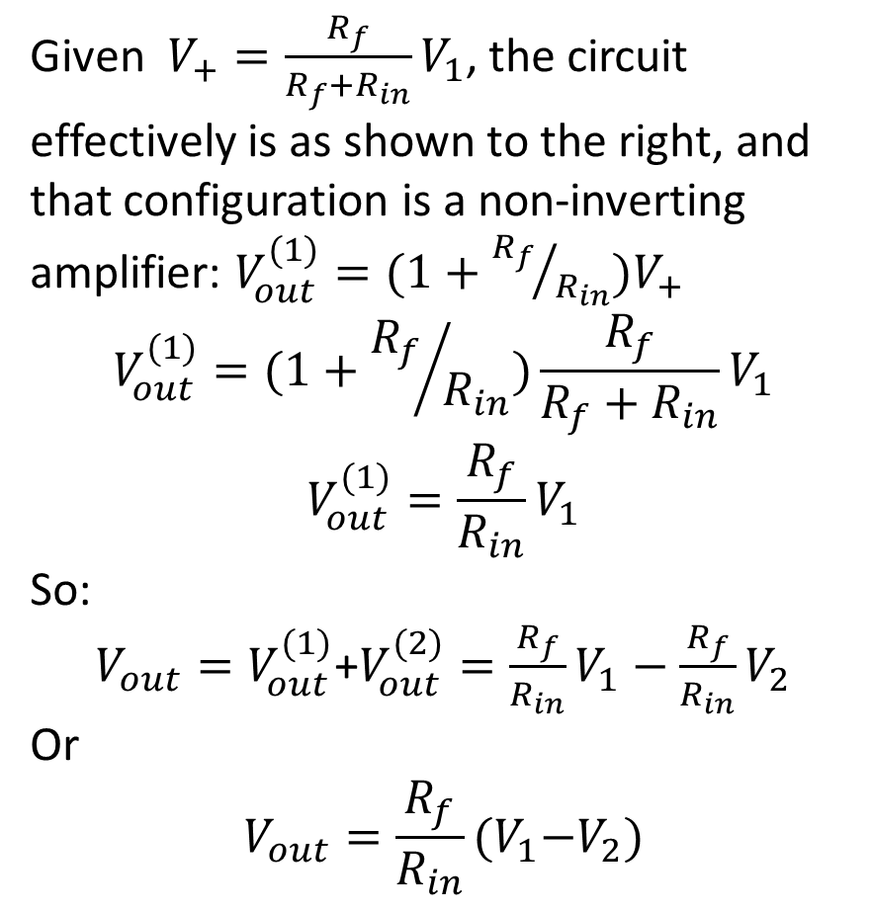
Subtraction circuit, the end
Given$V_{+}=\frac{R_{f}}{R_{f}+R_{in}}V_{1}$, the circuit effectively is as shown to the right, and that configuration is a non-inverting amplifier: $V_{out}^{(1)}=(1+{R_{f}}/{R_{in}})V_{+}$
$$V_{out}^{(1)}=(1+{R_{f}}/{R_{in}})\frac{R_{f}}{R_{f}+R_{in}}V_{1}$$
$$V_{out}^{(1)}=\frac{R_{f}}{R_{in}}V_{1}$$
So:
$V_{out}=V_{out}^{(1)}$+$V_{out}^{(2)}=\frac{R_{f}}{R_{in}}V_{1}−\frac{R_{f}}{R_{in}}V_{2}$
Or
$$V_{out}=\frac{R_{f}}{R_{in}}{(V}_{1}−V_{2})$$
R_{f}
-
+
R_{in}
+
V_{out}
-
(1)
+
V₊
-

