Slide 1
Malware
With material from Dave Levin, Michelle Mazurek, Vern Paxson, Dawn Song
http://betanews.com/wp-content/uploads/2013/06/stop-malware-600x521.jpg

Slide 2
Malware: Malicious code that runs on the victim’s system

Slide 3
How does malware run?
Attacks a user- or network-facing vulnerable service
e.g., using techniques from prior lectures
Backdoor: Added by a malicious developer
Social engineering: Trick user into running/clicking
Trojan horse: Offer a good service, add in the bad
Attacker with physical access installs & runs it

Slide 4
What does malware do?
Potentially nearly anything (subject to permissions)
Brag: “APRIL 1st HA HA HA HA YOU HAVE A VIRUS!”
Destroy: files, hardware
Crash the machine, e.g., by over-consuming resource
Fork bombing or “rabbits”: while(1) { fork();
Steal information (“exfiltrate”)
Launch external attacks: spam, click fraud, DoS
Ransomware: e.g., by encrypting files
Rootkits: Hide from user or software-based detection
Often by modifying the kernel
Man-in-the-middle attacks to sit between UI and reality

Slide 5
Viruses vs. worms
Virus: Run when user initiates something
Run program open attachment, boot machine
Typically infects by altering stored code
Self-propagating: Create new instance elsewhere
Worm: Runs while another program is running
No user intervention required
Typically infects by altering running code
Self-propagating: infect running code elsewhere
The line between these is thin and blurry; some are both

Slide 6
Technical challenges
Viruses: Detection
Antivirus software wants to detect
Virus writers want to avoid detection as long as possible
Evade human response
Worms: Spreading
The goal is to hit as many machines and as quickly as possible
Outpace human response

Slide 7
Viruses

Slide 8
Viruses
They are opportunistic: they will eventually be run due to user action
Two orthogonal aspects define a virus:
How does it propagate?
What else does it do (what is the “payload”)?
General infection strategy:
Alter some existing code to include the virus
Share it, expect users to (unwittingly, possibly automatically) re-share
Viruses have been around since at least the 70s

Slide 9
Classified by what they infect
Document viruses
Implemented within a formatted document (Word, PDF, etc.)
Enabled by macros, javascript
(Why you shouldn’t open random attachments)
Boot sector viruses
Boot sector: small disk partition at fixed location; loaded by firmware at boot
What’s supposed to happen: this code loads the OS
Similar: AutoRun on music/video disks
(Why you shouldn’t plug random USB drives into your computer)
Etc.

Slide 10
Viruses have resulted in a technological arms race
The key is evasion
Mechanisms for evasive propagation
Mechanisms for detection and prevention
Want to be able to claim wide coverage for a long time
Want to be able to claim the ability to detect many viruses

Slide 11
How viruses propagate
Opportunity to run: attach to something likely
autorun.exe on storage devices
Email attachments
Opportunity to infect:
See a USB drive: overwrite autorun.exe
User is sending an email: alter the attachment
Proactively create emails (“I Love You”)

Slide 12
Detecting viruses: Signatures
Identify bytes corresponding to known virus
Install recognizer to check all files
In practice, requires fast scanning
Drives multi-million$ antivirus market
Marketing via # signatures recognized
Is this a useful metric?

Slide 13
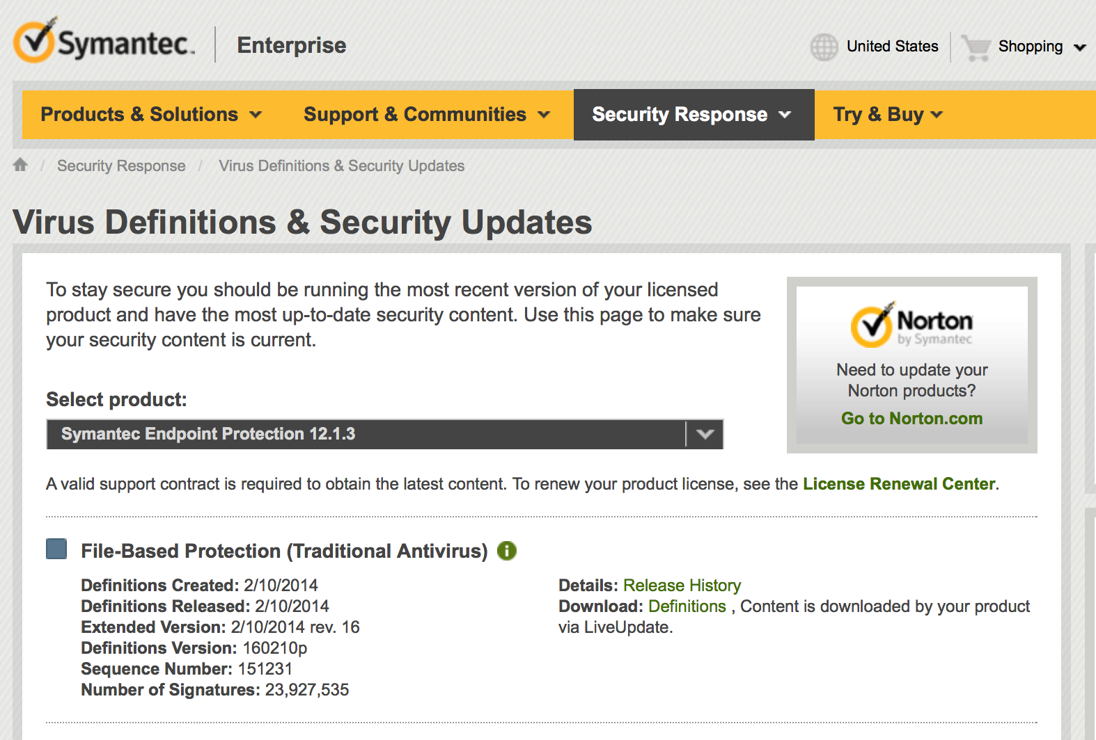
Um.. thanks?

Slide 14
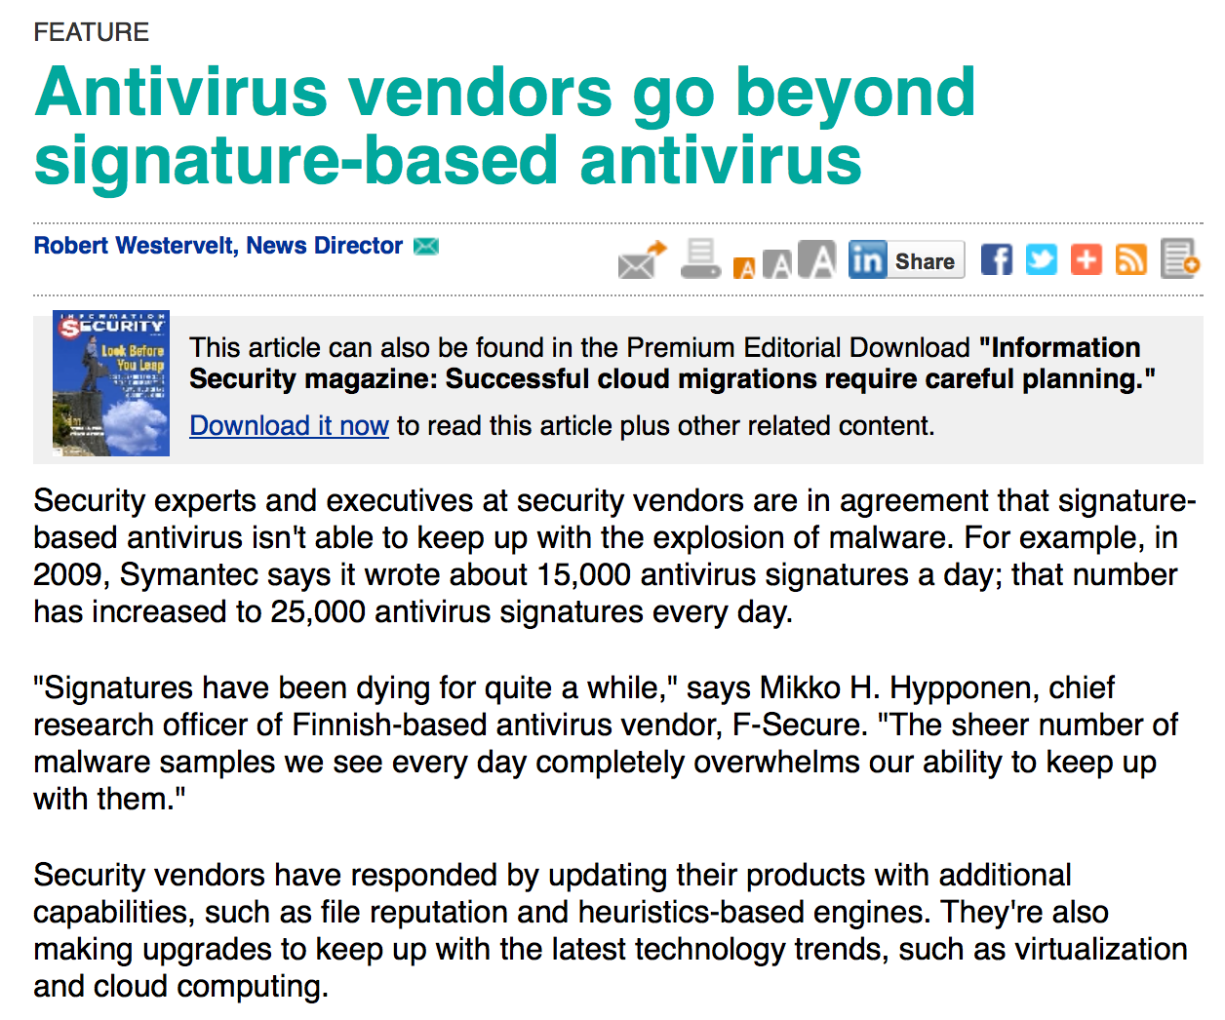

Slide 15
You are a virus writer
Your goal is for your virus to spread far and wide
How do you avoid detection by antivirus software that uses signatures?
Make signature harder to find

Slide 16
How viruses infect other programs
Entry
point
Original program
Entry
point
Virus
Original program
“Appending”
jmp
Entry
point
Original program
“Surrounding”
jmp
Confuse scanners
Entry
point
Original program
Overwrite uncommonly used parts of the program
etc.

Slide 17
You are a virus writer
Your goal is for your virus to spread far and wide
How do you avoid detection by antivirus software that uses signatures?
Make signature harder to find
Change code to prevent defining a signature
Mechanize code changes:
Goal: every time you inject your code, it looks different

Slide 18
Polymorphic and metamorphic viruses

Slide 19
Polymorphic using encryption
Entry
point
Virus
Original program
Take over the entry point
Virus
Encrypted virus code
Decrypter
Key
jmp
Virus code
Decrypter
Key

Slide 20
Making it automatic
Encrypted virus code
Decrypter
Key
jmp
Virus code
Decrypter
Key
Encryptor
When used properly,
encryption will yield
a different, random
output upon each
invocation
Encrypted virus code
(same code, but each time
you encrypt it looks different)
Decrypter
Key 2

Slide 21
Polymorphic viruses: Arms race
Now you are the antivirus writer: how do you detect?
Idea #1: Narrow signature to catch the decrypter
Often very small: can result in many false positives
Attacker can spread this small code around and jmp
Idea #2: Execute or statically analyze the suspect code to see if it decrypts.
How do you distinguish from common “packers” which do something similar (decompression)?
How long do you execute the code??
Now you are the virus writer again: how do you evade?

Slide 22
Polymorphic countermeasures
Change the decrypter
Oligomorphic viruses: assemble decrypter from several interchangeable alternative pieces
True polymorphic viruses: can generate an endless number of decrypters
Different encryption methods
Random generation of confounds
Downside: inefficient

Slide 23
Metamorphic viruses
Every time the virus propagates, generate a semantically different version of the code
Higher-level semantics remain the same
But the way it does it differs
Different machine code instructions
Different algorithms to achieve the same thing
Different use of registers
Different constants….
How would you do this?
Include a code rewriter with your virus
Add a bunch of complex code to throw others off (then just never run it)

Slide 25
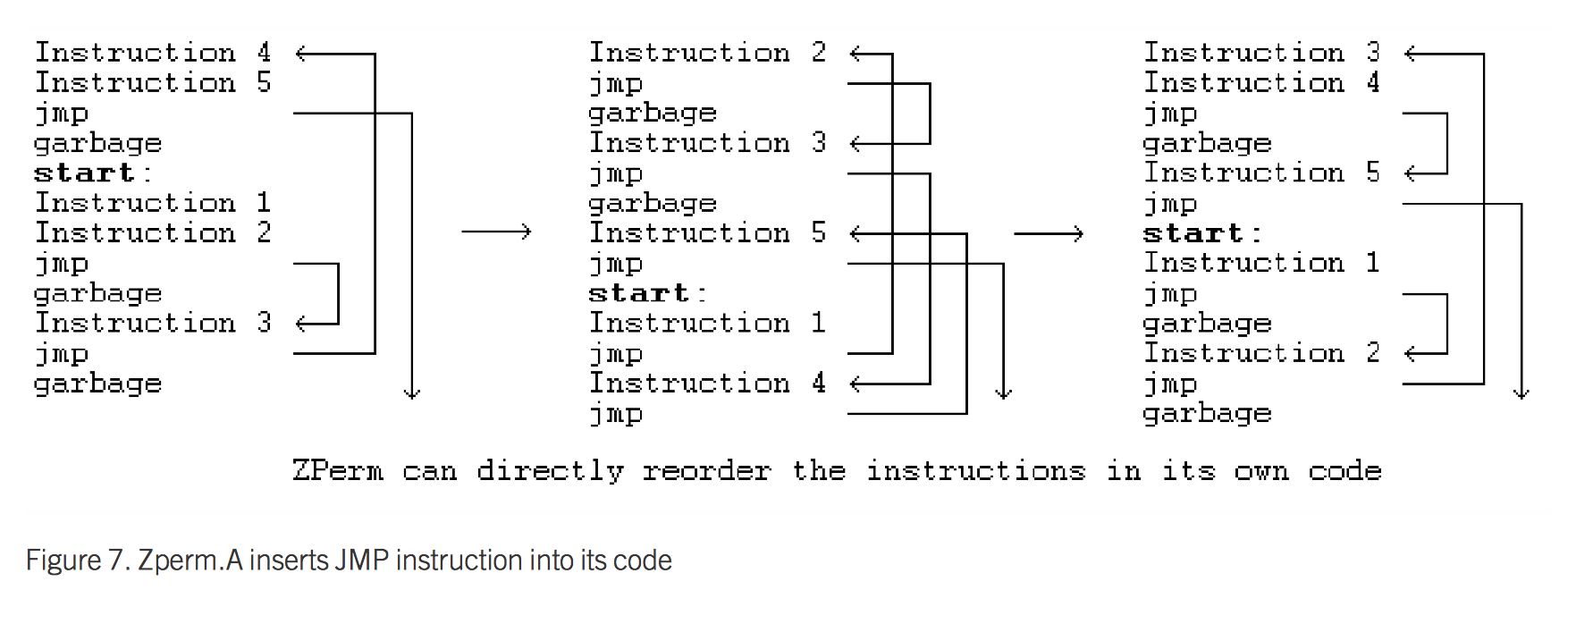

Slide 26
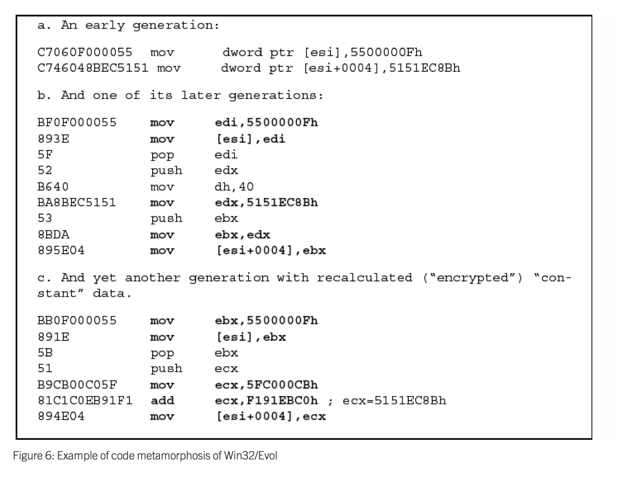

Slide 27
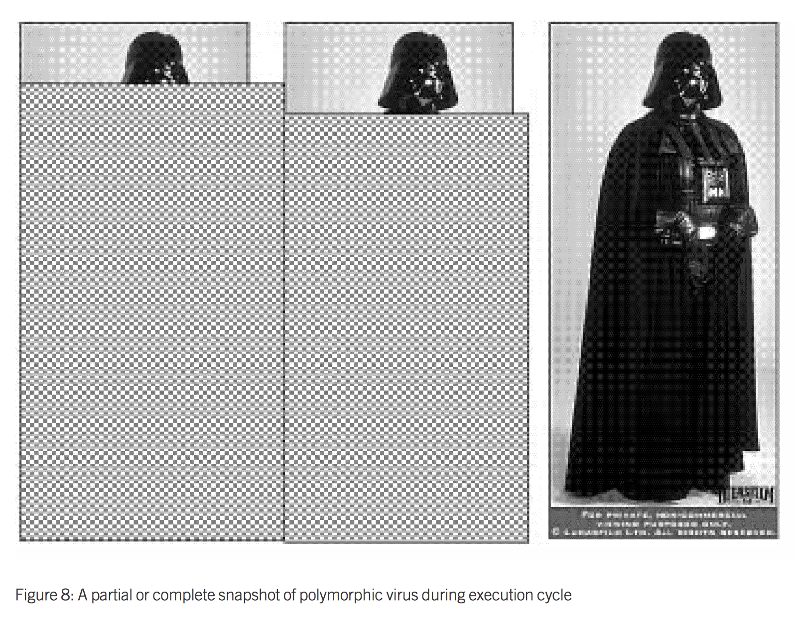
Polymorphic
When can AV software successfully scan?

Slide 28
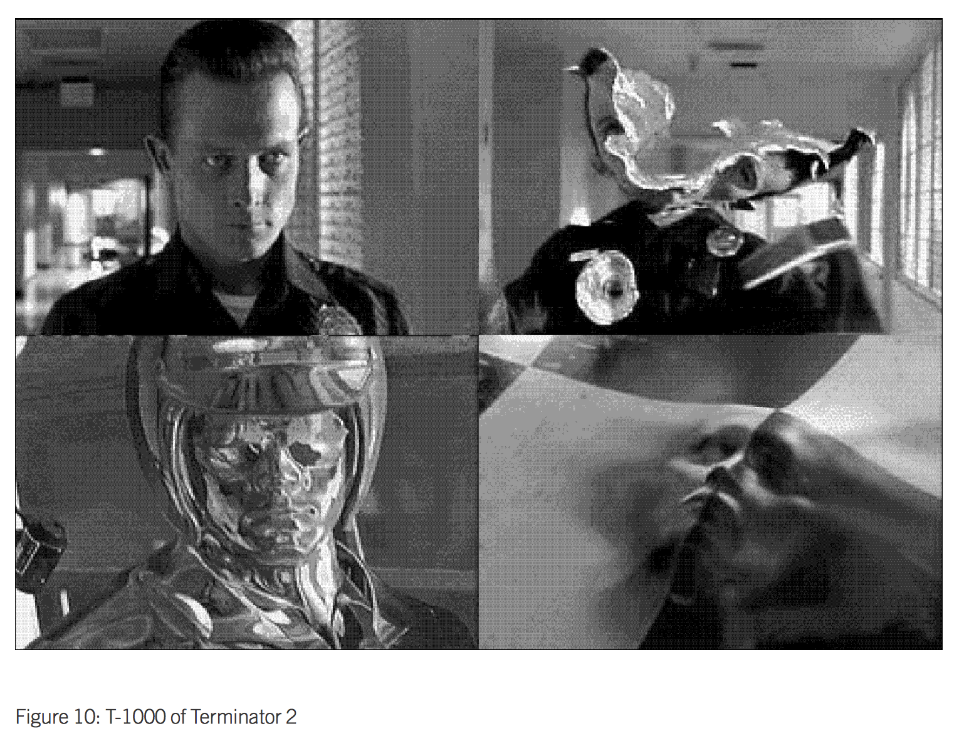
Metamorphic
When can AV software successfully scan?

Slide 29
Detecting metamorphic viruses?

Slide 30
Scanning isn’t enough
Need to analyze execution behavior
Two broad stages in practice (both take place in a safe environment, like gdb or a virtual machine)
AV company analyzes new virus to find behavioral signature
AV system at end host analyzes suspect code to see if it matches the signature

Slide 31
Detecting metamorphic viruses
Countermeasures
Change slowly (hard to observe pattern)
Detect if you are in a safe execution environment (e.g., gdb) and act differently
Counter-countermeasures
Detect detection and skip those parts
Counter-counter-counter…. Arms race
Attackers have the upper hand:
AV systems hand out signature oracles

Slide 32
Crypting services
Many different vendors
CoDe
code
code
AV
AV
Crypting service
AV
AV
“FUD” code
AV
AV
detected
clear
Iteratively obfuscate the
code (encrypt + jmp + …)
Until the obfuscated code is “fully undetectable”

Slide 33
So how much malware is out there?
Polymorphic and metamorphic viruses can make it easy to miscount viruses
Take numbers with a grain of salt
Large numbers are in the AV vendors’ best interest
Previously, most malware was showy
Now primary goal is frequently to not get noticed

Slide 34
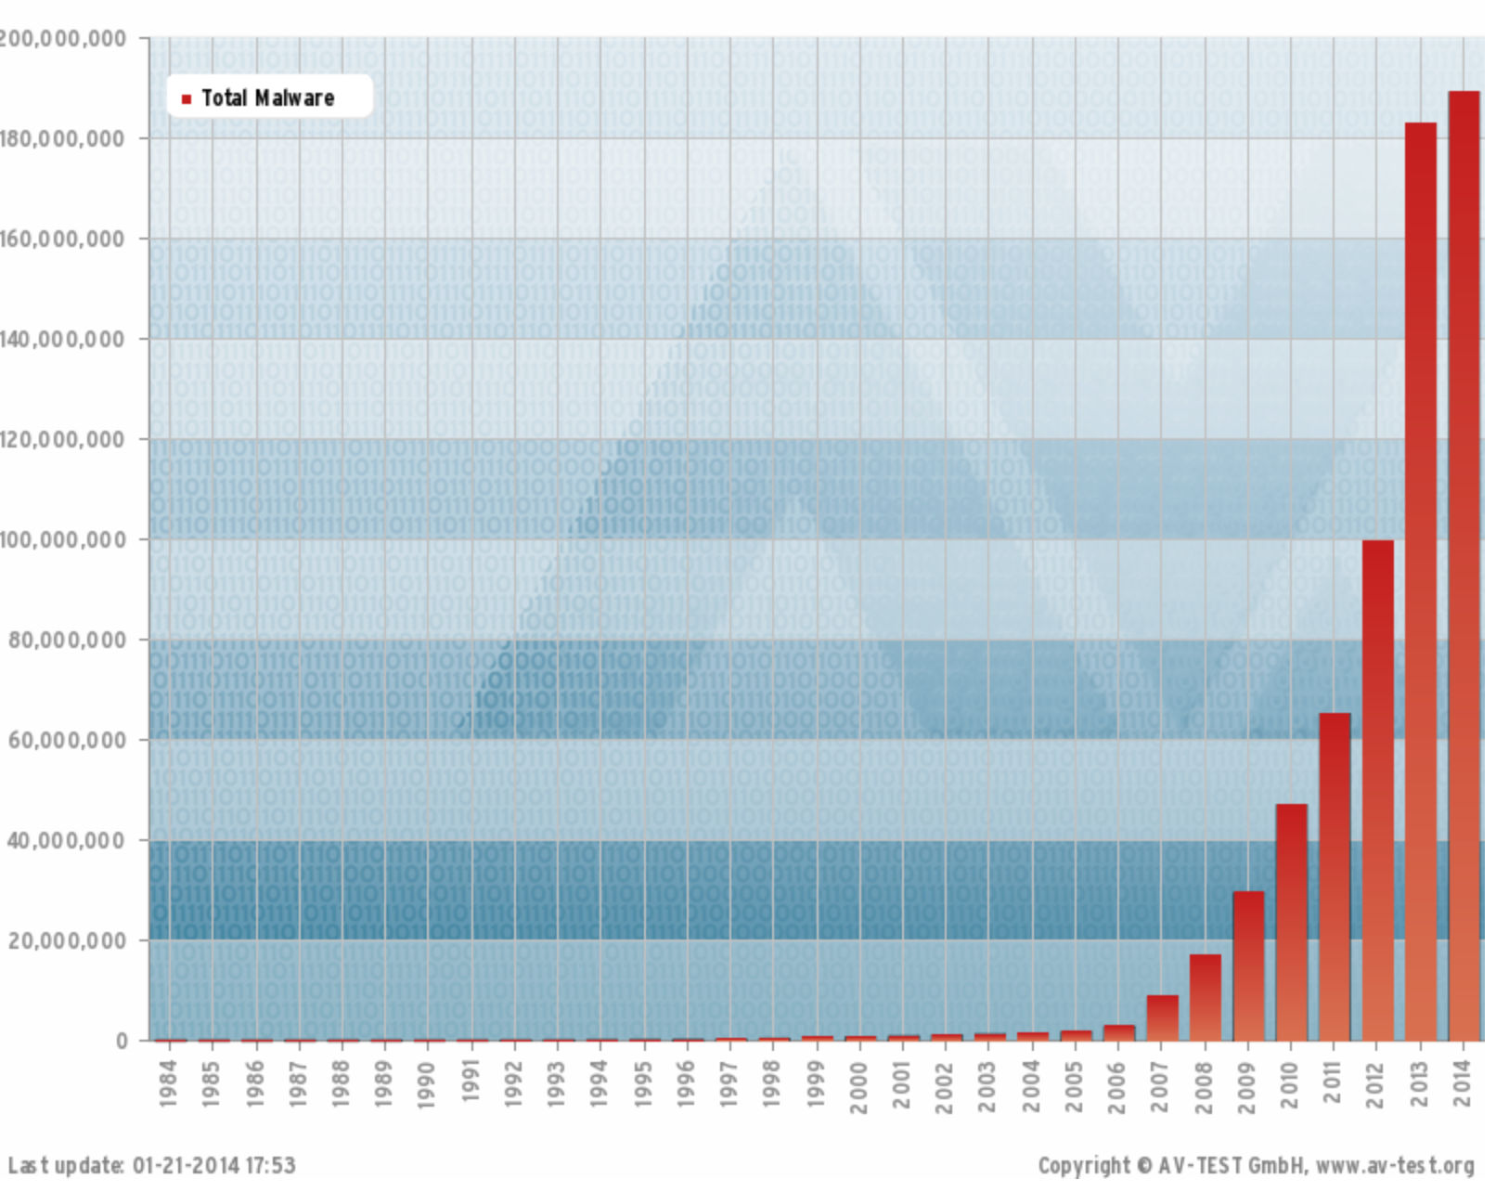

Slide 35
How do we clean up an infection?
Depends what the virus did, but..
May require restoring / repairing files
A service that antivirus companies sell
What if the virus ran as root?
May need to rebuild the entire system
So what, just recompile it?
What if the malware left a backdoor in your compiler?
Compile the malware back into the compiler
May need to use original media and data backups

Slide 36
Malware summary
Technological arms race between those who wish to detect and those who wish to evade detection
Started off innocuously
Became professional, commoditized
Economics, cyber warfare, corporate espionage
Advanced detection: based on behavior, anomalies
Must react to attacker responses

