Slide 1
Memory safety, continued
With material from Mike Hicks, Dave Levin and Michelle Mazurek
http://images.myhardhatstickers.com/img/lg/H/Everybody-Safety-Hard-Hat-Label-HH-0115.gif

Slide 2
Today’s agenda
Finishing up buffer overflows
gdb tutorial
Other memory exploits

Slide 3
Review of Stack During Execution
int main()
{
...
func("Hey", 10, -3);
...
}
0xffffffff
…
loc2
loc1
%ebp
???
%eip
arg1
arg2
arg3
caller’s data
Stack frame
for func
%ebp
%ebp

Slide 4
Stack and functions: Summary
Recall
Calling function:
Push arguments onto the stack (in reverse)
Push the return address, i.e., the address of the instruction you want run after control returns to you
Jump to the function’s address
Called function:
Push the old frame pointer onto the stack: %ebp
Set frame pointer to where the end of the stack is right now: %ebp = %esp
Push local variables onto the stack
Returning from function:
Reset the previous stack frame: %esp = %ebp, pop %ebp
Jump back to return address: pop %eip

Slide 5
Buffer overflows from 10,000 ft
Buffer =
Contiguous memory associated with a variable or field
Common in C
All strings are (NUL-terminated) arrays of char’s
Overflow =
Put more into the buffer than it can hold
Where does the overflowing data go?
Well, now that you are experts in memory layouts…
Notes:
or THINK PAIR SHARE here

Slide 6
Benign outcome
void func(char *arg1)
{
char buffer[4];
strcpy(buffer, arg1);
...
}
int main()
{
char *mystr = “AuthMe!”;
func(mystr);
...
}
Upon return, sets %ebp to 0x0021654d
M
e
!
\0
00 00 00 00
%ebp
A u t h
4d 65 21 00
%eip
&arg1
buffer
SEGFAULT (0x00216551)
(during subsequent access)

Slide 7
Benign outcome
void func(char *arg1)
{
char buffer[4];
strcpy(buffer, arg1);
...
}
int main()
{
char *mystr = "AuthMe!";
func(mystr);
...
}
Upon return, sets %ebp to 0x0021654d
M
e
!
\0
00 00 00 00
%ebp
A u t h
4d 65 21 00
%eip
&arg1
buffer
SEGFAULT (0x00216551)
Notes:
SEGFAULT on subsequent access

Slide 8
Security-relevant outcome
void func(char *arg1)
{
int authenticated = 0;
char buffer[4];
strcpy(buffer, arg1);
if(authenticated) { ...
}
int main()
{
char *mystr = "AuthMe!";
func(mystr);
...
}
Code still runs; user now ‘authenticated’
M
e
!
\0
00 00 00 00
4d 65 21 00
A u t h
00 00 00 00
%ebp
%eip
&arg1
buffer
authenticated

Slide 9
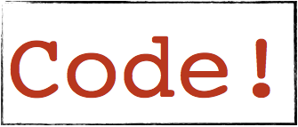
Could it be worse?
void func(char *arg1)
{
char buffer[4];
strcpy(buffer, arg1);
...
}
All ours!
00 00 00 00
%ebp
%eip
&mystr
buffer
strcpy will let you write as much as you want (til a ‘\0’)
What could you write to memory to wreak havoc?

Slide 10
Aside: User-supplied strings
These examples provide their own strings
In reality strings come from users in myriad ways
Text input, packets, environment variables, file input…
Validating assumptions about user input is critical!
We will discuss it later, and throughout the course

Slide 11
Code Injection
http://images.clipartpanda.com/injection-clipart-color-medical-injection-21941863.jpg

Slide 12
Code Injection: Main idea
void func(char *arg1)
{
char buffer[4];
sprintf(buffer, arg1);
...
}
%eip
Text
...
00 00 00 00
%ebp
%eip
&arg1
...
Haxx0r c0d3
buffer
(1) Load my own code into memory
(2) Somehow get %eip to point to it

Slide 13
This is nontrivial
Pulling off this attack requires getting a few things really right (and some things sorta right)
Think about what is tricky about the attack
The key to defending it will be to make the hard parts really hard

Slide 14
Challenge 1
Loading code into memory
It must be the machine code instructions (i.e., already compiled and ready to run)
We have to be careful in how we construct it:
It can’t contain any all-zero bytes
Otherwise, sprintf / gets / scanf / … will stop copying
It can’t use the loader (we’re injecting)
How to find addresses we need?
Notes:
zero bytes is an example; may vary depending on how you get into buffer

Slide 15
What code to run?
One goal: general-purpose shell
Command-line prompt that gives attacker general access to the system
The code to launch a shell is called shellcode
Other stuff you could do?
Notes:
most versatile, other things also potentially useful (overwrite important values? copy some file somewhere? etc.)

Slide 16
Shellcode
#include <stdio.h>
int main( ) {
char *name[2];
name[0] = "/bin/sh";
name[1] = NULL;
execve(name[0], name, NULL);
}
argv
envp
filename
xorl %eax, %eax
pushl %eax
pushl $0x68732f2f
pushl $0x6e69622f
movl %esp,%ebx
pushl %eax
...
"\x31\xc0"
"\x50"
"\x68" "//sh"
"\x68" "/bin"
"\x89\xe3"
"\x50"
...
(Part of)
your
input
xor to avoid zero byte
Assembly
Machine code
Notes:
note the xor to avoid including a 00 byte

Slide 17
Challenge 2
Getting injected code to run
We have code somewhere in memory
We don’t know precisely where
We need to move %eip to point at it
%eip
Text
...
00 00 00 00
%ebp
%eip
&arg1
...
\x0f \x3c \x2f ...
buffer
Notes:
any ideas of how we could do that? (if you’ve seen this before don’t give it away)

Slide 18
Stack and functions: Summary
Recall
Calling function:
Push arguments onto the stack (in reverse)
Push the return address, i.e., the address of the instruction you want run after control returns to you
Jump to the function’s address
Called function:
Push the old frame pointer onto the stack: %ebp
Set frame pointer to where the end of the stack is right now: %ebp = %esp
Push local variables onto the stack
Returning from function:
Reset the previous stack frame: %esp = %ebp, pop %ebp
Jump back to return address: pop %eip

Slide 19
Hijacking the saved %eip
%eip
%ebp
Text
00 00 00 00
%ebp
%eip
...
0xbff
&arg1
..
\x0f \x3c \x2f ...
buffer
0xbff
But how do we know the address?

Slide 20
Hijacking the saved %eip
What if we are wrong?
%eip
%ebp
Text
00 00 00 00
%ebp
%eip
...
0xbff
...
0xbdf
&arg1
\x0f \x3c \x2f ...
buffer
0xbff
This is most likely data,
so the CPU will panic
(Invalid Instruction)

Slide 21
Challenge 3
Finding the return address
We need an address to point to: Where is our shellcode?
One approach: try a lot of different values!
Worst case scenario: it’s a 32 (or 64) bit memory space, which means 2³² (2⁶⁴) possible answers
Without address randomization (discussed later):
Stack always starts from the same fixed address
Stack will grow, but usually it doesn’t grow very deeply (unless the code is heavily recursive)

Slide 22
Improving our chances: nop sleds
nop is a single-byte no-op instruction
(just moves to the next instruction)
Jumping anywhere
here will work
%eip
%ebp
Text
00 00 00 00
%ebp
%eip
0xbff
0xbdf
&arg1
nop nop nop …
...
…
\x0f \x3c \x2f ...
buffer
0xbff
Now we improve our chances of guessing by a factor of #nops

Slide 23
Putting it all together
Fill in the space between the target buffer and the %eip to overwrite
padding
good guess
%eip
Text
00 00 00 00
%ebp
%eip
&arg1
nop nop nop …
...
0xbdf
…
\x0f \x3c \x2f ...
buffer
nop sled
malicious code
Notes:
building exploit, back to front
amount of padding must be exactly right; depends on local vars and stack layout

Slide 24
gdb tutorial
LIVE DEMO
http://original.livestream.com/filestore/logos/9aa0a959-2380-7191-77e8-06fdaf

Slide 25
Some gdb commands
Show info about the current frame (prev. frame, locals/args, %ebp/%eip)
i f
Show info about registers (%eip, %ebp, %esp, etc.)
i r
Examine <n> bytes of memory starting at address <addr>
x/<n> <addr>
b <function> s
Set a breakpoint at <function> step through execution (into calls)

Slide 26
run, breakpoint, step, next, continue
stepi, nexti
print, x
backtrace, info [frame, registers, args, locals]
list, disas

Slide 27
Other memory exploits

Slide 28
Other attacks
The code injection attack we have just considered is called stack smashing
Constitutes an integrity violation, and arguably a violation of availability
Other attacks exploit bugs with buffers, too

Slide 29
Heap overflow
Stack smashing overflows a stack-allocated buffer
You can also overflow a buffer allocated by malloc, which resides on the heap
What data gets overwritten?

Slide 30
Heap overflow
typedef struct _vulnerable_struct {
char buff[MAX_LEN];
int (*cmp)(char*,char*);
} vulnerable;
int foo(vulnerable* s, char* one, char* two)
{
strcpy( s->buff, one );
strcat( s->buff, two );
return s->cmp( s->buff, "file://foobar" );
}
copy one into buff
copy two into buff
must have strlen(one)+strlen(two) < MAX_LEN
or we overwrite s->cmp

Slide 31
Heap overflow variants
Overflow into the C++ object vtable
C++ objects (that contain virtual functions) are represented using a vtable, which contains pointers to the object’s methods
This table is analogous to s->cmp in our previous example, and a similar sort of attack will work
Overflow into adjacent objects
Where buff is not collocated with a function pointer, but is allocated near one on the heap
Overflow heap metadata
Hidden header just before the pointer returned by malloc
Flow into that header to corrupt the heap itself

Slide 32
Integer overflow
void vulnerable()
{
char *response;
int nresp = packet_get_int();
if (nresp > 0) {
response = malloc(nresp*sizeof(char*));
for (i = 0; i < nresp; i++)
response[i] = packet_get_string(NULL);
}
What if we set nresp =1073741824?
Assume sizeof(char*) = 4
How many bytes are malloc’d?
The for loop now creates an overflow!
Notes:
2^32 = 4,294,967,296 = 4*1,073,741,824

Slide 33
Corrupting data
Attacks so far primarily affect code
Return addresses and function pointers
But attackers can overflow data as well, to
Modify a secret key to be one known to the attacker, to be able to decrypt future intercepted messages
Modify state variables to bypass authorization checks (earlier example with authenticated flag)
Modify interpreted strings used as part of commands
E.g., to facilitate SQL injection, discussed later in the course

Slide 34
Stale memory
A dangling pointer bug occurs when a pointer is freed, but the program continues to use it
An attacker can arrange for the freed memory to be reallocated and under his control
When the dangling pointer is dereferenced, it will access attacker-controlled data

Slide 35
Stale memory
struct foo { int (*cmp)(char*,char*); };
struct foo *p = malloc(…);
free(p);
. . .
q = malloc(…) //reuses memory
*q = 0xdeadbeef; //attacker control
. . .
p->cmp(“hello”,”hello”); //dangling ptr
When the dangling pointer is dereferenced, it will access attacker-controlled data

Slide 36
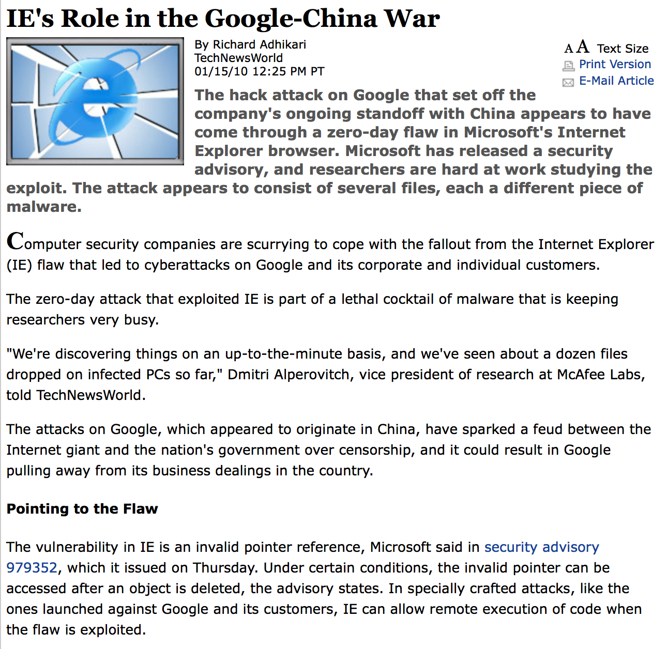
Dangling pointer dereference!

Slide 37
Format string vulnerabilities

Slide 38
Formatted I/O
Recall: C’s printf family of functions
Format specifiers, list of arguments
Specifier indicates type of argument (%s, %i, etc.)
Position in string indicates argument to print
void print_record(int age, char *name)
{
printf("Name: %s\tAge: %d\n",name,age);
}

Slide 39
What’s the difference?
void vulnerable()
{
char buf[80];
if(fgets(buf, sizeof(buf), stdin)==NULL)
return;
printf(buf);
}
Attacker controls the format string
void safe()
{
char buf[80];
if(fgets(buf, sizeof(buf), stdin)==NULL)
return;
printf("%s",buf);
}

Slide 40
printf implementation
int i = 10;
printf("%d %p\n", i, &i);
0x00000000
0xffffffff
…
%ebp
%eip
&fmt
10
&i
printf’s stack frame
caller’s stack frame
printf takes a variable number of arguments
Doesn’t know where the stack frame “ends”
Keeps reading from stack until out of format specifiers
Notes:
printf takes variable number of arguments
printf pays no mind to where the stack frame “ends”
It presumes that you called it with (at least) as many arguments as specified in the format string

Slide 41
void vulnerable()
{
char buf[80];
if(fgets(buf, sizeof(buf), stdin)==NULL)
return;
printf(buf);
}
" %d %x"
0x00000000
0xffffffff
…
%ebp
%eip
&fmt
caller’s stack frame

Slide 42
Format string vulnerabilities
printf(" 100% dinosaur ");
Prints stack entry 4 byes above saved %eip
printf(" %s ");
Prints bytes pointed to by that stack entry
printf(" %d %d %d %d ..");
Prints a series of stack entries as integers
printf(" %08x %08x %08x %08x ..");
Same, but nicely formatted hex
printf(" 100% not vulnerable! ")
WRITES the number 3 to address pointed to by stack entry
Notes:
100% dinosaur: 100 = width, %d = print an int
100% not vulnerable: count characters already printed (3)

Slide 43
Why is this a buffer overflow?
We should think of this as a buffer overflow in the sense that
The stack itself can be viewed as a kind of buffer
Size of that buffer is determined by the number and size of the arguments passed to a function
Providing a bogus format string thus induces the program to overflow that “buffer”

Slide 44
Vulnerability prevalence
100% preventable!
number of vulnerabilities that involve format string bugs
http://web.nvd.nist.gov/view/vuln/statistics
Notes:
Unlike other stuff we’re considering, format string bugs are 100% preventable (easily)

Slide 45
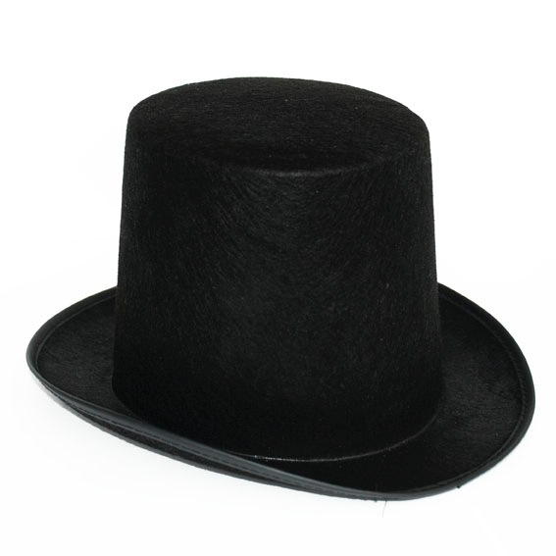
Time to switch hats
We have seen many styles of attack
How can we defend against them?

Slide 46
Defenses
Against memory and buffer attacks
http://www.full-stop.net/wp-content/uploads/2012/05/Great-wall-of-china.jpeg

Slide 47
Stepping back
What do these attacks have in common?
The attacker is able to control some data that is used by the program
The use of that data permits unintentional access to some memory area in the program
Past a buffer
To arbitrary positions on the stack / in the heap

Slide 48
Outline
Memory safety and type safety
Properties that, if satisfied, ensure an application is immune to memory attacks
Automatic defenses
Stack canaries
Address space layout randomization (ASLR)
Return-oriented programming (ROP) attack
How Control Flow Integrity (CFI) can defeat it
Secure coding

Slide 49
Memory Safety
https://diarrheapolice.files.wordpress.com/2015/08/elephant-bicycle-never-forget.png?w=590&h=334

Slide 50
What is memory safety?
A memory safe program execution:
Only creates pointers through standard means
p = malloc(…), or p = &x, or p = &buf[5], etc.
Only uses a pointer to access memory that “belongs” to that pointer
Combines two ideas:
temporal safety and spatial safety
Notes:
THINK/PAIR/SHARE: what are properties of memory safety? how would you define it? what rules are needed / what is ensured?

Slide 51
Spatial safety
View pointers as capabilities: triples (p,b,e)
p is the actual pointer (current address)
b is the base of the memory region it may access
e is the extent (bounds) of that region (count)
Access allowed iff b ≤ p ≤ (e-sizeof(typeof(p)))
Operations:
Pointer arithmetic increments p, leaves b and e alone
Using &: e determined by size of original type

Slide 52
Examples
int x; // assume sizeof(int)=4
int *y = &x; // p = &x, b = &x, e = &x+4
int *z = y+1; // p = &x+4, b = &x, e = &x+4
*y = 3; // OK: &x ≤ &x ≤ (&x+4)-4
*z = 3; // Bad: &x ≤ &x+4 ≤ (&x+4)-4
struct foo {
char buf[4];
int x;
};
struct foo f = { “cat”, 5 };
char *y = &f.buf; // p = b = &f.buf, e = &f.buf+4
y[3] = ‘s’; // OK: p = &f.buf+3 ≤ (&f.buf+4)-1
y[4] = ‘y’; // Bad: p = &f.buf+4 ≤ (&f.buf+4)-1

Slide 53
Visualized example
struct foo {
int x;
int y;
char *pc;
};
struct foo *pf = malloc(...);
pf->x = 5;
pf->y = 256;
pf->pc = "before";
pf->pc += 3;
int *px = &pf->x;
p
b
e
p
b
e
pf:
px:
p
b
e
5
256
b
e
f
o
r
e
⍉

Slide 54
No buffer overflows
A buffer overflow violates spatial safety
Overrunning bounds of source and/or destination buffers implies either src or dst is illegal
void copy(char *src, char *dst, int len)
{
int i;
for (i=0;i<len;i++) {
*dst = *src;
src++;
dst++;
}
}

Slide 55
No format string attacks
The call to printf dereferences illegal pointers
View the stack as a buffer defined by the number and types of the arguments it provides
The extra format specifiers construct pointers beyond the end of this buffer and dereference them
Essentially a kind of buffer overflow
char *buf = “%d %d %d\n”;
printf(buf);

Slide 56
Temporal safety
Violated when trying to access undefined memory
Spatial safety assures it was to a legal region
Temporal safety assures that region is still in play
Memory regions either defined or undefined
Defined means allocated (and active)
Undefined means unallocated, uninitialized, or deallocated
Pretend memory is infinitely large, no reuse

Slide 57
No dangling pointers
Accessing a freed pointer violates temporal safety
The memory dereferenced no longer belongs to p.
Accessing uninitialized pointers is similarly not OK:
int *p = malloc(sizeof(int));
*p = 5;
free(p);
printf(“%d\n”,*p); // violation
int *p;
*p = 5; // violation

Slide 58
Integer overflows?
int f() {
unsigned short x = 65535;
x++; // overflows to become 0
printf(“%d\n”,x); // memory safe
char *p = malloc(x); // size-0 buffer!
p[1] = ‘a’; // violation
}
Integer overflows are themselves allowed
But can’t become illegal pointers
Integer overflows often enable buffer overflows
For more on memory safety, see
http://www.pl-enthusiast.net/2014/07/21/memory-safety/

Slide 59
How to get memory safety?
The easiest way to avoid all of these vulnerabilities is to use a memory-safe language
Modern languages are memory safe
Java, Python, C#, Ruby
Haskell, Scala, Go, Objective Caml, Rust
In fact, these languages are type safe, which is even better (more on this shortly)

Slide 60
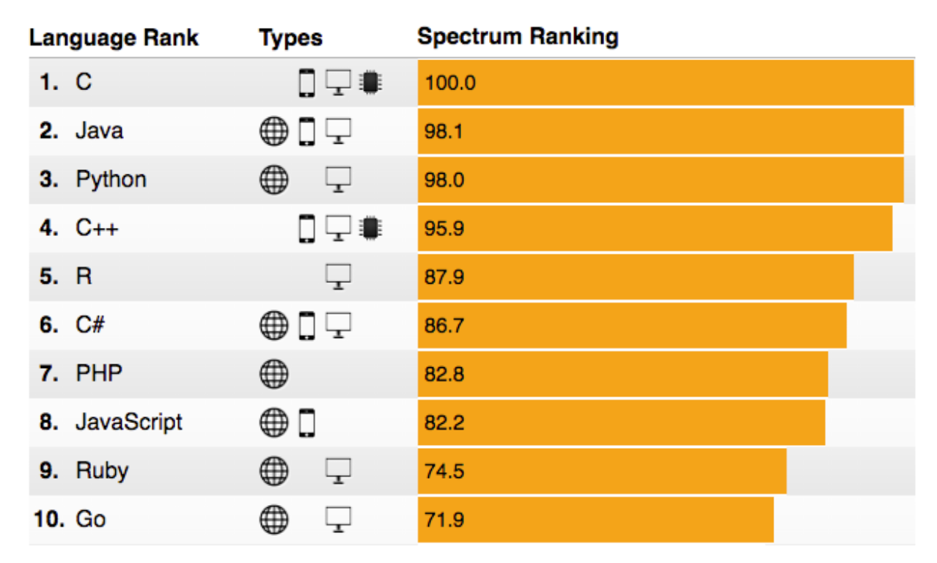
C and C++ still very popular
Recall
spectrum.ieee.org/computing/software/the-2016-top-programming-languages

Slide 61
Memory safety for C
C/C++ are here to stay.
You can write memory safe programs with them
But the language provides no guarantee
Compilers could add code to check for violations
Out-of-bounds: immediate failure (Java ArrayBoundsException)
This idea has been around for more than 20 years. Performance has been the limiting factor.
Work by Jones and Kelly in 1997 adds 12x overhead
Valgrind memcheck adds 17x overhead

Slide 62
Research progress
CCured (2004), 1.5x slowdown
But no checking in libraries
Compiler rejects many safe programs
Softbound/CETS (2010): 2.16x slowdown
Complete checking, highly flexible
Intel MPX hardware (2015 in Linux)
Hardware support to make checking faster
ccured
https://software.intel.com/en-us/blogs/2013/07/22/intel-memory-protection-extensions-intel-mpx-support-in-the-gnu-toolchain
Notes:
click on link to show MPX example!!!!

Slide 63
Type Safety
https://a.dilcdn.com/bl/wp-content/uploads/sites/8/2014/02/typewriterfont.jpg

Slide 64
Type safety
Each object is ascribed a type (int, pointer to int, pointer to function), and
Operations on the object are always compatible with the object’s type
Type safe programs do not “go wrong” at run-time
Type safety is stronger than memory safety
int (*cmp)(char*,char*);
int *p = (int*)malloc(sizeof(int));
*p = 1;
cmp = (int (*)(char*,char*))p;
cmp(“hello”,”bye”); // crash!
Memory safe,
NOT type safe

Slide 65
Aside: Dynamic Typing
Dynamically typed languages
Don’t require type declaration
e.g., Ruby and Python
Can be viewed as type safe
Each object has one type: Dynamic
Each operation on a Dynamic object is permitted, but may be unimplemented
In this case, it throws an exception
Checked at runtime not compile time!

Slide 66
Enforce invariants
Types most useful for enforcing invariants
(Examples next slide)
Enforcement of abstract types: modules with hidden representation
Allow reasoning more confidently about their isolation from the rest of the program
For more on type safety, see
http://www.pl-enthusiast.net/2014/08/05/type-safety/
Notes:
abstract types -> not instantiatable, such as java interfaces

Slide 67
Types for Security
Use types to enforce security property invariants
Invariants about data’s privacy and integrity
Enforced by the type checker
Example: Java with Information Flow (JIF)
int{Alice, Bob} x;
int{Alice, Bob, Chuck} y;
x = y; //OK: policy on x is stronger
y = x; //BAD: policy on y is weaker
Types have security labels that govern information flow
http://www.cs.cornell.edu/jif
Notes:
Only Alice and Bob can know x
Alice, Bob and Chuck can know y
x=y: Alice and Bob can find out y, that’s OK
y=x: Chuck can find out x, that’s NOT OK
(this is somewhat counter-intuitive to many people)

Slide 68
Why not type safety?
C/C++ often chosen for performance reasons
Manual memory management
Tight control over object layouts
Interaction with low-level hardware
Enforcement of type safety is typically expensive
Garbage collection avoids temporal violations
Can be as fast as malloc/free, often uses much more memory
Bounds and null-pointer checks avoid spatial violations
Hiding representation may inhibit optimization
Many C-style casts, pointer arithmetic, & operator, not allowed

Slide 69
A new hope?
Many applications do not need C/C++
Or the risks that come with it
New languages aim to provide similar features to C/C++ while remaining type safe
Google’s Go, Mozilla’s Rust, Apple’s Swift

