Slide 1
Memory Safety and Buffer Overflows
(with material from Mike Hicks, Dave Levin and Michelle Mazurek)

Slide 2
Today’s agenda
Why care about buffer overflows?
Memory layout refresher
Overflows and how they work

Slide 3
What is a buffer overflow?
A low-level bug, typically in C/C++
Significant security implications!
If accidentally triggered, causes a crash
If maliciously triggered, can be much worse
Steal private info
Corrupt important info
Run arbitrary code

Slide 4
Why study them?
Buffer overflows are still relevant today
C and C++ are still popular
Buffer overflows still occur with regularity
They have a long history
Many different approaches developed to defend against them, and bugs like them
They share common features with other bugs we will study
In how the attack works
In how to defend against it

Slide 5
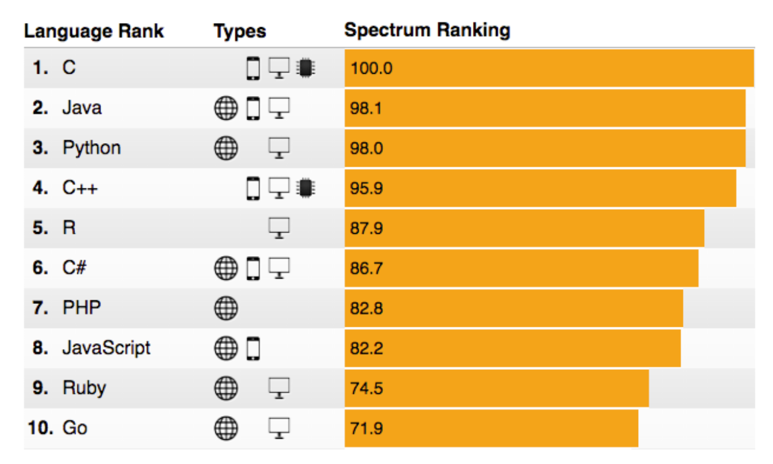
C and C++ still very popular
http://spectrum.ieee.org/computing/software/the-2016-top-programming-languages

Slide 6
Critical systems in C/C++
Most OS kernels and utilities
fingerd, X windows server, shell
Many high-performance servers
Microsoft IIS, Apache httpd, nginx
Microsoft SQL server, MySQL, redis, memcached
Many embedded systems
Mars rover, industrial control systems, automobiles, healthcare devices, IoT
A successful attack on these systems is
particularly dangerous!

Slide 7
History of buffer overflows
The harm has been substantial
1988
2001
2002
2003
Morris worm
Propagated across machines (too aggressively, thanks to a bug)
One way it propagated was a buffer overflow attack against a vulnerable version of fingerd on VAXes
Sent a special string to the finger daemon, which caused it to execute code that created a new worm copy
End result: $10-100M in damages, probation, community service
Morris now a professor at MIT

Slide 8
History of buffer overflows
The harm has been substantial
1988
2001
2003
CodeRed
Exploited an overflow in the MS-IIS server
300,000 machines infected in 14 hours

Slide 9
History of buffer overflows
The harm has been substantial
1988
2001
2003
SQL Slammer
Exploited an overflow in the MS-SQL server
75,000 machines infected in 10 minutes

Slide 10
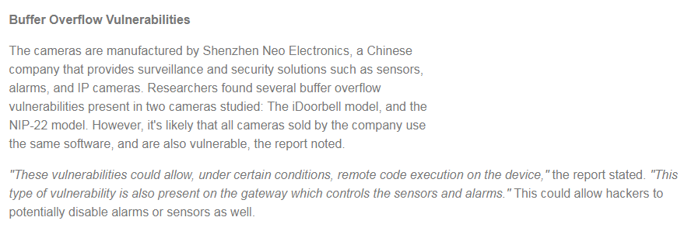
And a More Recent Example:

Slide 11
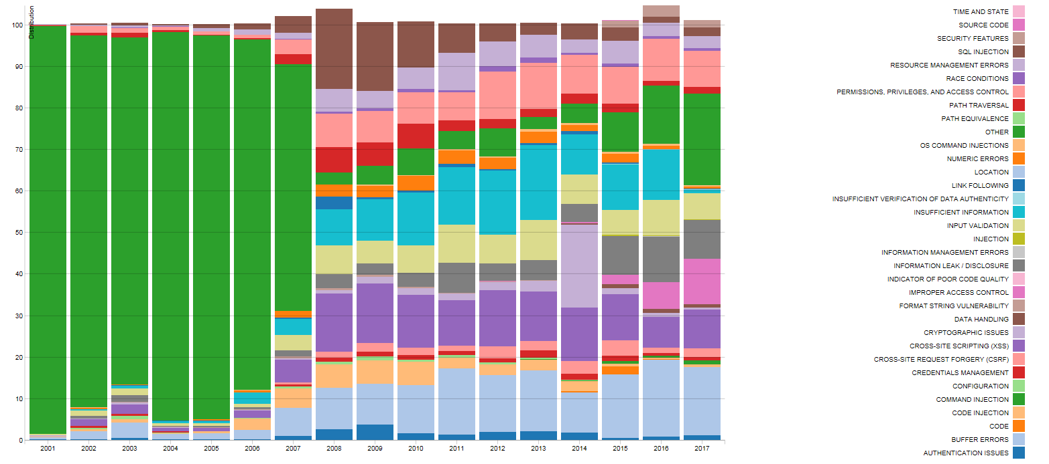
Trends
https://nvd.nist.gov/vuln/visualizations/cwe-over-time

Slide 12
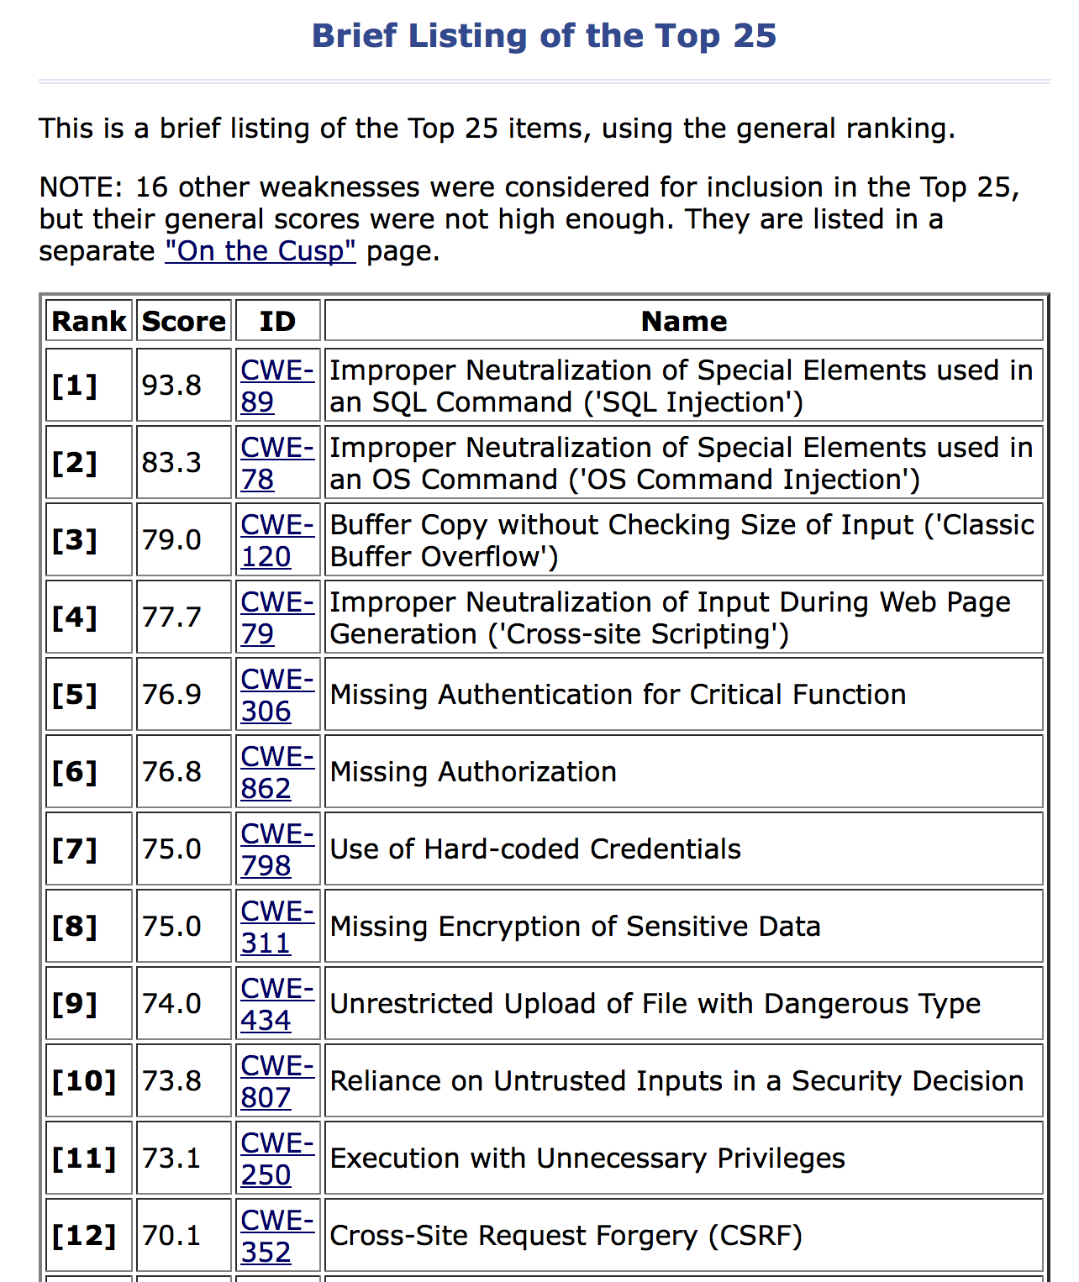
http://cwe.mitre.org/top25/

Slide 13
What we’ll do
Understand how these attacks work, and how to defend against them
These require knowledge about:
The compiler
The OS
The architecture
Analyzing security requires a whole-systems view

Slide 14
Note about terminology
We will use buffer overflow to mean any access of a buffer outside of its allotted bounds
An over-read, or an over-write
During iteration (“running off the end”) or by direct access
Could be to addresses that precede or follow the buffer
Other terms you may hear (more specific)
Underflow, over-read, out-of-bounds access, etc.
Some use buffer overflow only for writing off the end

Slide 15
Memory layout
http://www.williesimpson.com/wp-content/uploads/2011/03/memory-lane.jpg

Slide 16
Memory Layout Refresher
How is program data laid out in memory?
What does the stack look like?
What effect does calling (and returning from) a function have on memory?
We are focusing on the Linux process model
Similar to other operating systems

Slide 17
All programs stored in memory
4G
0xffffffff
The process’s view
of memory is that
it owns all of it
In reality, these are
virtual addresses;
the OS/CPU map
them to physical
addresses
0
0x00000000

Slide 18
Program instructions are in memory
4G
0xffffffff
...
0x4c2 sub $0x224,%esp
0x4c1 push %ecx
0x4bf mov %esp,%ebp
0x4be push %ebp
Text
...
0
0x00000000

Slide 19
Location of data areas
4G
0xffffffff
Set when process starts
cmdline & env
Stack
int f() { int x;
...
Runtime
Heap
malloc(sizeof(long));
Uninit’d data
static int x;
Known at
compile time
Init’d data
static const int y=10;
Text
0
0x00000000

Slide 20
Memory allocation
Stack and heap grow in opposite directions
Compiler emits instructions to
adjust the size of the stack at run-time
0x00000000
0xffffffff
{
Heap
3
2
1
Stack
apportioned by the OS;
managed in-process
by malloc
Stack
pointer
push 1 push 2 push 3
return
Focusing on the stack for now

Slide 21
Stack and function calls
What happens when we call a function?
What data needs to be stored?
Where does it go?
What happens when we return from a function?
What data needs to be restored?
Where does it come from?

Slide 22
Basic stack layout
void func(char *arg1, int arg2, int arg3)
{
char loc1[4]
int loc2;
...
}
0xffffffff
…
loc2
loc1
???
???
arg1
arg2
arg3
caller’s data
Local variables pushed in the
same order as
they appear in the code
Arguments pushed in reverse order
of code
Happens during caller
Happens during callee
The local variable allocation is ultimately up to the compiler: Variables could be allocated in any order, or not allocated at all and stored only in registers, depending on the optimization level used.

Slide 23
Accessing variables
void func(char *arg1, int arg2, int arg3)
{
...
loc2++;
...
}
Q: Where is (this) loc2?
A: -8(%ebp)
0xffffffff
…
loc2
loc1
???
???
arg1
arg2
arg3
caller’s data
Stack frame
for func
0xbffff323
%ebp
Frame pointer
Can’t know absolute address at compile time
But can know the relative address
loc2 is always 8B before ???s

Slide 24
Returning from functions
Q: How do we restore previous %ebp?
int main()
{
...
func("Hey", 10, -3);
...
}
%esp
0xffffffff
…
loc2
loc1
???
%ebp
???
arg1
arg2
arg3
caller’s data
Stack frame
for func
%ebp
previous %ebp
Push current %ebp before locals
Set %ebp to current %esp
Set %ebp to(%ebp) at return

Slide 25
Returning from functions
int main()
{
...
func("Hey", 10, -3);
...
}
Q: How do we resume here?
0xffffffff
…
loc2
loc1
%ebp
???
arg1
arg2
arg3
caller’s data
Stack frame
for func
%ebp
previous %ebp

Slide 26
Instructions in memory
4G
0xffffffff
...
0x5bf mov %esp,%ebp
need to save this address: 0x4a7
0x5be push %ebp
...
...
0x4a7 mov $0x0,%eax
0x4a2 call <func>
0x49b movl $0x804..,(%esp)
0x493 movl $0xa,0x4(%esp)
%eip
Text
...
0
0x00000000

Slide 27
Returning from functions
int main()
{
...
func("Hey", 10, -3);
...
}
Q: How do we resume here?
0xffffffff
…
loc2
loc1
%ebp
???
%eip
arg1
arg2
arg3
caller’s data
Stack frame
for func
%ebp
%ebp
Set %eip to 4(%ebp)
at return
Push next %eip before call

Slide 28
Stack and functions: Summary
Calling function:
Push arguments onto the stack (in reverse)
Push the return address, i.e., the address of the instruction you want run after control returns to you
Jump to the function’s address
Called function:
Push the old frame pointer onto the stack: %ebp
Set frame pointer to where the end of the stack is right now: %ebp = %esp
Push local variables onto the stack
Returning from function:
Reset the previous stack frame: %esp = %ebp, pop %ebp
Jump back to return address: pop %eip

Slide 29
Buffer overflows
http://rustedreality.com/stack-overflow/

Slide 30
Buffer overflows from 10,000 ft
Buffer =
Contiguous memory associated with a variable or field
Common in C
All strings are (NUL-terminated) arrays of char’s
Overflow =
Put more into the buffer than it can hold
Where does the overflowing data go?
Well, now that you are experts in memory layouts…

Slide 31
Benign outcome
void func(char *arg1)
{
char buffer[4];
strcpy(buffer, arg1);
...
}
int main()
{
char *mystr = “AuthMe!”;
func(mystr);
...
}
Upon return, sets %ebp to 0x0021654d
M
e
!
\0
00 00 00 00
%ebp
A u t h
4d 65 21 00
%eip
&arg1
buffer
SEGFAULT (0x00216551)
(during subsequent access)

Slide 32
Benign outcome
void func(char *arg1)
{
char buffer[4];
strcpy(buffer, arg1);
...
}
int main()
{
char *mystr = "AuthMe!";
func(mystr);
...
}
Upon return, sets %ebp to 0x0021654d
M
e
!
\0
00 00 00 00
%ebp
A u t h
4d 65 21 00
%eip
&arg1
buffer
SEGFAULT (0x00216551)

Slide 33
Security-relevant outcome
void func(char *arg1)
{
int authenticated = 0;
char buffer[4];
strcpy(buffer, arg1);
if(authenticated) { ...
}
int main()
{
char *mystr = "AuthMe!";
func(mystr);
...
}
Code still runs; user now ‘authenticated’
M
e
!
\0
00 00 00 00
4d 65 21 00
A u t h
00 00 00 00
%ebp
%eip
&arg1
buffer
authenticated

Slide 34
Could it be worse?
void func(char *arg1)
{
char buffer[4];
strcpy(buffer, arg1);
...
}
All ours!
00 00 00 00
%ebp
%eip
&mystr
buffer
strcpy will let you write as much as you want (til a ‘\0’)
What could you write to memory to wreak havoc?

Slide 35
Aside: User-supplied strings
These examples provide their own strings
In reality strings come from users in myriad ways
Text input, packets, environment variables, file input…
Validating assumptions about user input is critical!
We will discuss it later, and throughout the course

Slide 36
Code Injection
http://images.clipartpanda.com/injection-clipart-color-medical-injection-21941863.jpg

Slide 37
Code Injection: Main idea
void func(char *arg1)
{
char buffer[4];
sprintf(buffer, arg1);
...
}
%eip
Text
...
00 00 00 00
%ebp
%eip
&arg1
...
Haxx0r c0d3
buffer
(1) Load my own code into memory
(2) Somehow get %eip to point to it

Slide 38
This is nontrivial
Pulling off this attack requires getting a few things really right (and some things sorta right)
Think about what is tricky about the attack
The key to defending it will be to make the hard parts really hard

Slide 39
Challenge 1
Loading code into memory
It must be the machine code instructions (i.e., already compiled and ready to run)
We have to be careful in how we construct it:
It can’t contain any all-zero bytes
Otherwise, sprintf / gets / scanf / … will stop copying
How to write assembly to never contain a full zero byte?
It can’t use the loader (we’re injecting)
How to find addresses we need?

Slide 40
What code to run?
One goal: general-purpose shell
Command-line prompt that gives attacker general access to the system
The code to launch a shell is called shellcode
Other stuff you could do?

Slide 41
Shellcode
#include <stdio.h>
int main( ) {
char *name[2];
name[0] = "/bin/sh";
name[1] = NULL;
execve(name[0], name, NULL);
}
argv
envp
filename
xorl %eax, %eax
pushl %eax
pushl $0x68732f2f
pushl $0x6e69622f
movl %esp,%ebx
pushl %eax
...
"\x31\xc0"
"\x50"
"\x68" "//sh"
"\x68" "/bin"
"\x89\xe3"
"\x50"
...
(Part of)
your
input
xor to avoid zero byte
Assembly
Machine code

Slide 42
Challenge 2
Getting injected code to run
We have code somewhere in memory
We don’t know precisely where
We need to move %eip to point at it
%eip
Text
...
00 00 00 00
%ebp
%eip
&arg1
...
\x0f \x3c \x2f ...
buffer
Notes:
any ideas of how we could do that? (if you’ve seen this before don’t give it away)

Slide 43
Stack and functions: Summary
Recall
Calling function:
Push arguments onto the stack (in reverse)
Push the return address, i.e., the address of the instruction you want run after control returns to you
Jump to the function’s address
Called function:
Push the old frame pointer onto the stack: %ebp
Set frame pointer to where the end of the stack is right now: %ebp = %esp
Push local variables onto the stack
Returning from function:
Reset the previous stack frame: %esp = %ebp, pop %ebp
Jump back to return address: pop %eip

Slide 44
Hijacking the saved %eip
%eip
%ebp
Text
00 00 00 00
%ebp
%eip
...
0xbff
&arg1
..
\x0f \x3c \x2f ...
buffer
0xbff
But how do we know the address?

Slide 45
Hijacking the saved %eip
What if we are wrong?
%eip
%ebp
Text
00 00 00 00
%ebp
%eip
...
0xbff
...
0xbdf
&arg1
\x0f \x3c \x2f ...
buffer
0xbff
This is most likely data,
so the CPU will panic
(Invalid Instruction)

Slide 46
Challenge 3
Finding the return address
If we don’t have access to the code, we don’t know how far the buffer is from the saved %ebp
One approach: try a lot of different values!
Worst case scenario: it’s a 32 (or 64) bit memory space, which means 2³² (2⁶⁴) possible answers
Without address randomization (discussed later):
Stack always starts from the same fixed address
Stack will grow, but usually it doesn’t grow very deeply (unless the code is heavily recursive)

Slide 47
Improving our chances: nop sleds
nop is a single-byte no-op instruction
(just moves to the next instruction)
Jumping anywhere
here will work
%eip
%ebp
Text
00 00 00 00
%ebp
%eip
0xbff
0xbdf
&arg1
nop nop nop..
...
…
\x0f \x3c \x2f ...
buffer
0xbff
Now we improve our chances of guessing by a factor of #nops

Slide 48
Putting it all together
Fill in the space between the target buffer and the %eip to overwrite
padding
good guess
%eip
Text
00 00 00 00
%ebp
%eip
&arg1
nop nop nop..
...
0xbdf
…
\x0f \x3c \x2f ...
buffer
nop sled
malicious code

Slide 49
gdb tutorial

Slide 50
Your new best friends
Show info about the current frame (prev. frame, locals/args, %ebp/%eip)
i f
Show info about registers (%eip, %ebp, %esp, etc.)
i r
Examine <n> bytes of memory starting at address <addr>
x/<n> <addr>
b <function> s
Set a breakpoint at <function> step through execution (into calls)

