Slide 1
Welcome to ENEE244-02xx Digital Logic Design
Instructor: Dana Dachman-Soled
TA: Nathan Sesto
UTFs: Max DePalma (201,202)
Jordan Appler (203,204)

Slide 2
Administrative Stuff
How to reach me:
Email: danadach@ece.umd.edu
Office: AVW 3407
Grading:
Homework: 10%, Small quizzes: 6%,
3 midterms: 54%, Final exam: 30%.
For detailed information see syllabus. Feel free to contact me with any questions.

Slide 3
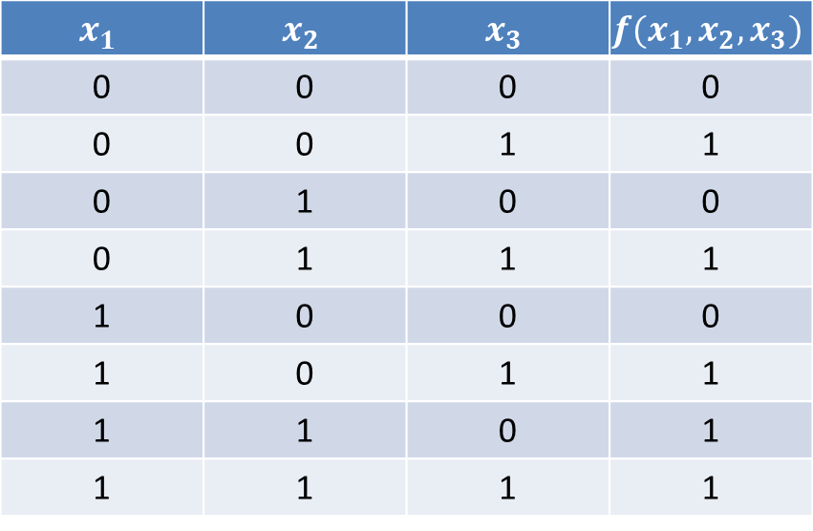

What is this course about?
Given a Boolean function $f:{\left\{0,1\right\}}^{n}→\{0,1\}$, design a circuit computing $f.$
Given only a truth table for $f$
$$x_{1}$$ | $$x_{2}$$ | $$x_{3}$$ | $$f(x_{1}, x_{2}, x_{3})$$
0 | 0 | 0 | 0
0 | 0 | 1 | 1
0 | 1 | 0 | 0
0 | 1 | 1 | 1
1 | 0 | 0 | 0
1 | 0 | 1 | 1
1 | 1 | 0 | 1
1 | 1 | 1 | 1
$$\left(x_{1} AND x_{2}\right) OR x_{3}$$
There are many ways of expressing this function.

Slide 4
What is this course about?
Given a Boolean function $f:{\left\{0,1\right\}}^{n}→\{0,1\}$, design a circuit computing $f.$
Given only a truth table for $f$
Study techniques for finding the minimal circuit computing $f$
Understand the design of basic circuit components
Adders, comparators, decoders, encoders, multiplexers

Slide 5
What is this course about?
Previous topics were all examples of combinational networks.
Output depends only on the inputs at that instant.
Sequential networks
Output depends on the state of memory
Flip-flops—basic logic element of sequential networks
Synchronous sequential networks—behavior determined by a clock signal

Slide 6
List of Topics
Number systems
Boolean algebra
Combinational networks
Design
Analysis
Synchronous sequential networks
Design
Analysis

Slide 7
Introduction

Slide 8
Digital vs. Analog
Two general ways to represent information
Digital: information is denoted by a finite sequence of digits. This form is discrete.
Analog: a continuum is used to denote the information.
Examples:
Digital vs. analog watch (range of angular displacement)

Slide 9
Digital vs. Analog
Digital | Analog
Any degree of precision is possible by using more digits. | Measure to read information, precision is the number of digits obtained. Limitation on precision.
Can copy without degradation. e.g. digital recording. | Copying causes degradation. e.g. analog tape.
Groups of numbers can be compressed by finding patterns. Easy to manipulate. | Harder to compress and manipulate.

Slide 10
Digital Computers
The electrical values (i.e. voltages) of signals in a circuit are treated as integers (0 and 1)
Alternative is analog, where electrical values are treated as real numbers.
Usually assume only use two voltages: high and low (square wave).
Signal at high voltage: “1”, “true”, “set”, “asserted”
Signal at low voltage: “0”, “false”, “unset”, “deasserted”
Assumption hides a lot of engineering.

Slide 11
Representing Data Digitally

Slide 12
Positional Number Systems
The decimal number system:
$932.86=9×{10}^{2}+3×{10}^{1}+2×{10}^{0}+8×{10}^{−1}+6×{10}^{−2}$
In general, can consider base r representation
$N=d_{n−1}d_{n−2}⋯d_{1}d_{0}.d_{−1}⋯d_{−m}$
$=d_{n−1}×r^{n−1}+d_{n−1}×r^{n−2}+⋯+d_{0}×r^{0}+d_{−1}×r^{−1}+⋯+d_{−m}×r^{−m}$
We will be mainly concerned with the binary number system.
Two digit symbols: 0,1
A digit is referred to as a bit

Slide 13
Positional Number Systems
Binary, Decimal, Hexadecimal
Hexadecimal:
Base 16 (r = 16)
Digit symbols: 0,1,2,3,4,5,6,7,8,9,A,B,C,D,E,F

Slide 14
Basic Arithmetic Operations—Examples
Addition:
101100011 + 100110010
Subtraction:
101100011 – 100110010
Multiplication:
1011 X 1001
Division:
100100/1100

Slide 15
Switching Bases

Slide 16
Algorithmic techniques
There are many ways to convert bases, e.g., can eyeball it.
Outline two algorithmic approaches to converting bases.
Can both be straightfowardly implemented on a computer.

Slide 17
Polynomial method of number conversion
Convert from base $r_{1}$ to base $r_{2}$
Express number as polynomial in base $r_{1}$
$N=d_{2}×{r_{1}^{}}^{2}+d_{1}×{r_{1}^{}}^{1}+d_{0}×{r_{1}^{}}^{0}$
Switch each digit symbol $d_{i}$ to its base $r_{2}$representation and each base symbol $r_{1}$to its base $r_{2}$ representation.
Evaluate the polynomial in base $r_{2}.$

Slide 18
Polynomial Method of Number Conversion
Example: convert from hexadecimal to decimal
Hexadecimal number: A78E
$A78E =A×{10}^{3}+7×{10}^{2}+8×{10}^{1}+E×{10}^{0}$
$A78E =\left(10\right)×{\left(16\right)}^{3}+\left(7\right)×{\left(16\right)}^{2}+\left(8\right)×{\left(16\right)}^{1}+\left(14\right)×{\left(16\right)}^{0}$
$A78E=42894$
Used when converting a number into decimal form.

Slide 19
Iterative Method of Number Conversion
Convert from base $r_{1}$to base $r_{2}$.
Perform repeated division by $r_{2}$. The remainder is the digit of the base $r_{2}$ number.
Example: Convert 50 from decimal to binary
Divide 50 by 2, get 25 remainder 0
Divide 25 by 2, get 12 remainder 1
Divide 12 by 2, get 6 remainder 0
Divide 6 by 2, get 3 remainder 0
Divide 3 by 2, get 1 remainder 1
Divide 1 by 2, get 0 remainder 1
Answer is: 110010
Can verify using the polynomial method
Used when converting from decimal to another base.

Slide 20
Iterative Method for Converting Fractions
Convert from base $r_{1}$to base $r_{2}$.
Perform repeated multiplication by $r_{2}$. The integer part is the digit of the base $r_{2}$ number.
Ex: Convert .40625 from decimal to binary
Multiply .40625 by 2, get 0 + .8125
Multiply .8125 by 2, get 1 + .625
Multiply .625 by 2, get 1 + .25
Multiply .25 by 2, get 0 + .5
Multiply .5 by 2, get 1 + 0
Answer is: .01101
Can verify using the polynomial method

Slide 21
Special Conversion Procedures
When converting between two bases in which one base is a power of the other, conversion is simplified.
Ex: Convert from 1101 0110 1111 1001 from binary to hexadecimal:
1101 = 13 = D
0110 = 6
1111 = 15 = F
1001 = 9
Answer: D6F9

